Slide 1
Ensemble Forecast Layer
Is a layer with the dimension ENSEMBLE_MEMBER
Need of a Best Practice for:
  specification of this new dimension in WMS capabilities
  use of this new dimension in WMS GetMap requests
  WMS handling for ensemble clusters
  WMS handling for derived statistical ensemble products, e.g. ensemble mean, ensemble standard deviation, etc.

Slide 2
Proposal for WMS handling of ensemble clusters and derived products
Implement a cluster algorithm or a raster aggregation function as a WPS process
Use WPS processes in the Styled Layer Descriptors
Use ENV parameter for the definition of environment variables
Snapshot from a WPS capabilities:
<wps:Process wps:processVersion="1.0.0">
<ows:Identifier>raster_aggregation</ows:Identifier>
<ows:Title>Raster Aggregation</ows:Title>
<ows:Abstract>Aggregates a set of input rasters.
An aggregation function is applied to the
values at each grid of the input rasters.
</ows:Abstract>
</wps:Process>

Slide 3
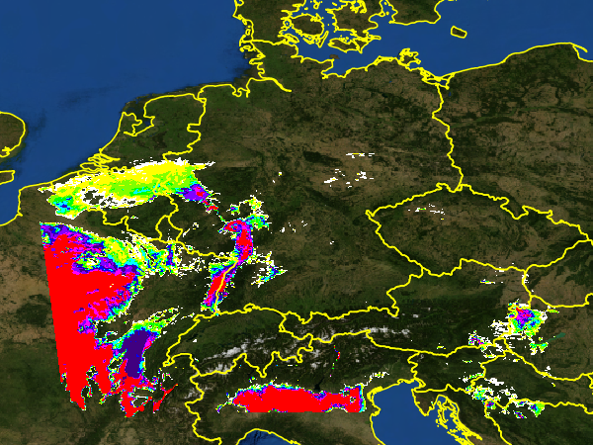
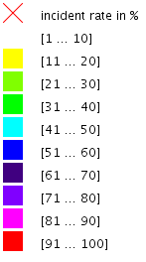
Example 1
Probability that it gets warmer than 297 K on 2015-04-15 at 14 UTC
http://server?service=WMS &version=1.3.0 &request=GetMap &layers=bluemarble, T_2M_ENSEMBLE, border &styles=,range_incident_rate, &bbox=1,44,19,56 &width=600&height=450 &crs=EPSG:4326 &format=image/png &time=2015-04-15T14:00:00Z &dim_member=1/20 &env=range:[297,1000]

Slide 4
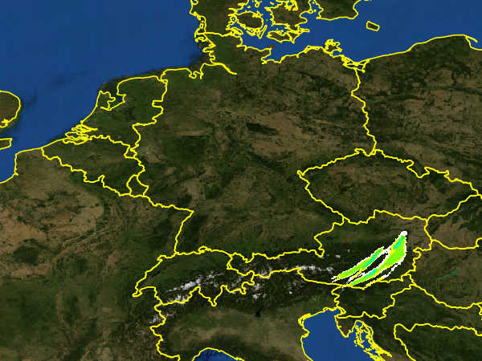
Example 2
Probability that there will be more than 10 mm precipitation over the last 4 hours on 2015-04-23 at 8 UTC
http://server?service=WMS &version=1.3.0 &request=GetMap &layers=bluemarble, TOT_PREC_ENSEMBLE, border &styles=,range_incident_rate, &bbox=1,44,19,56 &width=600&height=450 &crs=EPSG:4326 &format=image/png &time=2015-04-23T08:00:00Z &dim_member=1/20 &env=range:(10,100);steps:-4

Slide 5
range_incident_rate SLD
Name of the SLD
<StyledLayerDescriptor ogc="http://www.opengis.net/ogc">
<NamedLayer>
<Name>range_incident_rate</Name>
<UserStyle>
<Title>Range Incident Rate</Title>
<Abstract>….</Abstract>
<FeatureTypeStyle>
<Transformation>
<ogc:Function name="RangeIncidentRate">
<ogc:Function name="parameter">
<ogc:Literal>data</ogc:Literal>
</ogc:Function>
<ogc:Function name="parameter">
<ogc:Literal>cache</ogc:Literal>
<ogc:Literal>EnsembleCache</ogc:Literal>
</ogc:Function>
<ogc:Function name="parameter">
<ogc:Literal>range</ogc:Literal> <ogc:Function name="env"> <ogc:Literal>range</ogc:Literal>
</ogc:Function>
</ogc:Function>
<ogc:Function name="parameter">
<ogc:Literal>steps</ogc:Literal> <ogc:Function name="env"> <ogc:Literal>steps</ogc:Literal>
</ogc:Function>
</ogc:Function>
</ogc:Function>
</Transformation>
<Rule>
……………………………
</StyledLayerDescriptor>
WPS process with parameters „data“, „cache“, „range“ and „steps“
Input coverages
JNDI resource for caching precalculated products
Value of the environment variable ‚range‘
Value of the environment variable ‚steps‘

Slide 6
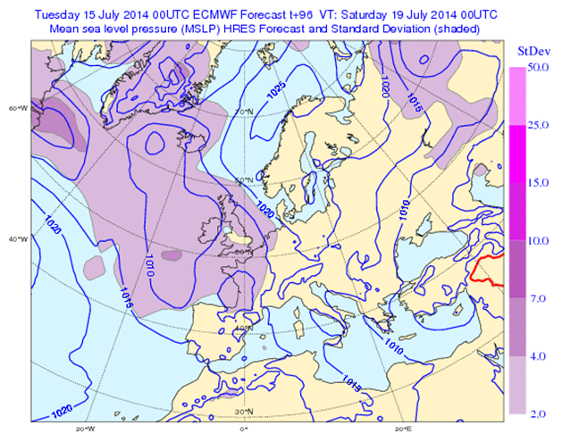
Example 3
http://...../wms?request=GetMap&
layers=background,MSLP,MSLP& time=2014-09-14T00:00:00Z& dim_reference_time=2014-09-12T00:00:00Z&
dim_ensemble=1/20&
styles=default,mslp_mean_contour,mslp_stddev& ….

Slide 7
Transformations in SLD
<StyledLayerDescriptor version="1.0.0"
xsi:schemaLocation="http://www.opengis.net/sld StyledLayerDescriptor.xsd"
xmlns="http://www.opengis.net/sld"
xmlns:ogc="http://www.opengis.net/ogc">
<NamedLayer>
<Name>mslp_StDev</Name>
<UserStyle>
<Title>Style for the ensemble standard deviation of MSLP</Title>
<Abstract>Transforms the input set of coverages (one coverage for
each ensemble member) to one coverage by calculating the
standard deviation of this set.</Abstract>
<FeatureTypeStyle>
<Transformation>
<ogc:Function name=„raster_aggregation">
<ogc:Function name="parameter">
<ogc:Literal>data</ogc:Literal>
</ogc:Function>
<ogc:Function name="parameter">
<ogc:Literal>aggregation</ogc:Literal>
<ogc:Literal>stddev</ogc:Literal>
</ogc:Function>
</ogc:Function>
</Transformation>
<Rule>
……………………………
</StyledLayerDescriptor>
Name of the SLD
Variable name of the input coverages
WPS process
Aggregation function

Slide 8

GetCapabilities Example
Layer represents an ensemble forecast for temperature
The default style to visualize a map of the ensemble forecast
Style to visualize the mean
Style to visualize the standard deviation

Slide 9
Pros and Cons
Pros
  User-defined selection of input members for ensemble product generation with DIM_ENSEMBLE_MEMBER parameter in GetMap request
  No extra layers needed for ensemble products
  No WMS extensions needed; fully compliant with WMS 1.3.0
  Ensemble clusters can be handled accordingly
Cons
  On-the-fly computation of ensemble products may cause performance issues
  WPS access is needed and WPS must provide methods for raster aggregation
  Overloading of “style” between visualization approach and data content/meaning
  Little use of abstracts, keywords, or dimensions to allow for better search and discovery in capabilities document

