Slide 1
Environmental Observation Systems
Soil and Landscapes Perspective
Alistair Ritchie, Informatics Team
Lincoln, New Zealand

Slide 2



Environmental Observation Systems
National EnvironmentPerspective
Alistair Ritchie, Brent Watson, Sean Hodges, Adrienne Bonnington, Jochen Schmidt, David Medyckyj-Scott , Alex Kmoch, Byron Cochrane

Slide 3
Overview
New Zealand Crown Research Institutes
  Landcare Research as an example
Research Motivation
Open(-ish) data services and standards
  Profiles of O&M
  Interoperability Experiments

Slide 4
Crown Research Institutes
Corporate Crown (government) entities charged with conducting scientific research for the public good
  Landcare Research NZ Ltd
  National Institute of Water and Atmospheric Research (NIWA)
  Institute of Geological and Nuclear Sciences (GNS Science)
  New Zealand Pastoral Agriculture Research Institute (AgResearch)
  New Zealand Institute for Plant and Food Research
  Institute of Environmental Science and Research
  New Zealand Forest Research Institute Limited (Scion)

Slide 5
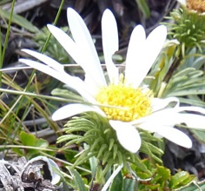
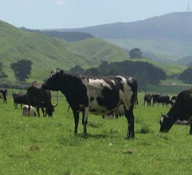
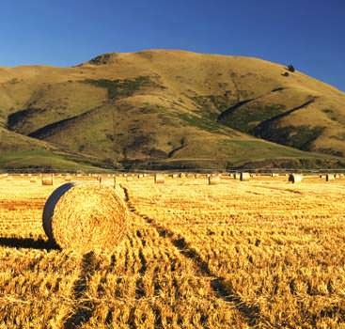
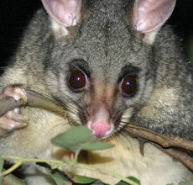
Landcare Research
Drive innovation in the management of terrestrial biodiversity and land resources
Protect and enhance the land environment and grow the country’s prosperity
Informatics team of 40
  Research and operations
  Technical support for a set of Nationally Significant Collections and Databases

Slide 6
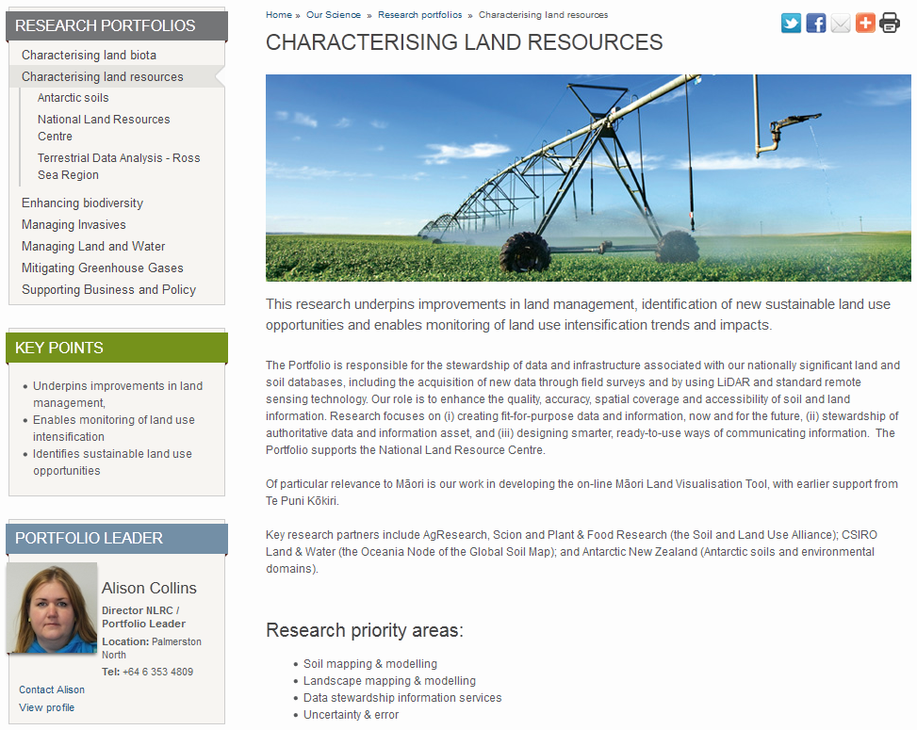
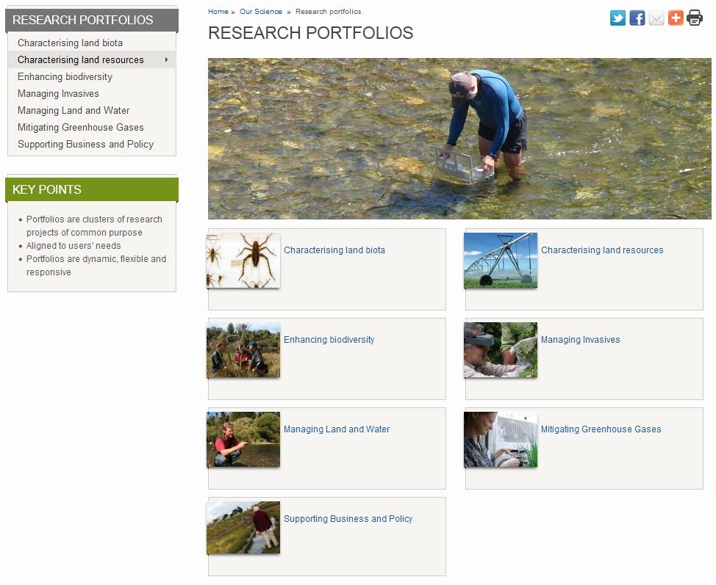
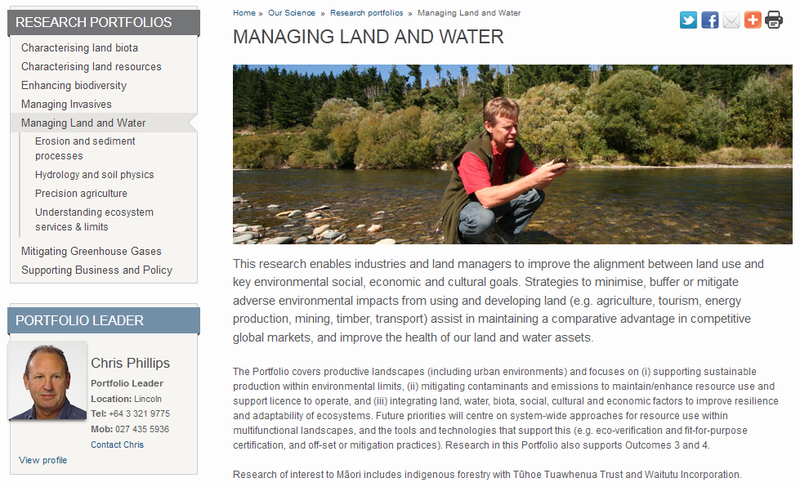

Slide 7
Open(-ish) Data
(Why open-ish? The CRIs commercial imperative.
  A whole ‘nother story …)
Our science sits at the intersection of the earth and life sciences
Not only need to publish data
Need to integrate data across domains
Need as much interoperable common ground as possible

Slide 8
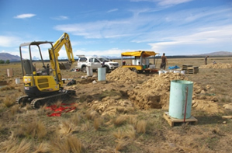
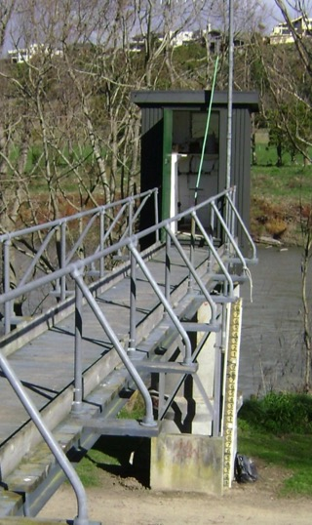
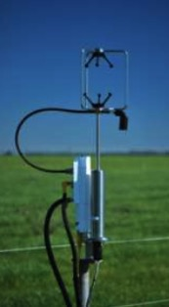
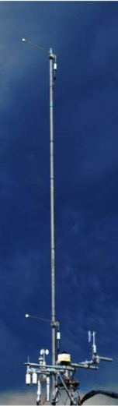
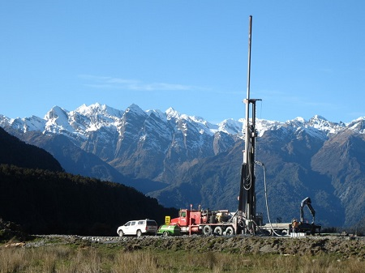
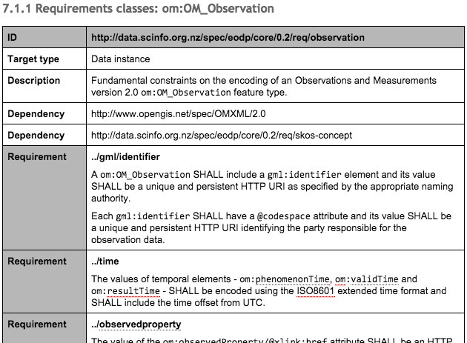
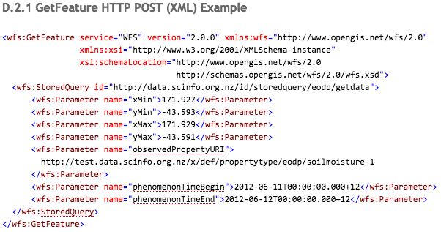
Environmental Observation Data Profile

Slide 9
Environmental Observation Data Profile
AKA EODP
Lock down app schema
  O&M
  WaterML 2.0
Defined content
  Vocabularies
Support discovery
  GetDataAvaliability for WFS

Slide 10
Environmental Observation Data Profile
Modular specification for O&M based services
First modules:
  Core – O&M ‘register’
  Hydrology - WaterML 2.0 SOS
Future modules
  Soil (TimeseriesML, ‘SoilML’)
  Water Quality
  Biodiversity data integration …
eodp-core
eodp-hydro
eodp-water-quality
eodp-bio
eodp-soil

Slide 11
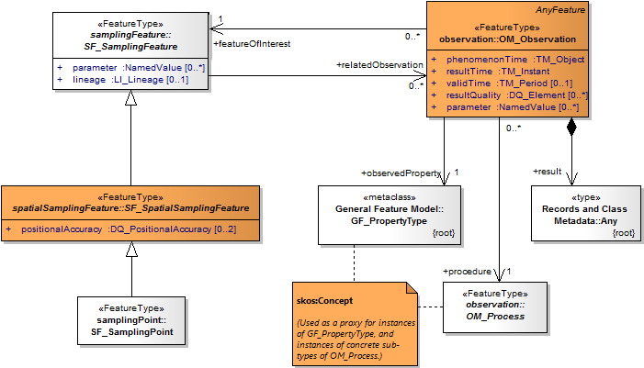
Observations and Measurements
Core information model for all monitoring data

Slide 12
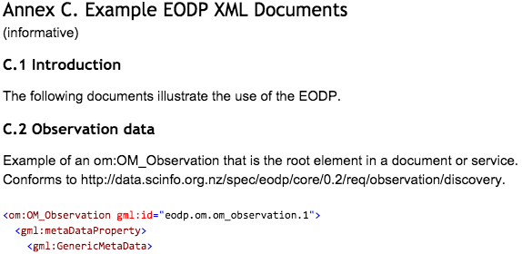
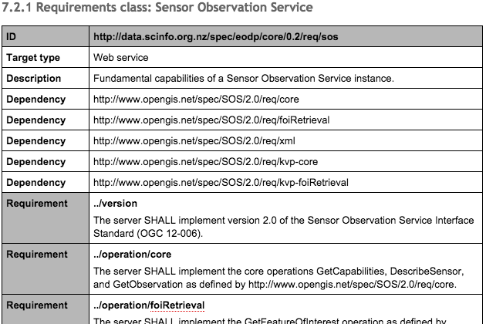
Environmental Observation Data Profile
Formal definition of requirements
  Documented according to the OGC modular spec.

Slide 13
Soil Data Interoperability Experiment
Initiated by the International Union of Soil Sciences Working Group on Soil Information Standards
Agriculture Domain Working Group
Participants:
  IE Initiators: CSIRO, Landcare Research, IRSIC
  USDA, USGS, Federation Uni (Aus), CRA-ABP (Italy), Horizons
6 months to implement; 6 months to write up
Deploy a set of demonstrators; engineering report

Slide 14
Soil IE Use Cases
Use Case 1: soil data integration & publication
  Publication of heterogeneous soil data from different data stores
Use Case 2: soil sensor data
  Publication of data from sensors monitoring dynamic soil properties
Use Case 3: soil property modelling and predictions
  Provision of high resolution estimates of functional soil properties
Use Case 4: pedo-transfer functions
  Process observed and interpreted soil properties using of pedo-transfer functions - algorithms that calculate additional interpreted soil properties

Slide 15
Soil IE Exchange Standard
Reviewed five existing standards
  Australia and New Zealand Soil Mark-up Language
  e-SOTER Soil and Terrain Mark-up Language
  INSPIRE D2.8.III.3 Data Specification on Soil
  ISO 28258:2013 Soil quality – Digital exchange of soil-related data
  IUSS/ISO ‘Wageningen Proposal’ (effort to reconcile 1. and 4.)
No clear candidate from this work

Slide 16
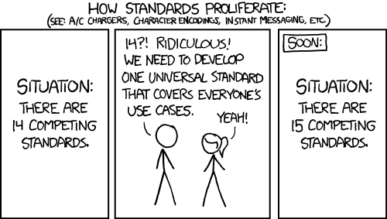
UH OH
Not quite … point to prove … can use existing standards
  Back to basics using as much existing work as possible

Slide 17
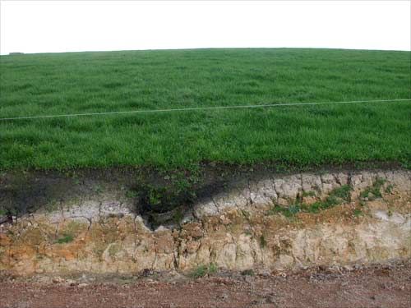
Soil IE Candidate Standard

Slide 18
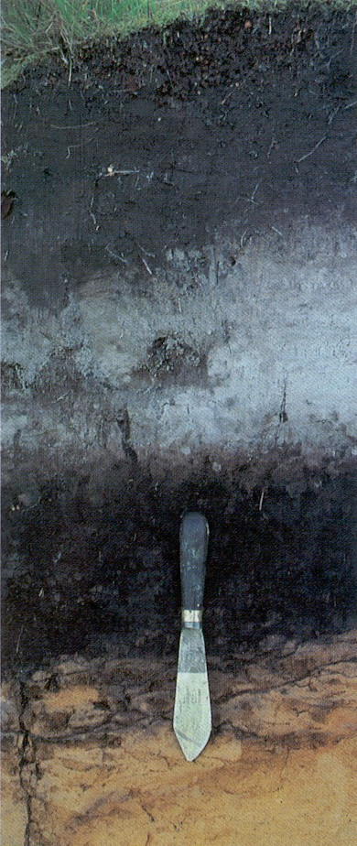
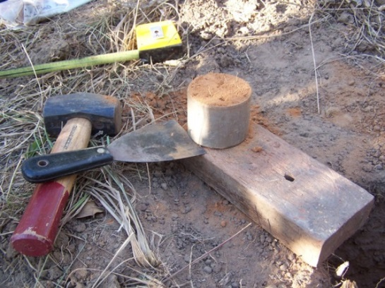
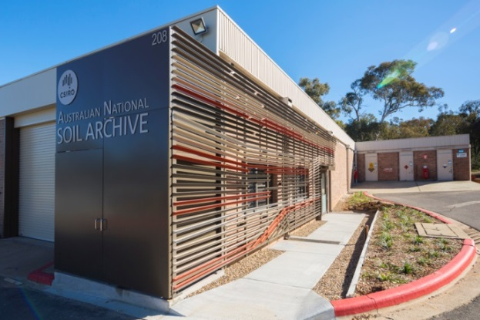
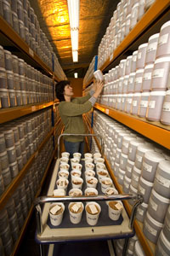
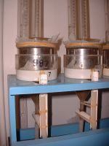
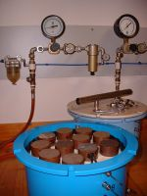
Soil Observations
ISO19156/OGC10-004r3 - Observations and Measurements

Slide 19
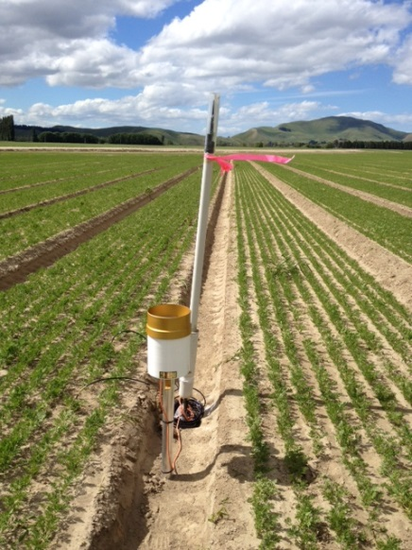
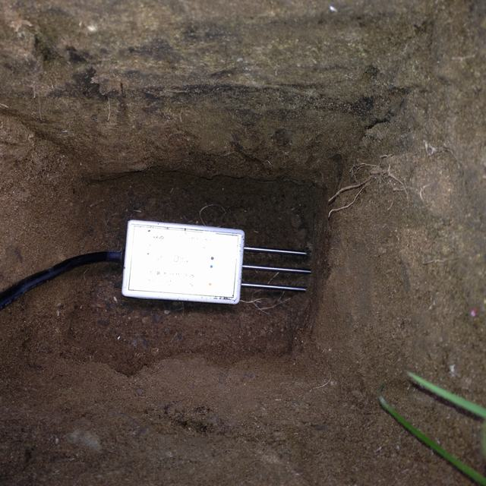
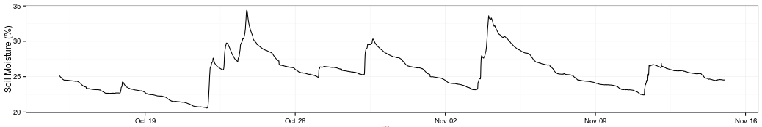
Soil Sensors
OGC15-043r3 – Timeseries Profile of Observations and Measurements

Slide 20
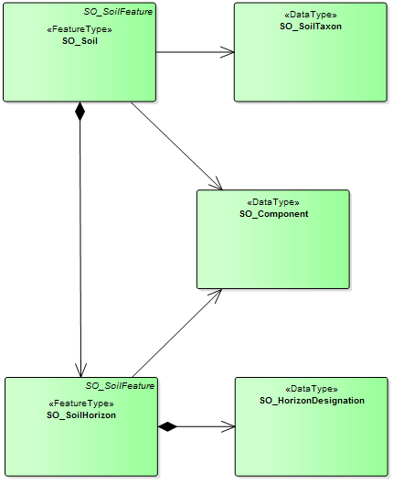
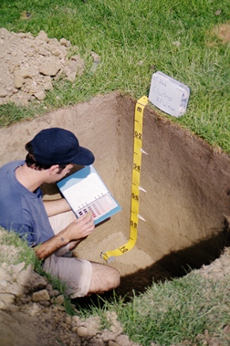
Soil Descriptions
OGC16-088r3 - OGC Soil Data Interoperability Experiment
Podzol Soil (Z)
[NZSC]
Ah
E
texture
bulk density
organic carbon
particle size distribution
…
Bh
C

Slide 21
Soil IE Implementation
Soil Data
WFS
WPS
Execute PTFs
SOS
Vocabularies
Soil Taxonomies
Observable Properties
Sensor
Data
Registry
PID Service
Client
HTTP URIs
(conneg)
Gridded Data
WCS
WMS
Maps

Slide 22
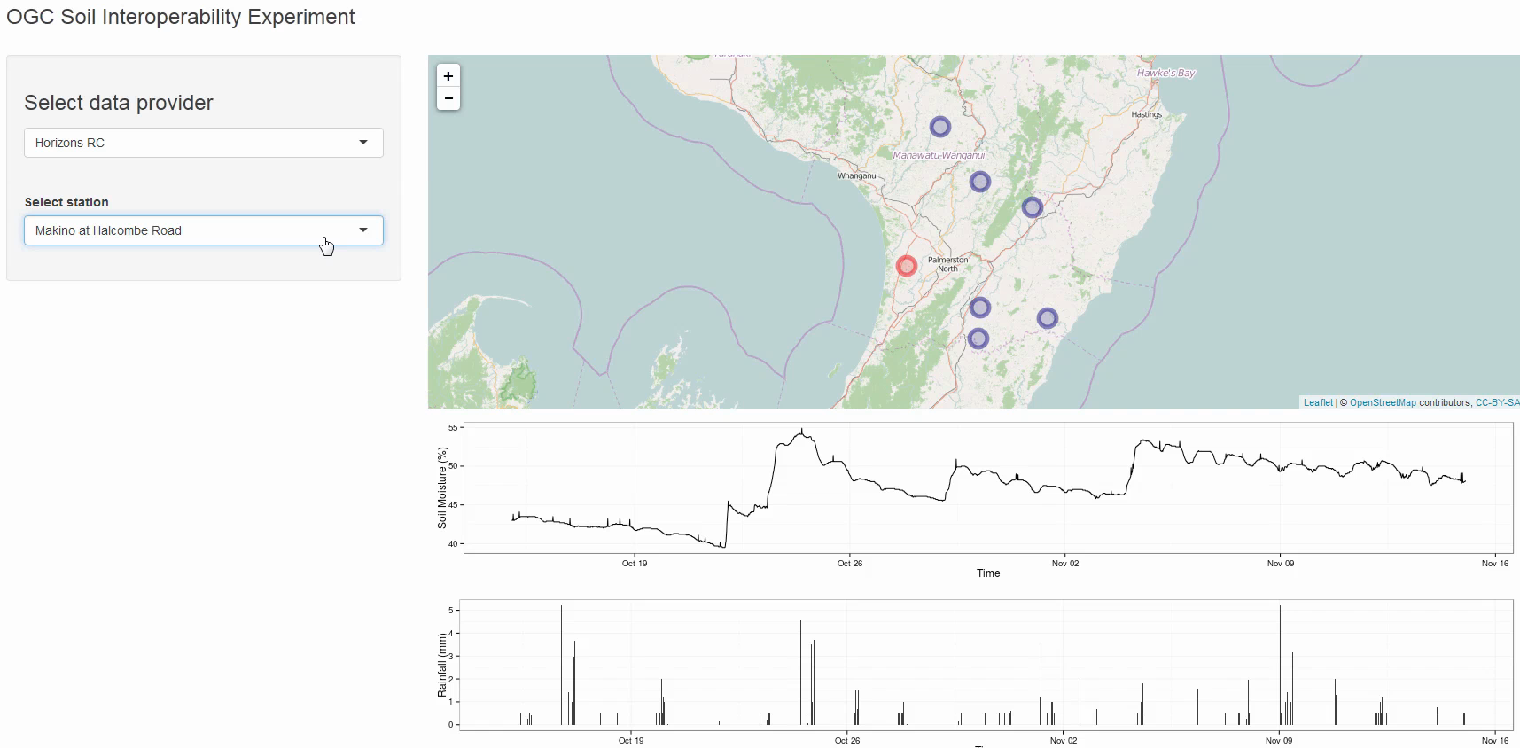
Demonstration: Soil Sensors
  Use Case Two
  Provision of soil moisture
  and rainfall data
  Contributors
  Landcare Research;
  Horizons RC; USGS

Slide 23
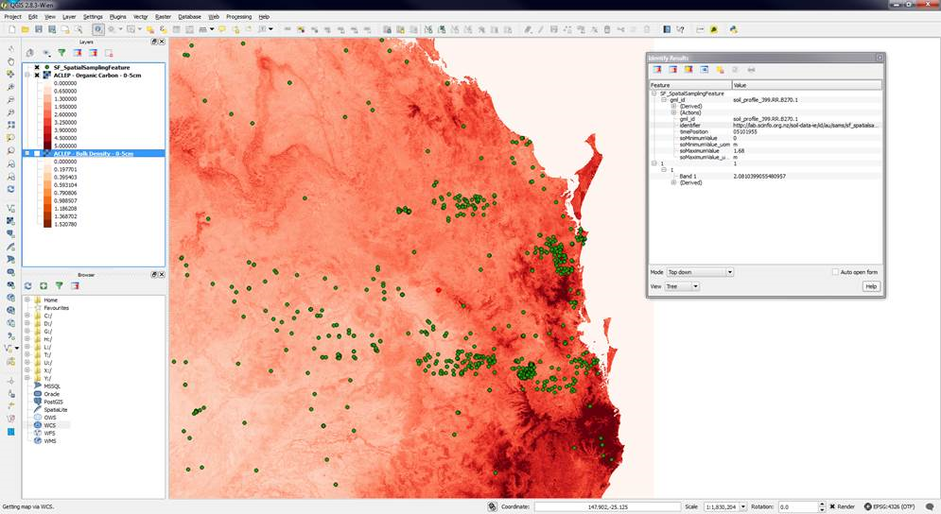
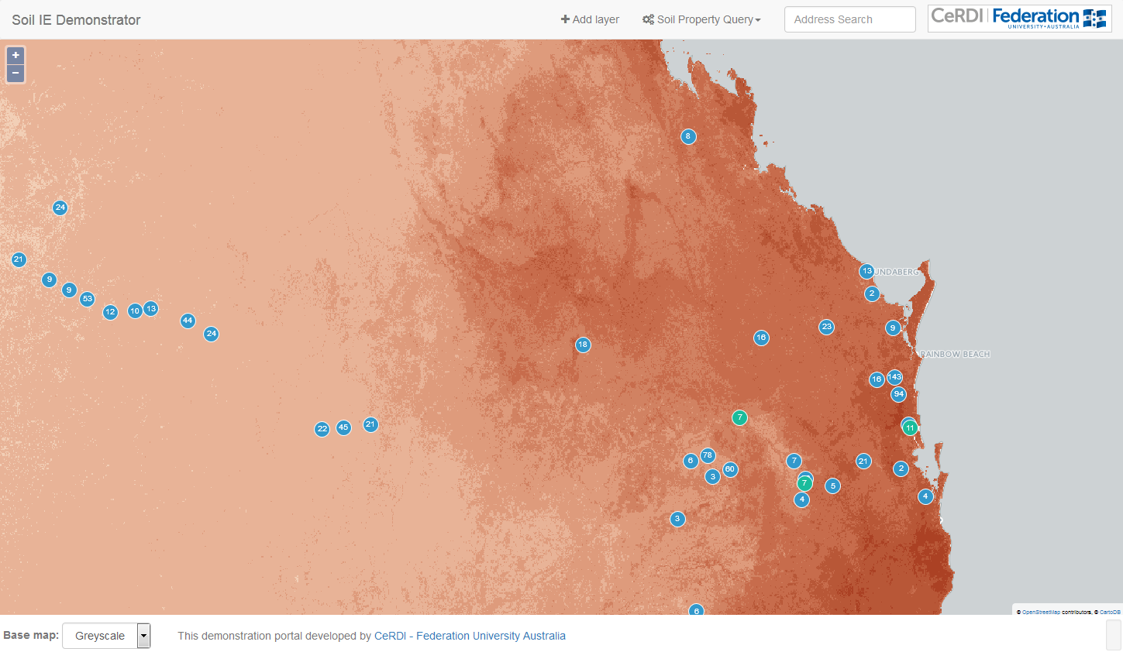
Demonstration: Soil Properties
Use Case Three
Provision of soil property
models and predictions
Contributors
CSIRO Land and Water (AU); Federation University of Australia (AU)

Slide 24
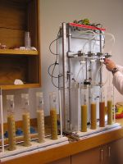
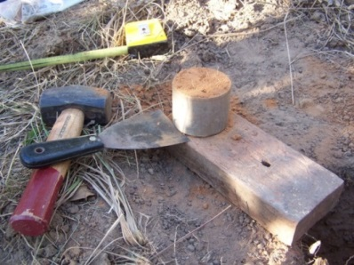
Demonstration: Soil Descriptions
Use Cases One and Four
  Field observations, sampling, and laboratory analyses
  Pedo-transfer functions
Contributors
  Landcare Research (NZ)
  CSIRO Land and Water (AU)
  Federation University of Australia (AU)
  ISRIC World Soil Information (NL)

Slide 25
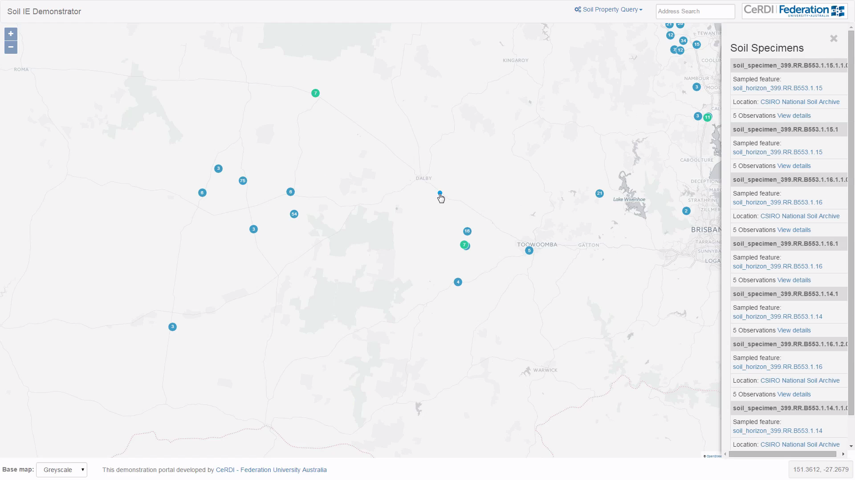
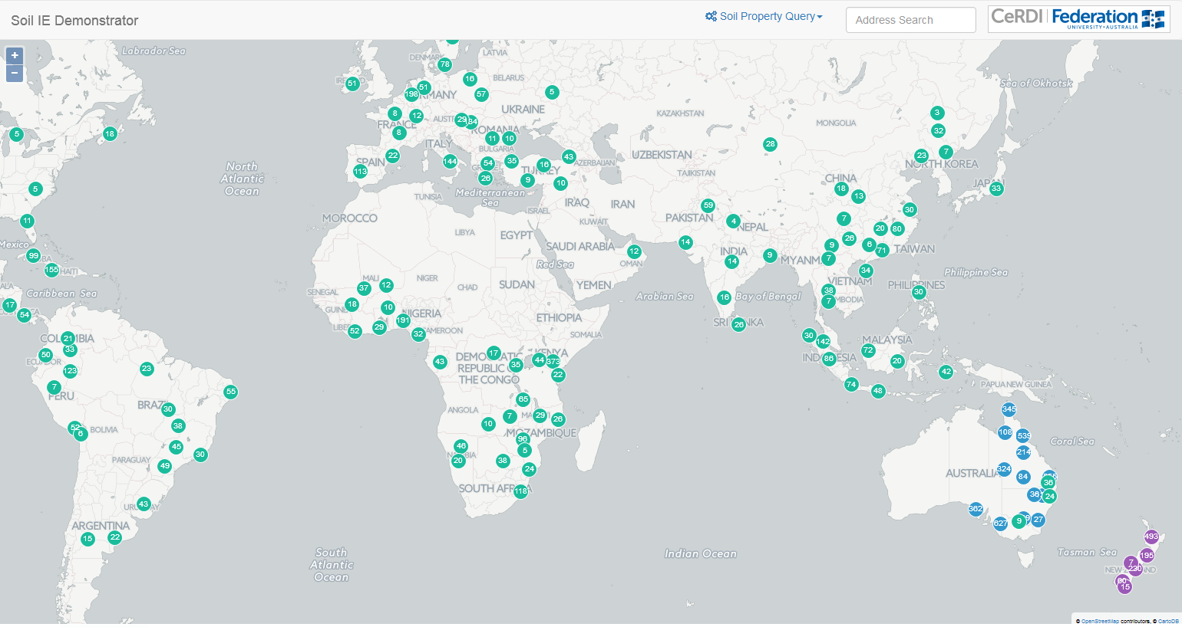
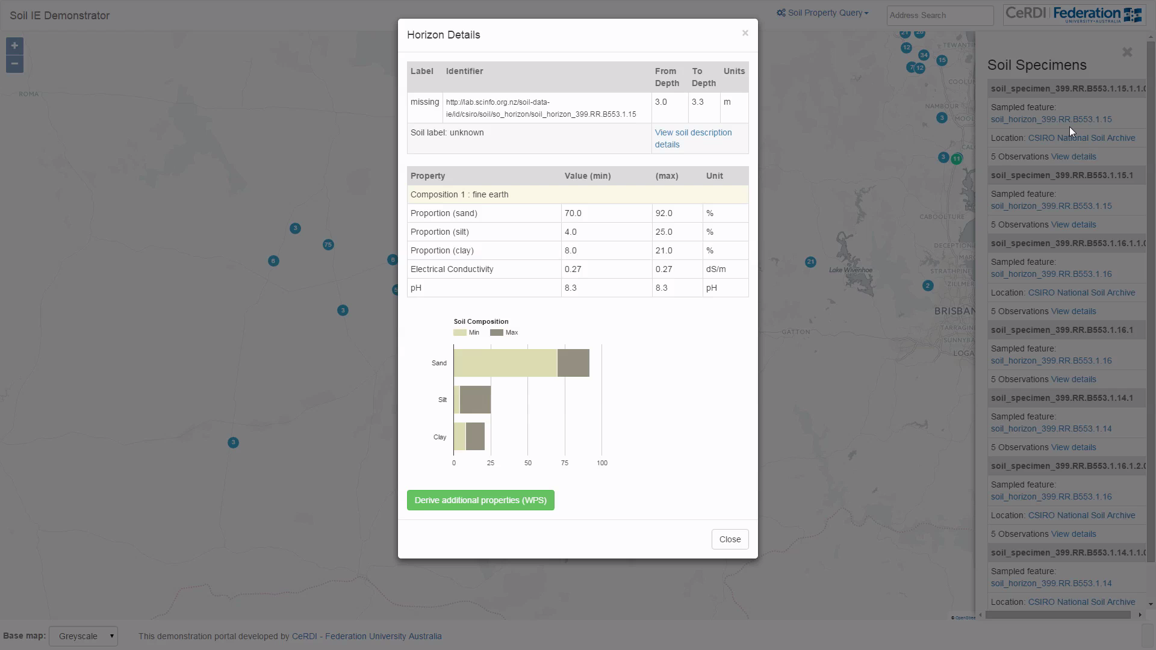
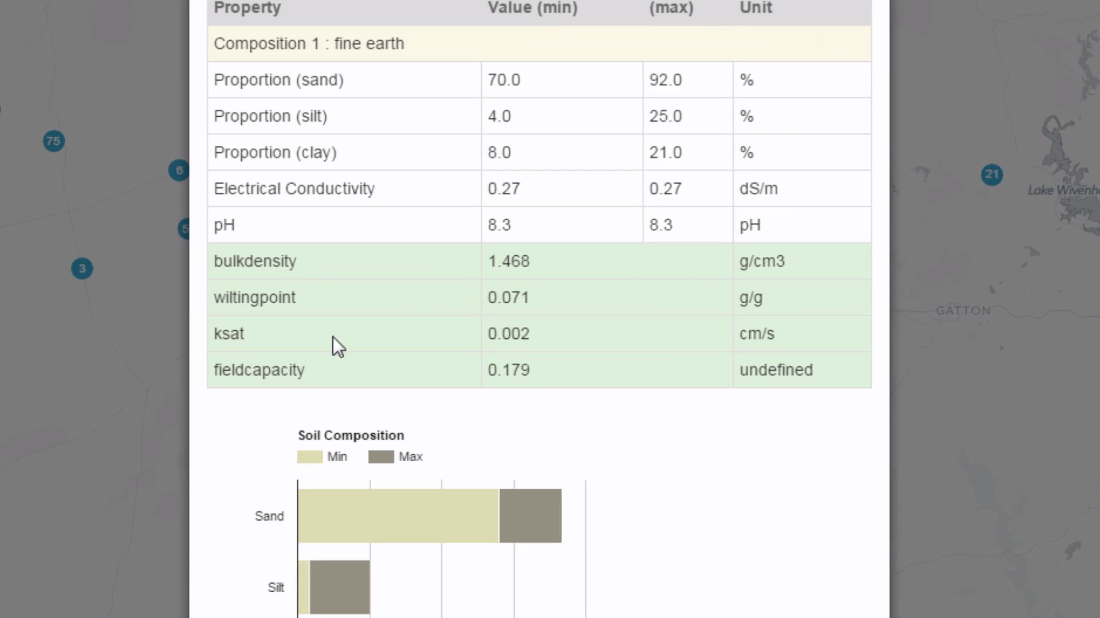
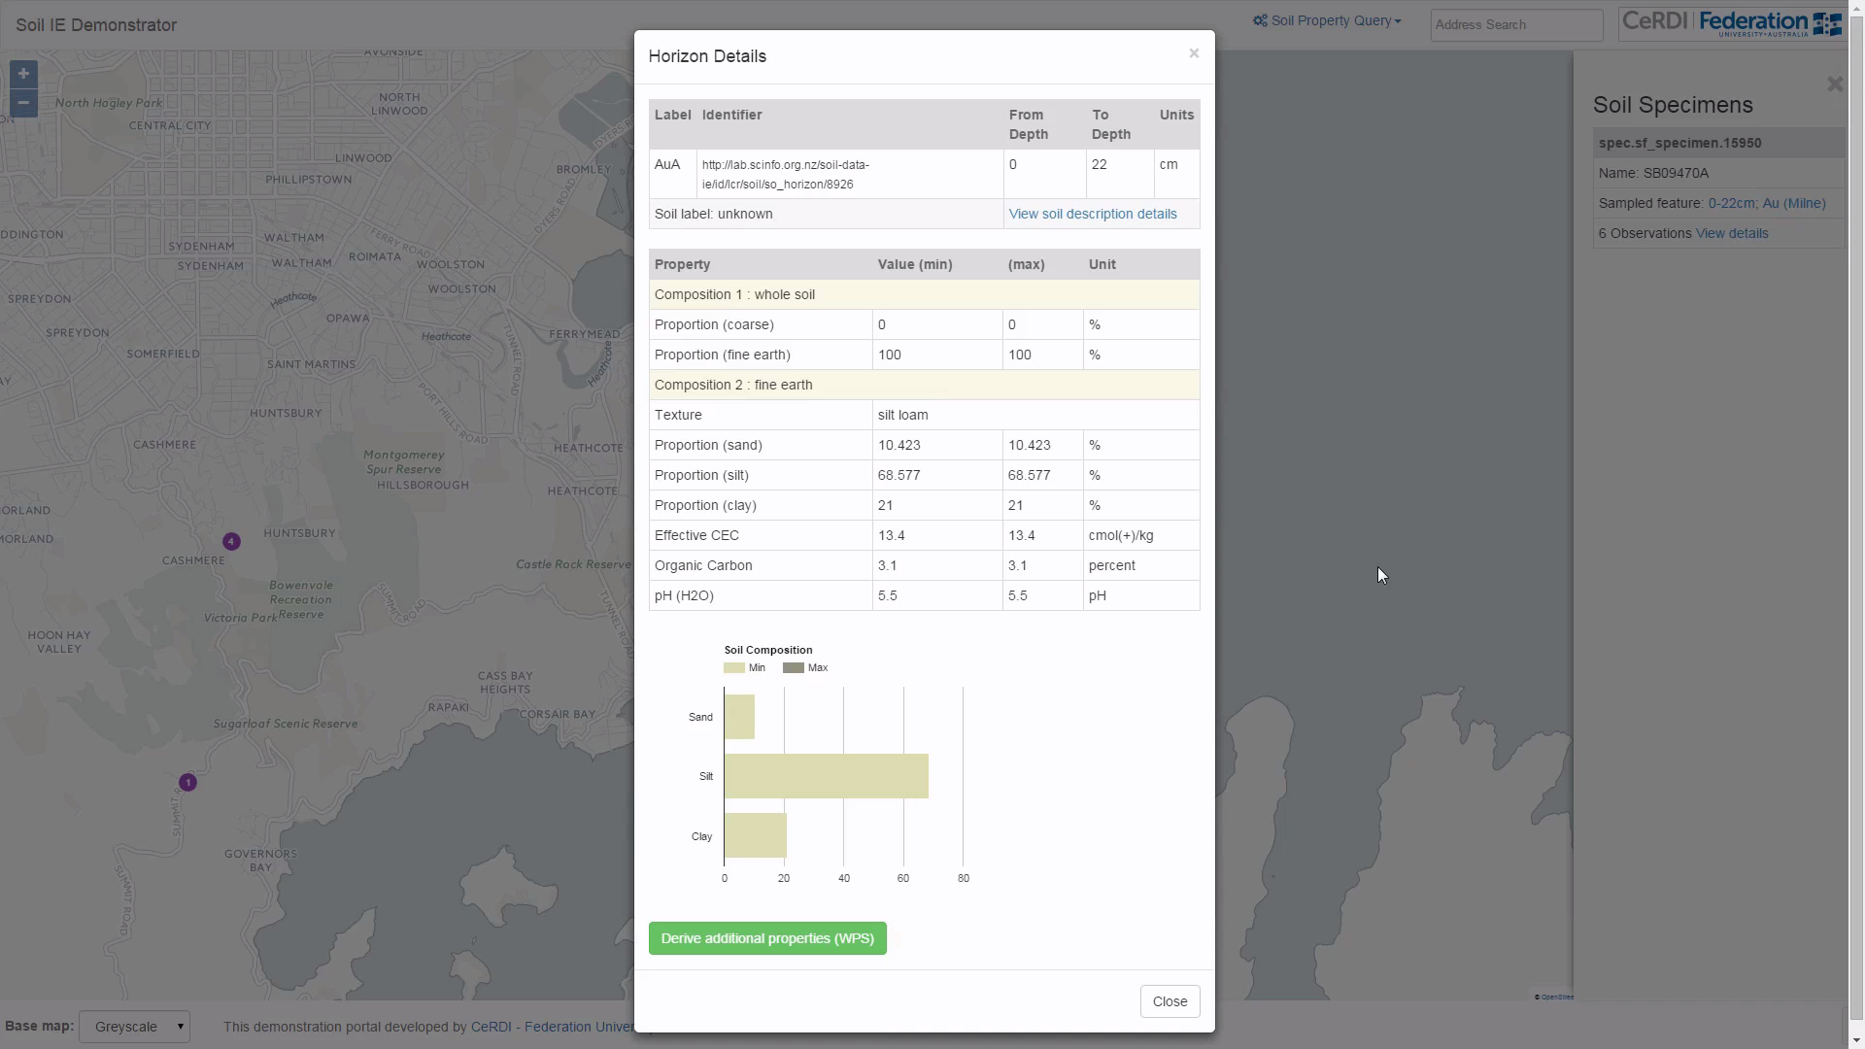
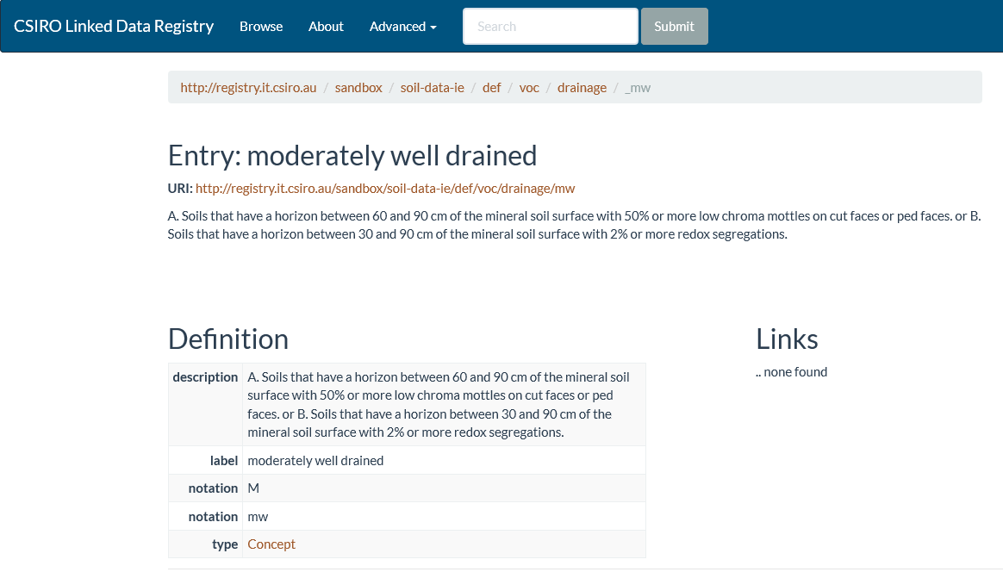

Slide 26
Soil IE and ELFIE
WFS
WPS
SOS
Registry
PID Service
Client
WCS
WMS

Slide 27
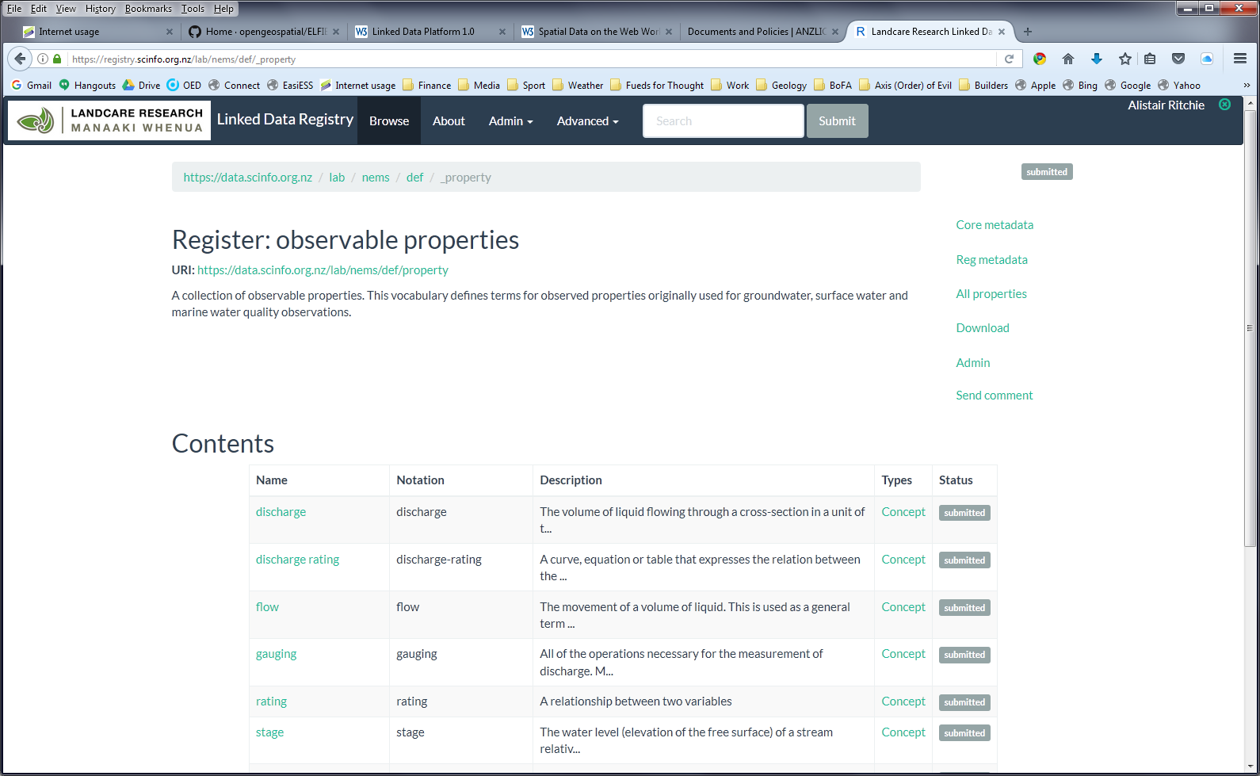
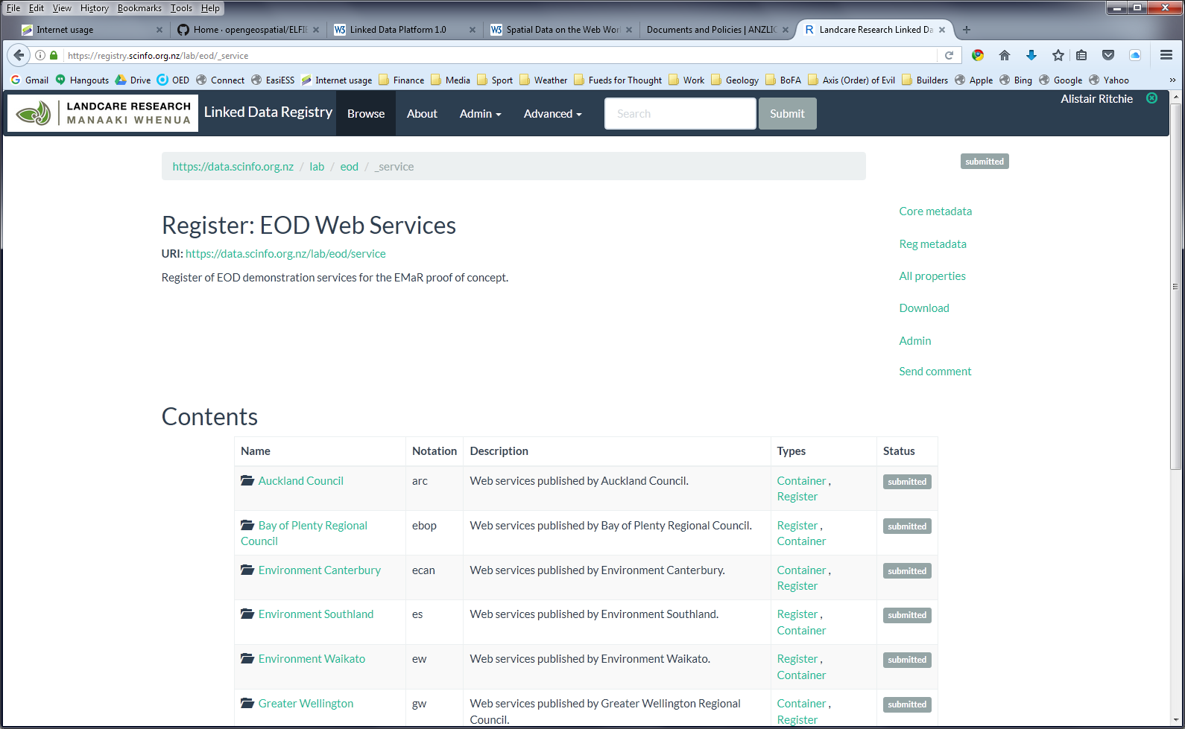
EODP and ELFIE

Slide 28
Application in New Zealand
Over to Brent …

