Slide 1
OGC Geotech Interoperability Experiment progress
OGC TC June 2022
GeoScienceDWG Session
Mickaël Beaufils (BRGM)
14 June 2022

Slide 2
Geotech IE Timeline
2023
#1: Common conceptual model
#2: Extension of OGC Geoscience standards
#3: Technical documentation on the use of OGC APIs
#4: Technical paper
#5: Implementation Guide for Software Vendors
v1
March - June
…
May - October
…
June - December
April - December
June - December

Slide 3
Geotech IE objectives and Work Packages (reminder)
Community oriented goals
Contribute to federate the geotechnical community around a common position / proposal for geotechnical data,
Scientific – IT connection
BIM – GIS and more connection
Users – Solution providers connection
Work packages:
#1: Common conceptual model
#4: Technical paper
#5: Implementation Guide for Software Vendors
Technical oriented goals
Propose effective solutions to enable digital continuity between GIS and BIM
Work packages:
#2: Extension of OGC Geoscience standards,
#3: Technical documentation on the use of OGC APIs
#3bis: Implementation forum
Image courtesy © ESRI

Slide 4
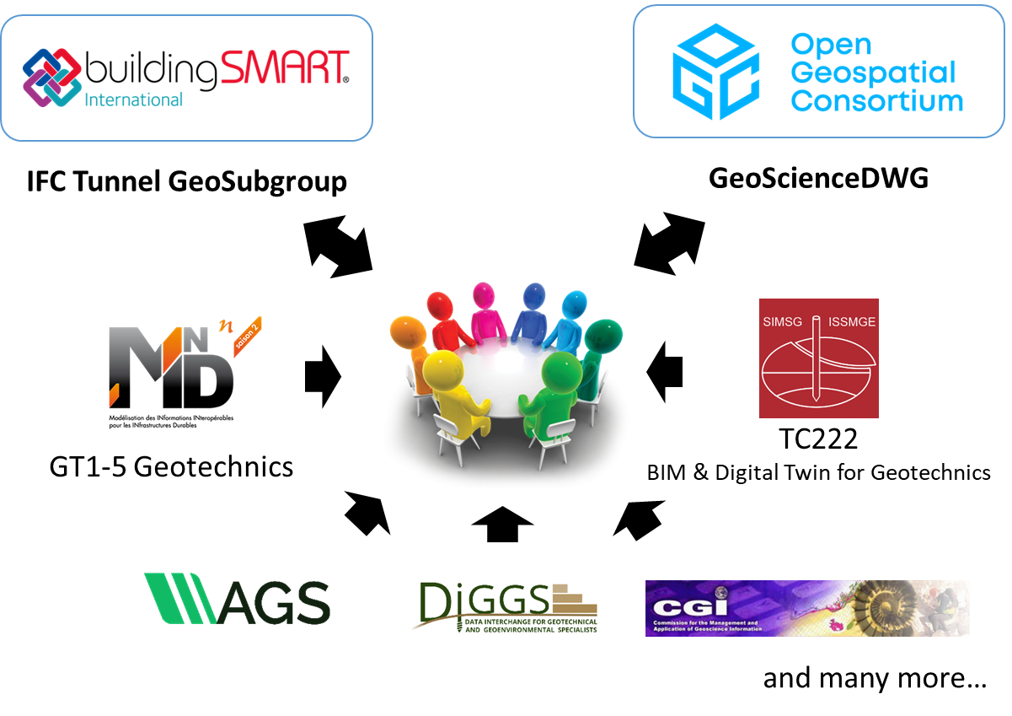
#1: Common conceptual model
Conceptual model:
Technology agnostic
Base for all implementations
Conceptual model

Slide 5
Geotechnics is « simple » as A, B, C
Following the terminology from AFTES GT32 (also used in bSI IFC Tunnel WG)
AFTES = French Association of Tunnel and Underground Space
Book C depends on Book B which depends on Book A
Book C: Design report: « Projection »
Book B: Models and interpretations
Book A: Observations and measurements

Slide 6
Contents of each book (based on current discussion)
 | Objects | Associated properties
Book A | Observation Supports or Sampling Features Borehole, Material Sample, Trial Pit, Observed Zone | Observations and measurements In-situ tests Laboratory tests Monitoring
Book B | Models and their (possible) components GeologicUnit, Fault, Contact, Fold HydrogeologicUnit, FluidBody, FluidBodySurface, WaterBody GeotechnicalUnit, Discontinuity, Void HazardArea GeophysicalUnit? | Interpretations
Book C | GeotechSynthesis Model Alignment, TypicalDesignArea, GeotechnicalZoneOfInfluence | Interpretations / Projections

Slide 7
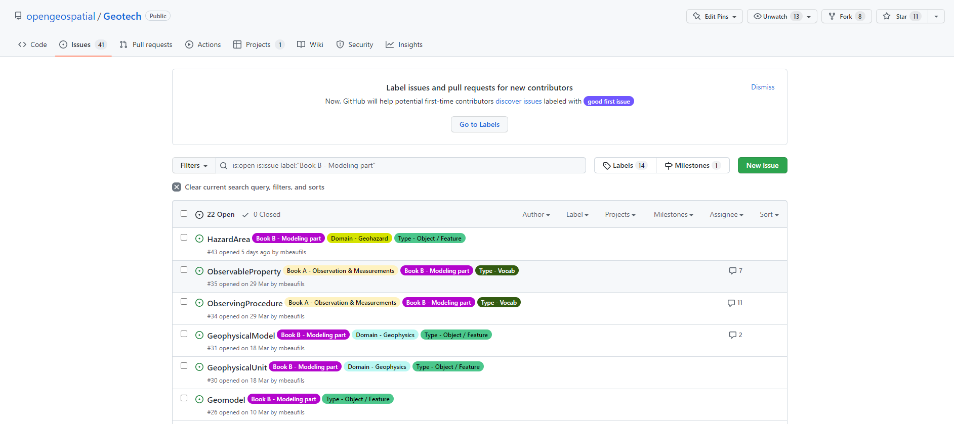
Objects definition

Slide 8
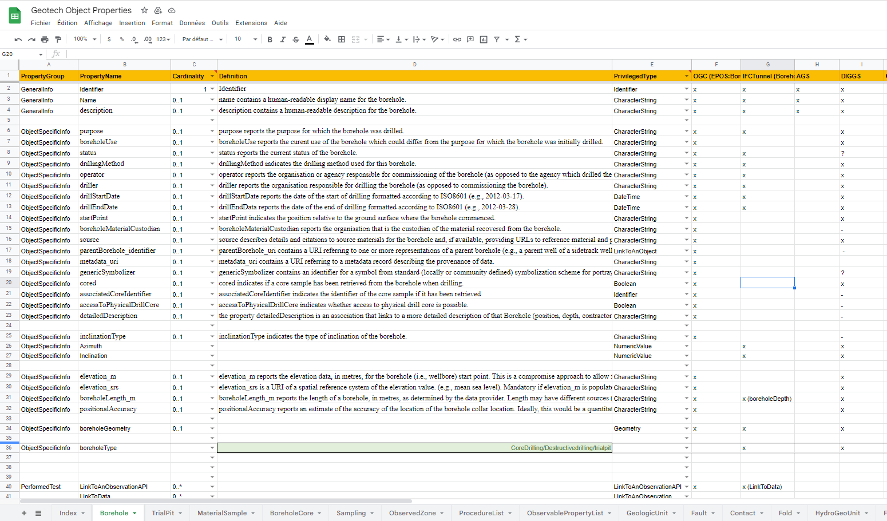
Objects attributes (and alignment)

Slide 9
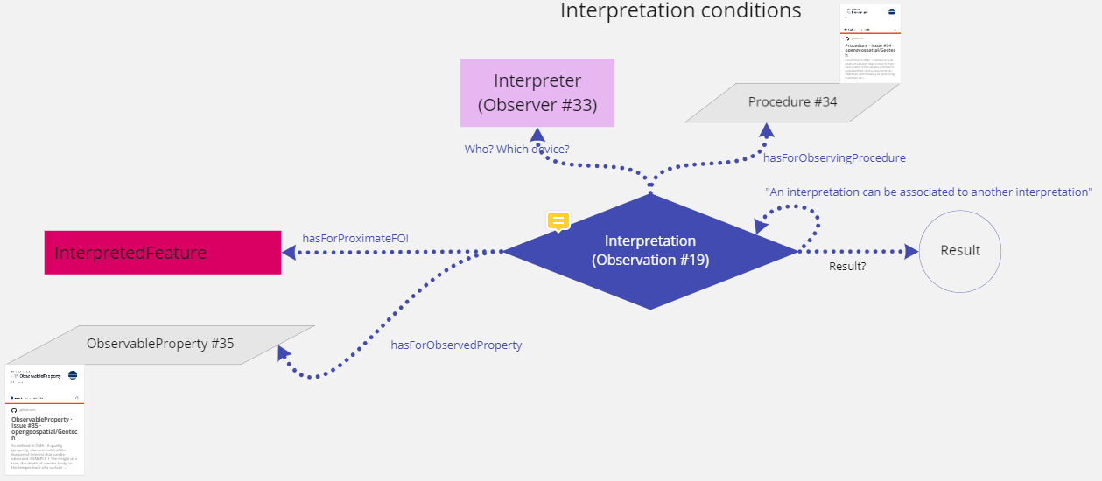
Observations, measurements and interpretations
Proposal based on the Observation Measurements and Samples « pattern » (ISO19156 v2 proposal)
Application for observations, measurements AND interpretation

Slide 10
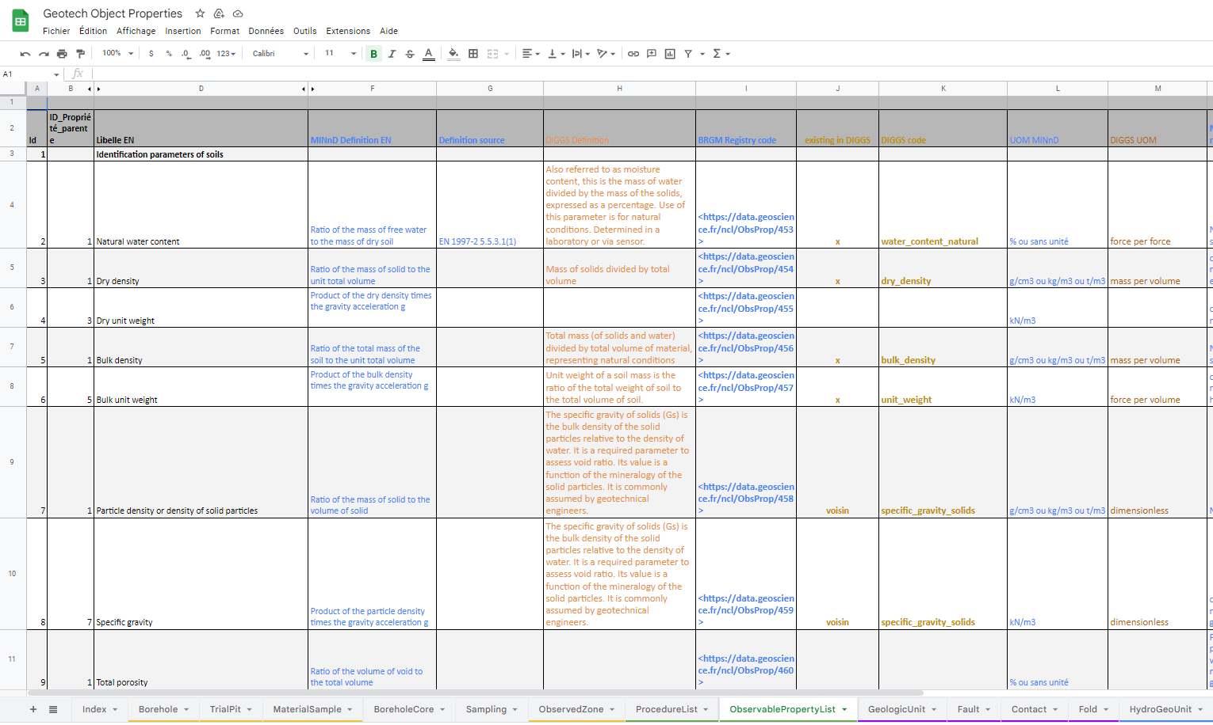
Semantics alignment
Topics:
ObservableProperties
InterpretedProperties
Procedure
Sources:
DIGGS
AGS
MINnD

Slide 11
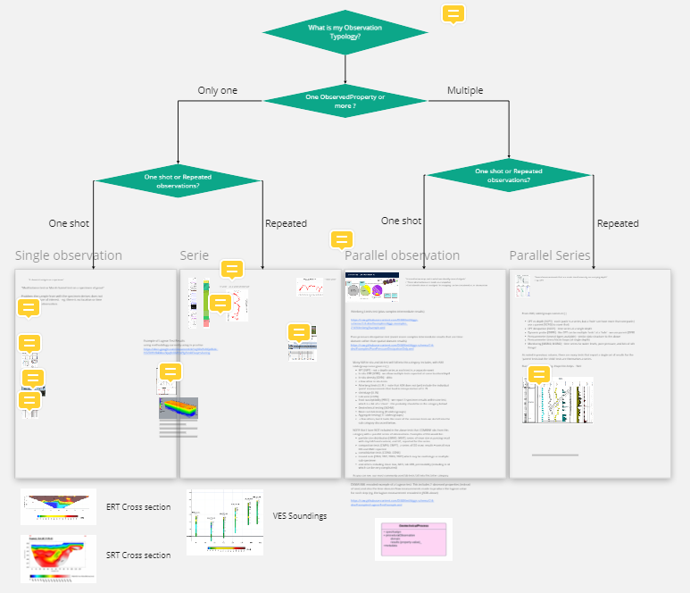
Observations, measurements and interpretations (on-going discussions)
How to deal with complex Procedure?
ComplexResult vs ObservationCollection

Slide 12
Next steps
#1 Conceptual model
From Miro + GitHub + GoogleSpreadsheet to an UML Model
Procedure subgroup (also addressing result typology)
Start of the others packages

Slide 13
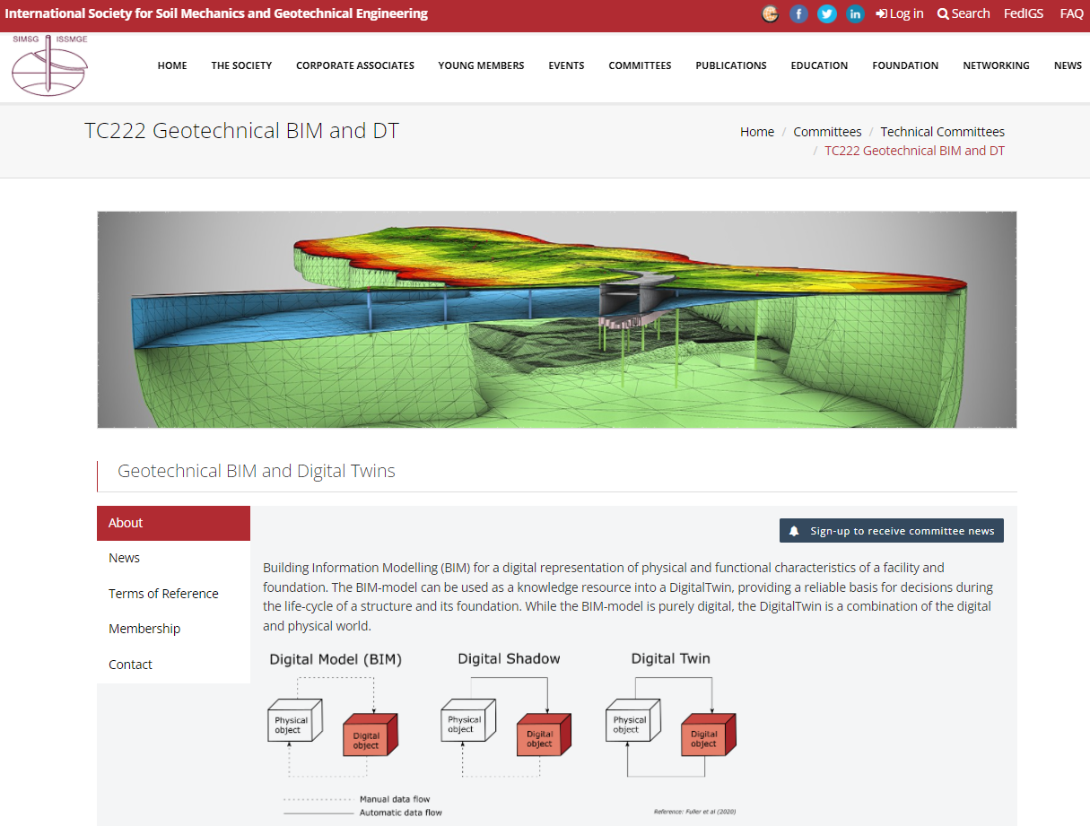
News from ISSMGE TC222
International Society for Soil Mechanics and Geotechnical Engineering
TC222 : Geotechnical BIM & Digital Twins
https://www.issmge.org/committees/technical-committees/applications/geotechnical-bim-and-dt
First member meeting on June 28th
Workshop on September 14th

Slide 14
Questions? Contact: m.beaufils@brgm.fr

