Slide 1
GeoScienceDWG 2021 Overview
Mickaël BEAUFILS (BRGM)
CGI Webinar
Virtual | 23rd June 2021

Slide 2
What is the GeoscienceDWG
The joint Domain Working group (DWG) between OGC and CGI-IUGS
Officially created in September 2017
Current chair: Mickaël Beaufils (BRGM)
One goal: Organize activities / set actions to reach FAIR Geoscience Data
Geospatial Data Standardization
Geoscience Data Community

Slide 3
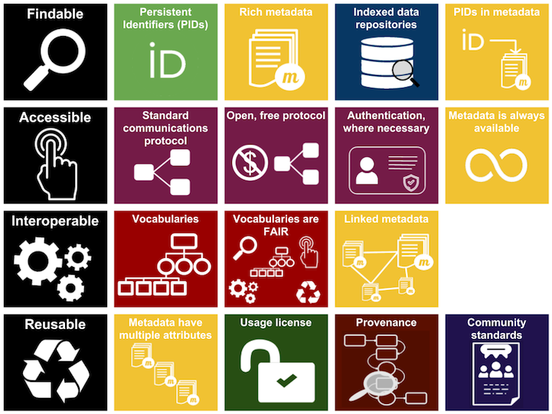
Make FAIR Geoscience Data

Slide 4
GeoscienceDWG perimeter
Volcanology
Agriculture oriented WG
Technology oriented WG
Mineral
resources
Seismology
Soil
GeoScience DWG
Climate
oriented WG
Geology
City & infrastructure oriented WG
Mining
Oil & gas
Geophysics
Hydrology oriented WG
HydroGeology
Underground
constructions

Slide 5
Ensure proper connections with other groups
GeoScience DWG
Earth, Space, and Environmental Sciences
Interest Group
… and many others

Slide 6
Key goals
Foster technical solutions which support interoperable concepts, data definitions, formats and services for publishing, search, and exchange of geoscientific information.
Ensure thematic/semantic coherence within the Geoscience domains and the Geoscience related ones: Geology, Hydrogeology, Mineral Resources, Surface Hydrology, Soil …
Define proper interfaces with City and Infrastructure related domain
Support proper exchange with Risk monitoring, prevention and management activities
Focus industry and research organizations (incl. RDA) attention on the value added of interoperable approaches
Identify and work with a select set of partners in this area, and initiate demonstration projects to develop and publicize best practices in this area.
Establish a workable approach to managing standards for geoscience spatial features, their temporal aspects, related metadata, and other business information.

Slide 7
Participation to OGC TC and highlights
Dublin TC June 2016: Ad’hoc Meeting, initiating the idea of having a GeoScienceDWG
Delft TC March 2017: Official proposal for a GeoScienceDWG
St-John’s TC June 2017: Charter validation
Southampton TC September 2017: GeoScience 1st meeting
Palmerston North TC 2018: Update on BoreholeIE and 3D-4D Model IE
Orleans TC March 2018: Borehole IE pre-kick off
Stuttgart TC September 2018: BoreholeML / GeoValML + IDBE Geotech presentation
Toulouse TC December 2019: Borehole IE engineering report

Slide 8
OGC Virtual TC December 2020
Welcome / Agenda presentation : 5’
Presentations : ~ 60’
M.Beaufils & al. : Extension of OGC standards for geotechnics : 10+2’
L.Ailleres & al. : Loop Project introduction : 10+2’
B.Brodaric & al. : Geoscience ontologies (especially in Loop) : 10+2’
S.Grellet & A.Feliachi & al. : News from EPOS and GeoERA : 10+2’
E.Lewis & JA.Stevenson : Exposing geoscience data with SensorThings API : 10+2’
Discussion : ~ 30’
Going JSON(-LD) and other topics

Slide 9
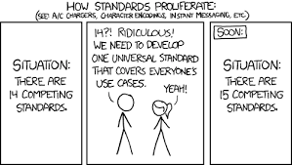
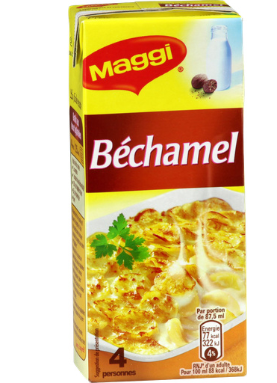
Borehole IE
Borehole, Bore, Well or Wellbore & their associated data: many standards, each of them from a different point of view for the same object
Propose a Generic Conceptual model (BhML) to reconcile them all
Inspired by ISO19148 Linear Referencing

Slide 10
API4INSPIRE
Demonstration of OGC – API Features and OGC SensorThings API as alternative for INSPIRE Download Services
https://datacoveeu.github.io/API4INSPIRE/
INSPIRE Conference 2016
The user interface you imagine
Still Identifier & resolver
OGC SensorThingsAPI
OGC API - Features
New flavors!

Slide 11
SMART Data Loader
Make WFS AppSchema / OGC API – Features setting less painful with
https://docs.geoserver.org/stable/en/user/community/smart-data-loader/data-store.html

Slide 12
Express information
ISO 19156 / Observation & Measurement: v2 > v3
https://github.com/opengeospatial/om-swg/tree/master/oms-abstract-spec/ogc-as-topic20
Submission expected in Autumn 2021 > Expected as a standard in June 2022
May impact OGC - CGI standards
Activities around EPOS / GeoERA and the EGS actions
Discussion on BIM – GIS Digital continuity for Geotechnics: OGC + bSI

Slide 13
Next topics (not necessarily in this order)
Borehole SWG
3D-4D Model IE
Extension of OGC Geoscience Standards to cover geotechnics
Going (Geo)JSON(– LD) for GeoSciML and GroundWaterML2
…

Slide 14
GeoScienceDWG: Doggy bag slide
Contact: Mickael Beaufils - BRGM
E-mail: m.beaufils@brgm.fr
Mail list: geoscience.dwg@lists.ogc.org
Wiki: https://external.ogc.org/twiki_public/GeoScienceDWG/
Next GeoScienceDWG meeting: OGC TC Septembre 2021

