Slide 1

BoreholeML from the user‘s point of view
Field Report
108th OGC Technical Committee
Stuttgart, Germany
Gerd Arns-Krogmann
12th September 2018

Slide 2
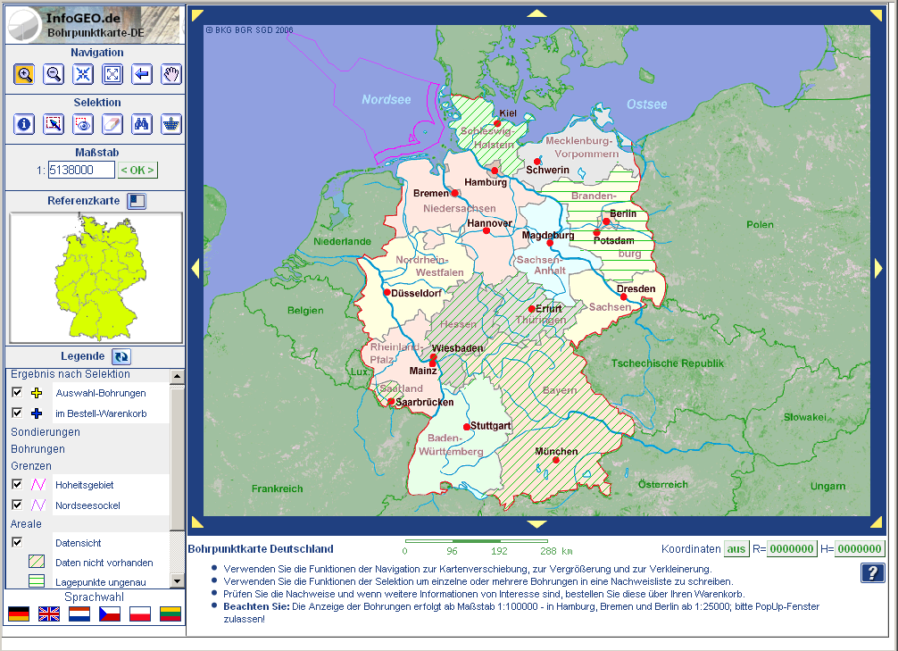
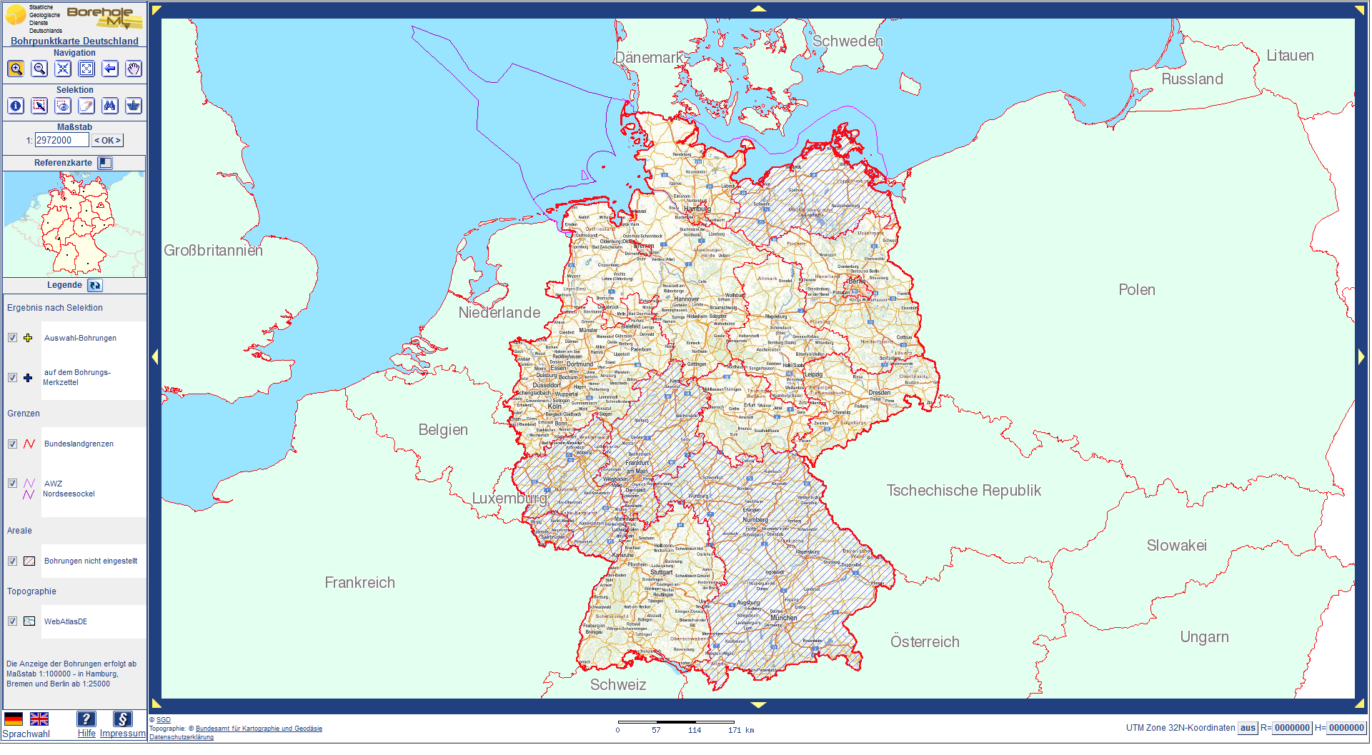
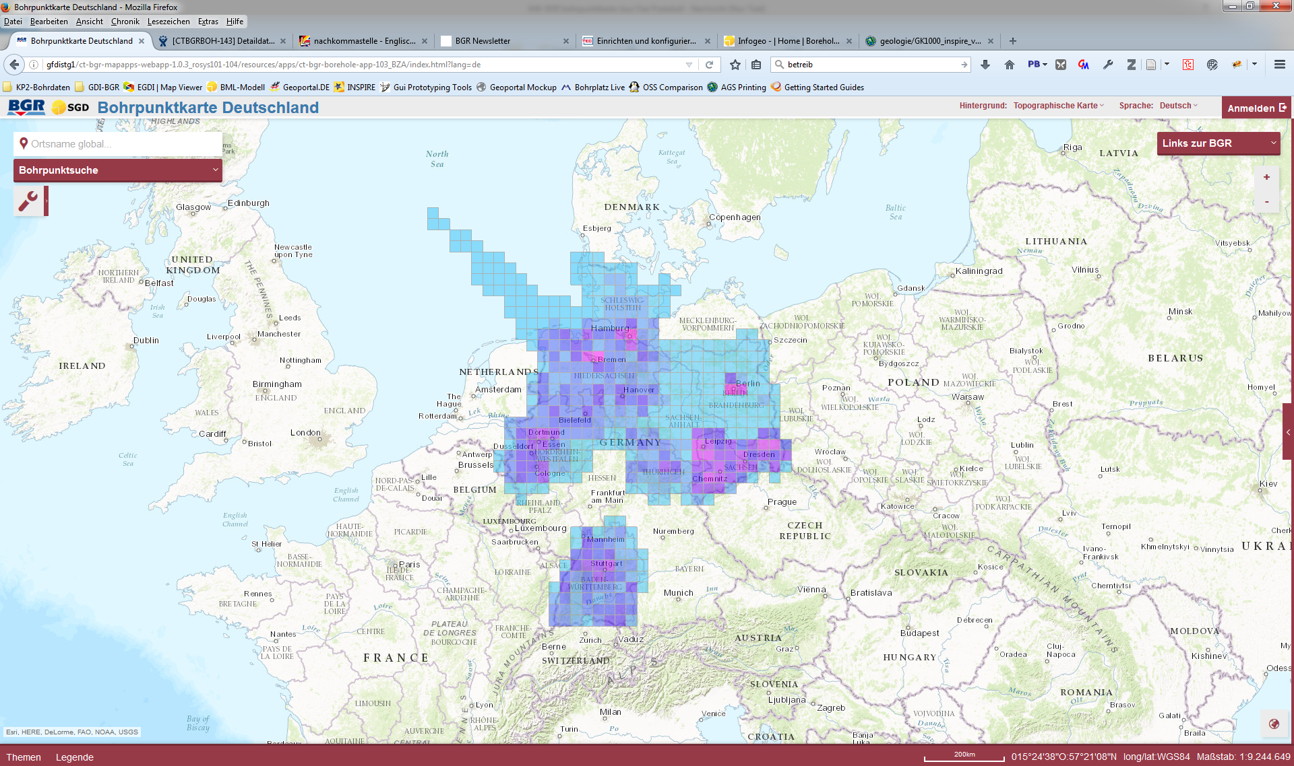

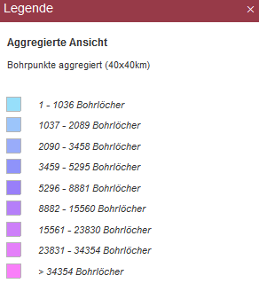
Implementation history of BoreholeML
2006 client version 1
EU Project „eEarth“
2012 client version 2
Economic stimulus program II
„Interoperable borehole data in the national geoportal“
?
2017 client version 3
Migration into the SDI-BGR
2020 client version 4 BoreholeML2INSPIRE
Notes:
Projektwurzeln 2002: Idee Austausch von Bohrdaten via XML

Slide 3
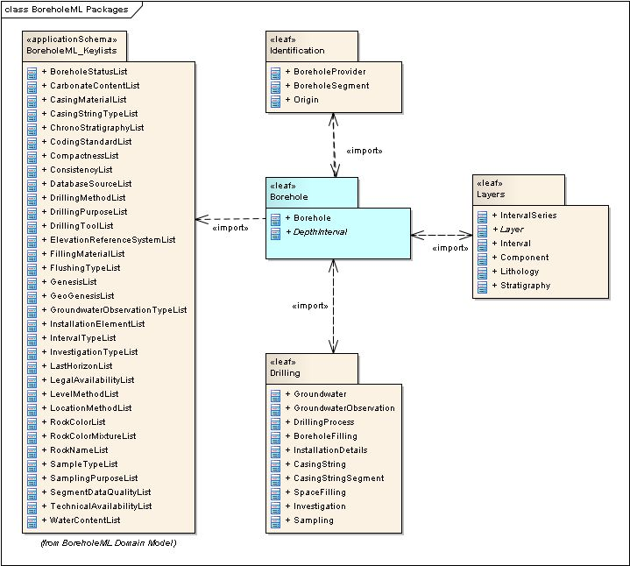

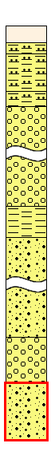
Structural overview of BoreholeML
Identification
codeLists
BoreholeML is the lowest common denominator of the German borehole data formats
generalised
community commitment of the GSO
Version 3.0.1 released in October 2011
Version 3.0.1
Headerdata
+ Metadata
Strata details
    Logging & Sampling
    Casing
    Technical data
    Groundwater
    Measurements
    =„kind of metadata“
Main features
Multilingual German – English
codeLists can easily be extended
(GML Dictionary)
3D geometry as point and polyline
Focuses on strata details
Soruce: Infogeo.de

Slide 4
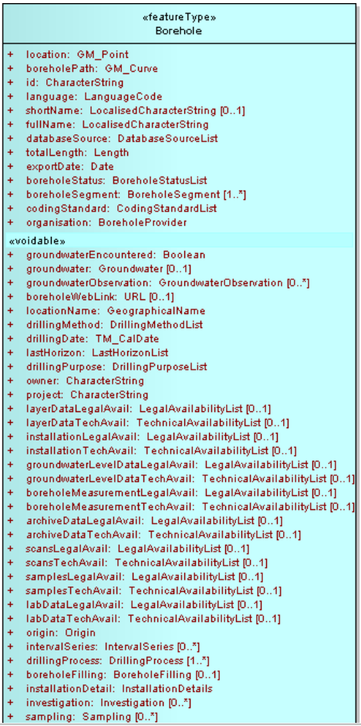
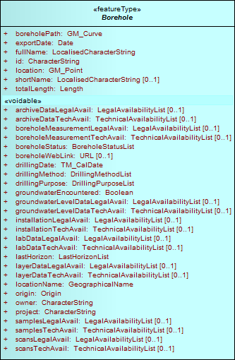
FeatureType „Borehole“
FullFeature
HeaderFeature
(harvested metadata)
Mandatory header properties
All other details are
modelled as voidable data types
Legal and technical availabilities of each detailed information part
Development process
Influenced by INSPIRE Generic Conceptual Model
Master UML Classdiagramm (EAP)
> GML application schema (shape change)
> HTML / PDF documentation
> DDL-skripts
Database oriented modeling approach

Slide 5
„Hybrid model“ I
Possibility to transport unmodified data
from the source without losses of
information through
transformation
Examples:
  Data type Origin
  Properties Layer:rock code /
  Layer:rockNameText
  Property Stratigraphy:lithoStratigraphy

Slide 6
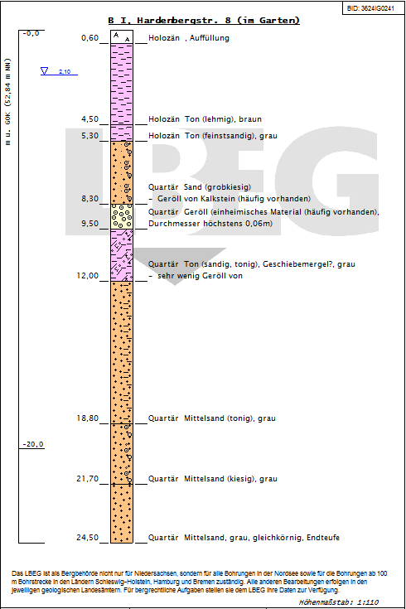
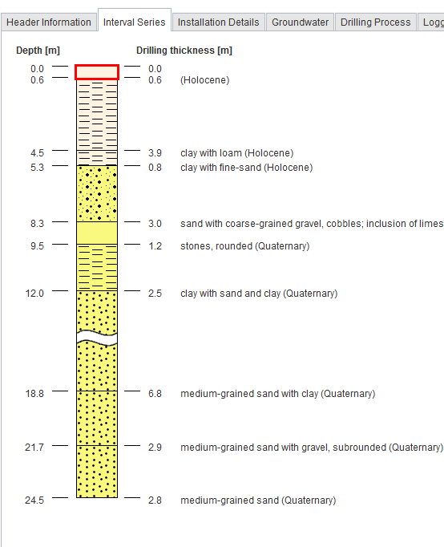
Borehole:boreholeWebLink [0..1]
„Hybrid model“ II
data
transformation
Source format (SEP3)
complete set of all information
BoreholeML
transformed and generalised

Slide 7
Use cases
Borehole Map Germany - Single point of access for all freely available borehole related data
  Search and broker contacts between user and data provider
Support for small and medium-sized enterprises
  engineering offices / small drilling companies
  foundation exploration for railways and roads
Interoperability for unproblematic data exchange
  Use of borehole data in other geoscientific projects
  Use of borehole services in several geoportals at local government level

Slide 8
Practical Experiences
No other implementation of BoreholeML outside our project context
  To complicated for a rapid implementation
  Not an established nor an approved standard (yet)
  But new business models are based on our architekture / service
Contact with developers from small and medium-sized enterprises
  They prefer REST-Interfaces with HTML (JS / CSS) output or just images (png, pdf)
  They don‘t know much about OWS
WFS with complex gml data schema is too complicated to use in GIS
  No established software available
  Breaks idea of convienent data processing through interoperability (data preparation needed)
  No visualisation
WMS prefered interface for the users > SIMPLE and Good User Experience
  We wanted a WMS including visualisation of the strata details
  Solution: Backend transformation into HTML with JavaScript

Slide 9









„Cascading-Borehole-WMS“
borehole
converter
Server
WFS
NRW
BoreholeML
WMS-Clients
XSLT
3. Detailinformation
ArcGIS
borehole
converter
Server
Java profile
backend
WFS
FeatureType: FullFeature
HTML / JS
BoreholeML
Borehole Map
NI
ArcGIS Server
REST
Internet
QGIS
Server
BoreholeML
1. Map
2. Search
borehole
converter
WFS
HH
BoreholeML
Header data
FeatureType: Header
Harvester
Notes:
ETL Processor = GeODin der Fa. Fugro
WFS Server = deegree; WFS version 1.1.0
WMS Name = German Borehole Locations (GBL)

Slide 10
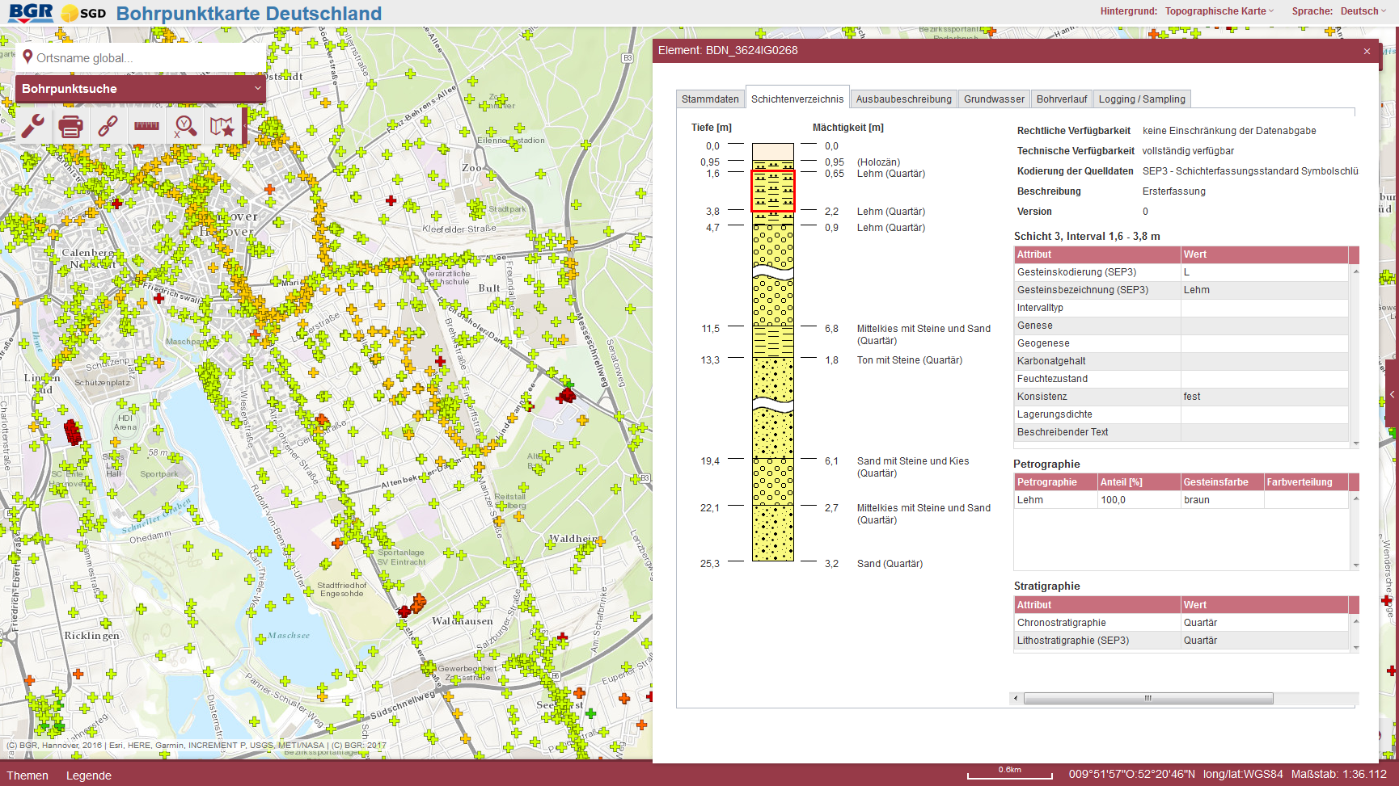
ESRI-REST in
Borehole Map of Germany

Slide 11
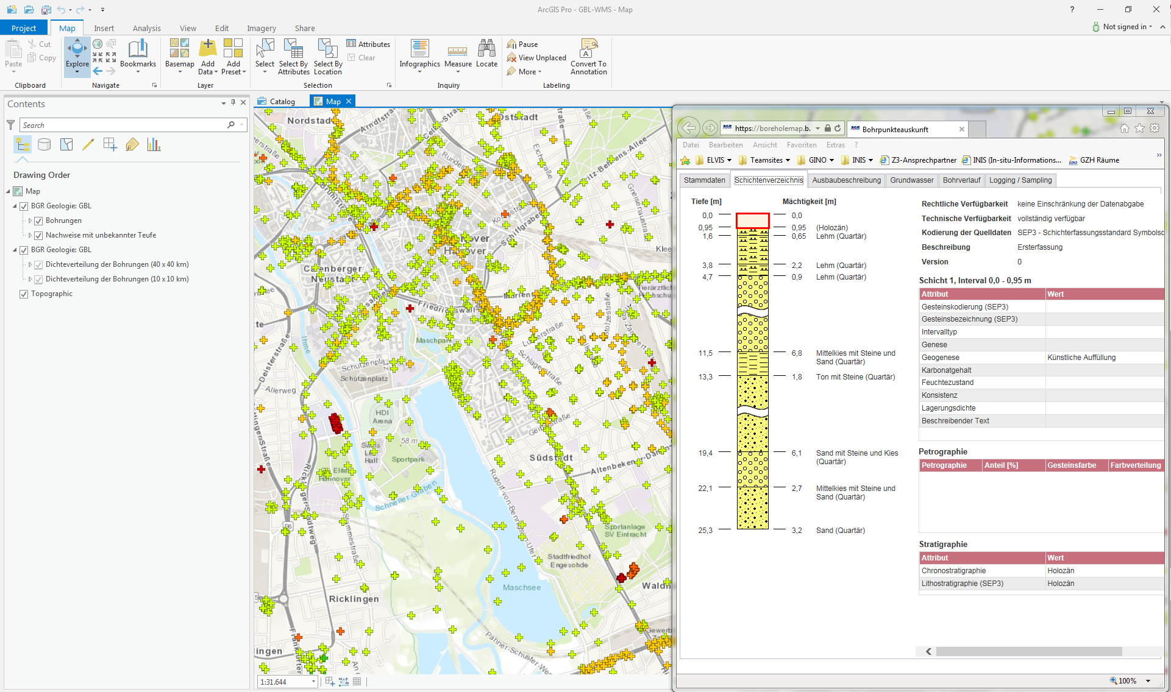

WMS in ArcGIS Pro
German Borehole Locations
Notes:
Anzeige aller BoreholeML-Daten

Slide 12
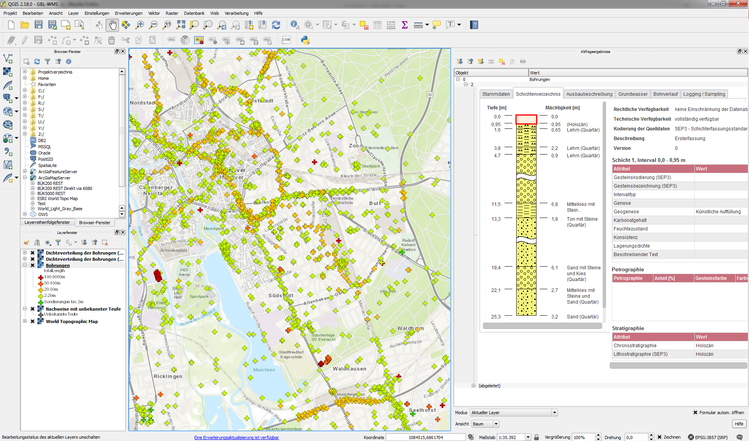

WMS in GIS
German Borehole Locations
Notes:
Unser Dienst funktioniert in jedem WMS Client, der HTML/CSS und JavaScript interpretiert

Slide 13
Lessions learned
periodic data transformations are expensive and complicated
→ doubling data stores (sync and data-updates)
Keep the model stable enough for a longterm support
→ Save investments of implementation
Integrate simple ways for linking external or related data
Provide very simple interfaces for non experts in geoinformatics
Don‘t forget the requirements of small and medium-sized enterprises
Implement the model in software to demonstrate its benefits

Slide 14
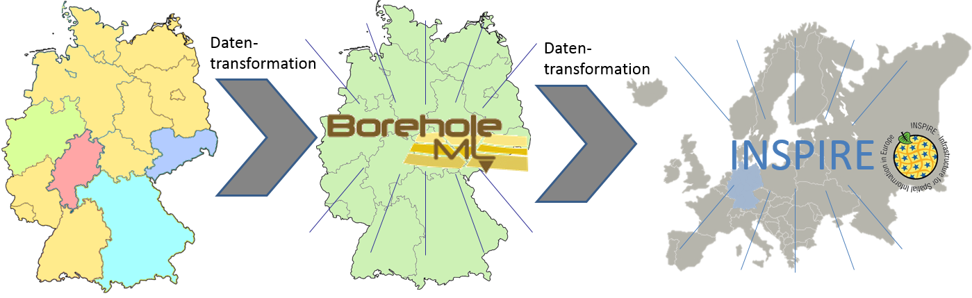
Follow-up project 2018 – 2020:
„Providing INSPIRE compliant borehole data in the Federal Republic of Germany based on BoreholeML (BoreholeML2INSPIRE)“
Next stop - INSPIRE

Slide 15
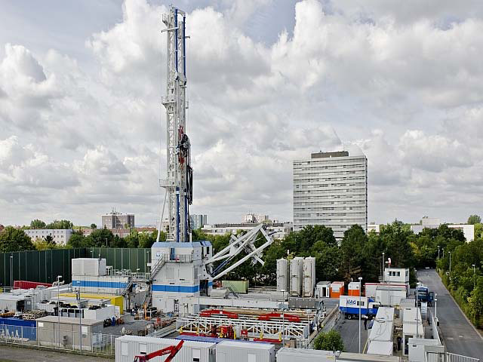



Thanks for listening!
Any questions?
Resources
Spec BoreholeML
App Borehole Map Germany
WMS German Borehole Locations (GBL)
Gerhard Arns-Krogmann
Federal Institute for Geoscience and
Natural Resources
Stilleweg 2
30655 Hannover
Phone: +49 511 643 3343
Mail: gerd.arns-krogmann@bgr.de boreholeml@bgr.de

Slide 16
Appendix

Slide 17
Aggregated Layer 40x40 km
Scale < 1:1.200.000

Slide 18
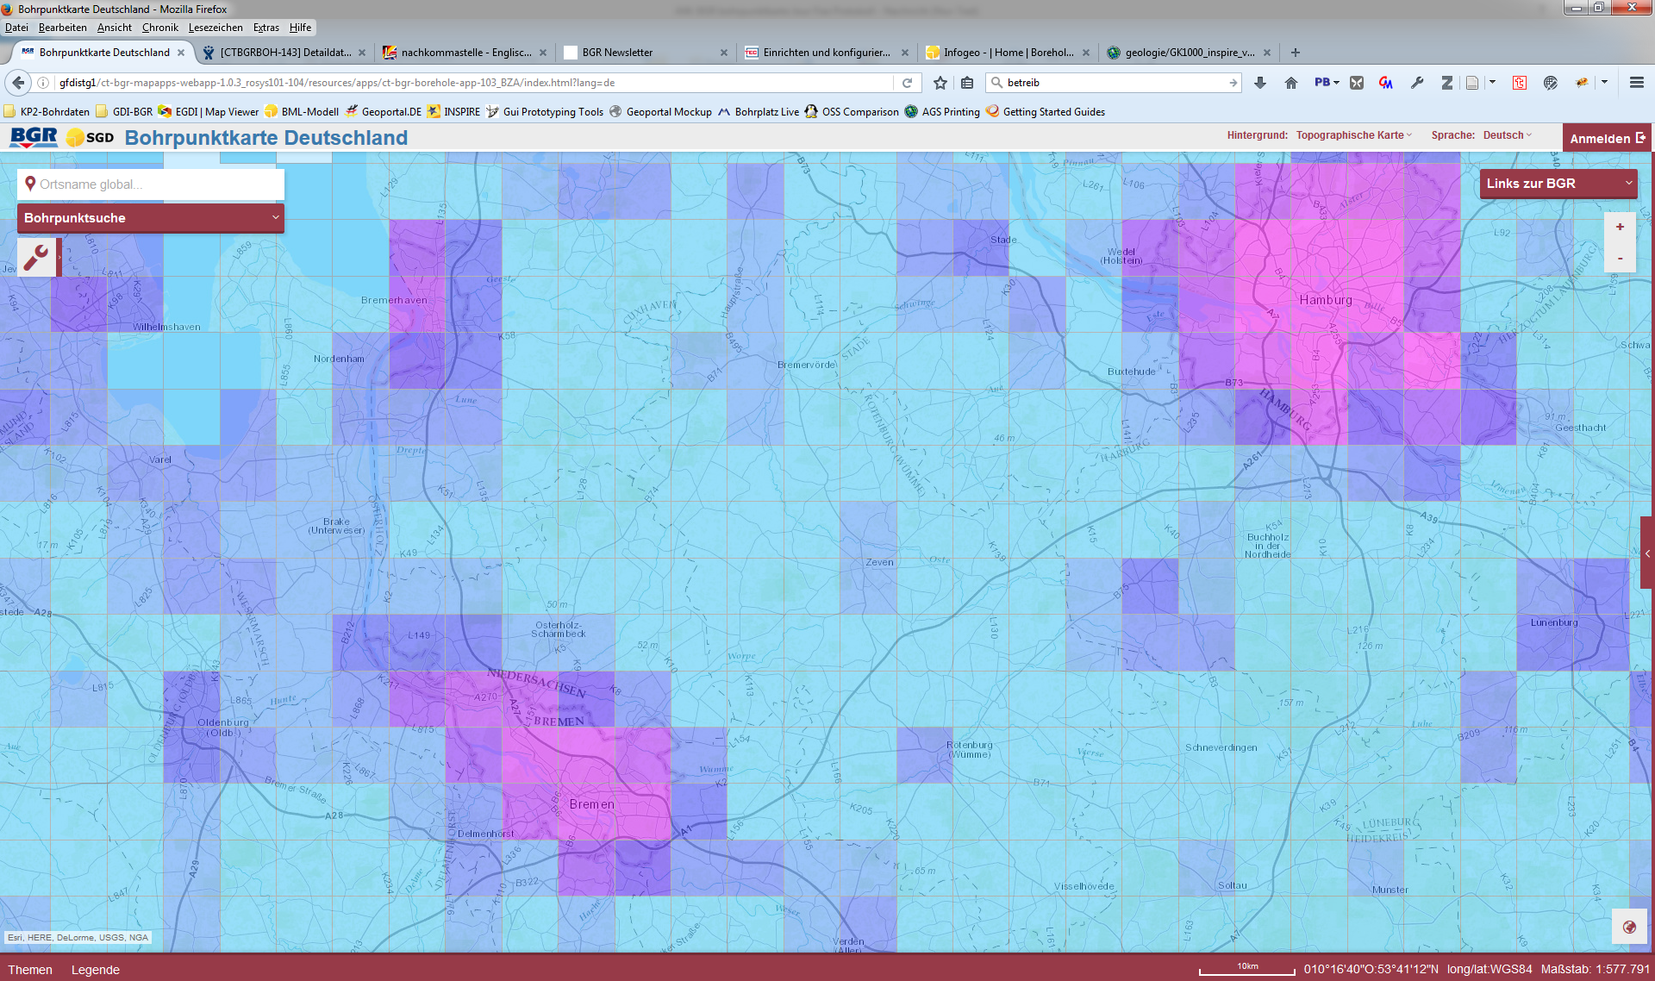
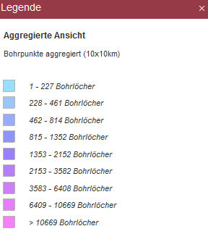
Aggregated Layer 10x10 km
Scale 1:72.000 - 1:1.200.000
Hamburg
Bremen

Slide 19
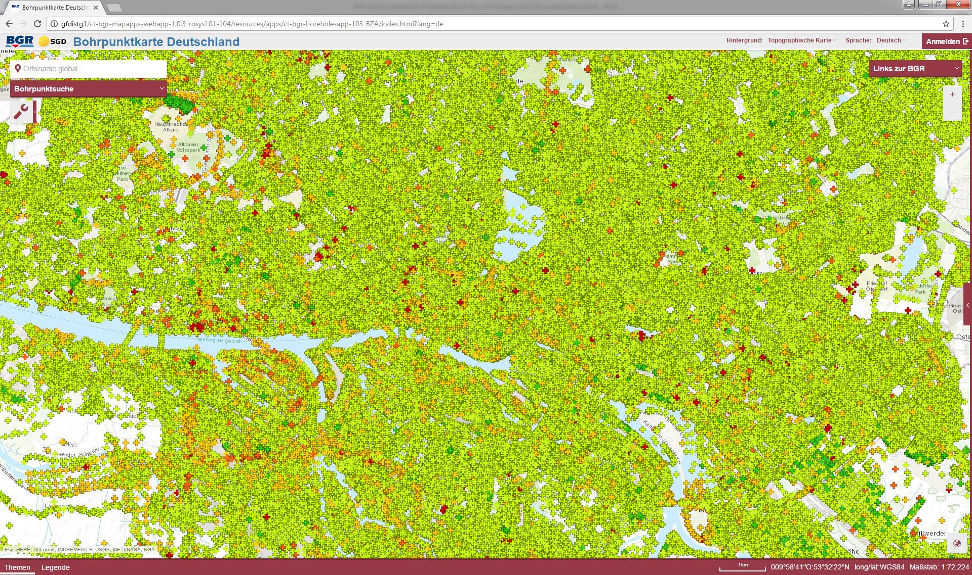
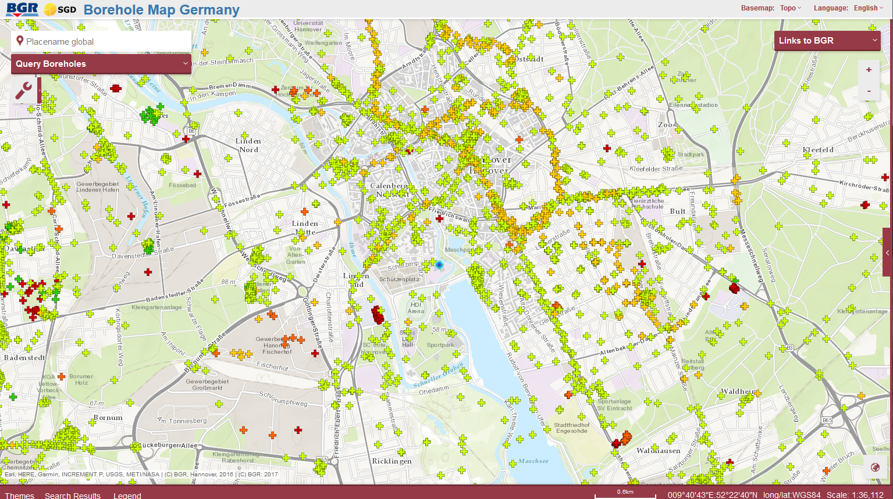
Boreholes are visable
at a scale > 1:72.000
Hamburg
Hanover
Notes:
Aussage: Große Unterschiede in der Bohrungsdichte in Deutschland
Meine Lieblingsbohrung zum zeigen
ID = BDN_3624IG0268 (die blaue Bohrung)
Oder
ID = DABO_18018 (Über Query Boreholes zu finden)

Slide 20
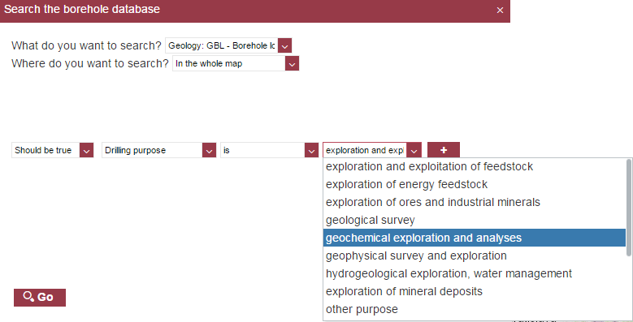
Query Boreholes
Operators depends on data type
string: is / sugguest (like)
integer: < ; > ; <= ; >= ; =
date: before / after
Dropdown with coded values for attributes with code lists
All header attributes of BoreholeML

Slide 21
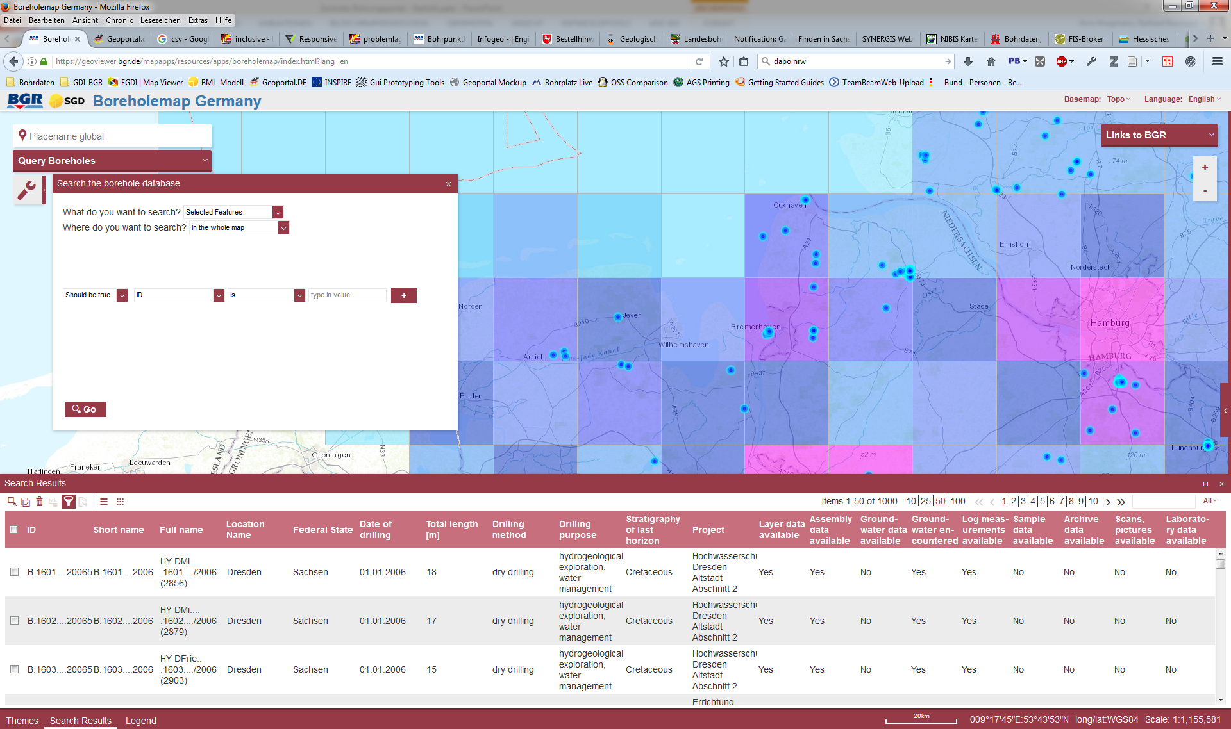
Further filtering of the first search results
geographically or
attributive

Slide 22
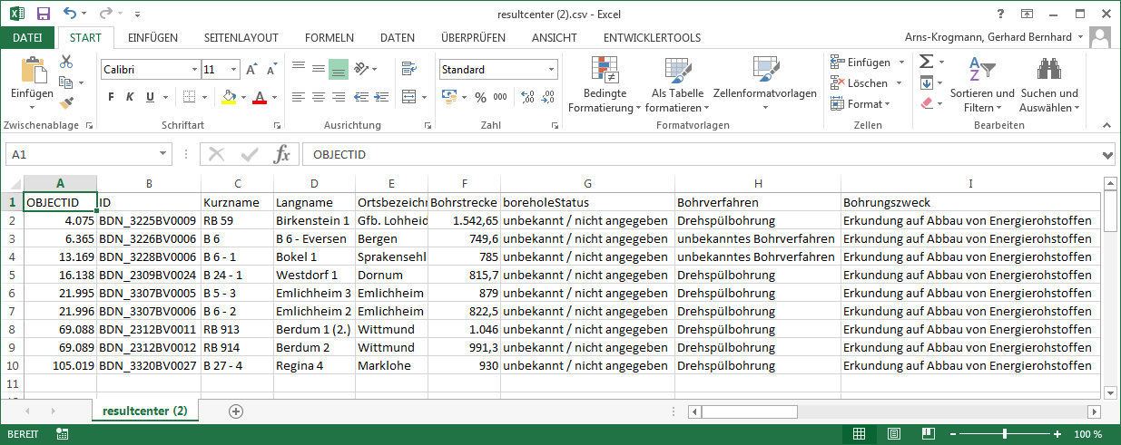
Development Borehole Map Germany version 3
CSV-Export → Important for ordering borehole data by email

Slide 23
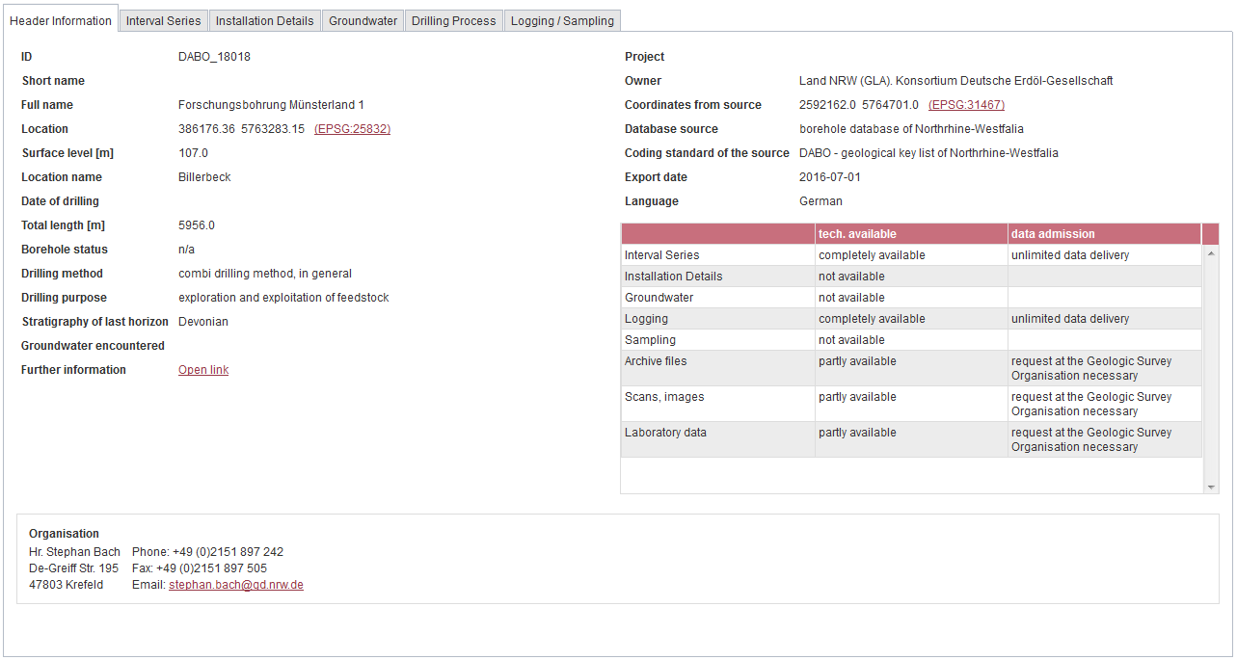
These header attributes are harvested by the BGR

Slide 24
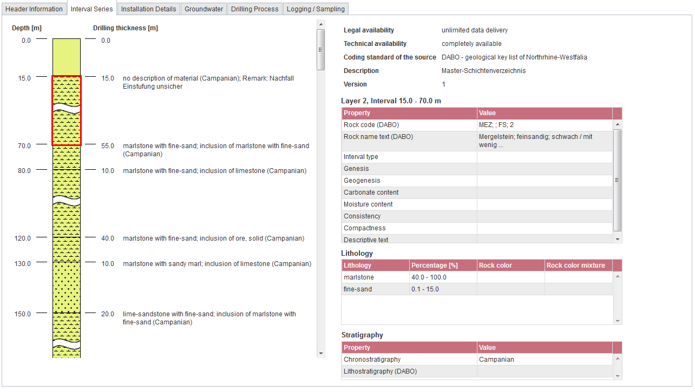
The detailed information is delivered by WFS on demand
Each layer (left) is selectable and presents the available strata data (right)

Slide 25
Sequence diagramm of the Borehole-WMS (GBL)
User
Header DB
WFS Server
GSO

