Slide 1
Standardizing geomodeling and geotechnical data exchanges: the SCUDDD and MINND projects
104th OGC Technical Committee – GeoScience DWG session
Southampton, United Kingdom
Mickaël BEAUFILS
14 September 2017

Slide 2
Standardizing geomodelling exchange
Statement
Several geomodelling tools exist (e.g. two « homemade » tools exist in BRGM) and have their own native format,
Geomodels shall be updated by considering new available data,
Conversion between format is often tricky and not lossless
Rationale
Having a pivot format would probably mean maintaining at least two formats:
The raw data format,
The “to share” format
Is there other solutions?

Slide 3
How to cope with users thirst of geological models data?
Expression of the “geological architecture” (P. Calcagno & al.)
“How geology is here”
Define which geological units are involved
Define relationship between them (onlap, erod, …)
Not about geometries expression and exchange
Develop APIs to query geological models stored in their native formats (SCUDDD project: C. Loiselet & al.)
Extraction of relevant code from the geomodelling tools to query the model
Develop services to build on demand representations and visualizations

Slide 4
SCUDDD architecture
(adapted from Loiselet & al., 2016)
Representations
(machine readable)
Visualizations
(human readable only)
Delivery
- Geologic logs
- Profiles
- Maps
- Points cloud
- TIN
- 2D/3D regular grid
- 2D/3D irregular grid
- ….
WPS
SCUDDD methods
Interface
SCUDDD_API
iSCUDDD_GEOL = Model queries / responses :
1) which formation?
2) which contact?
Model part
Native directory of geomodels

Slide 5
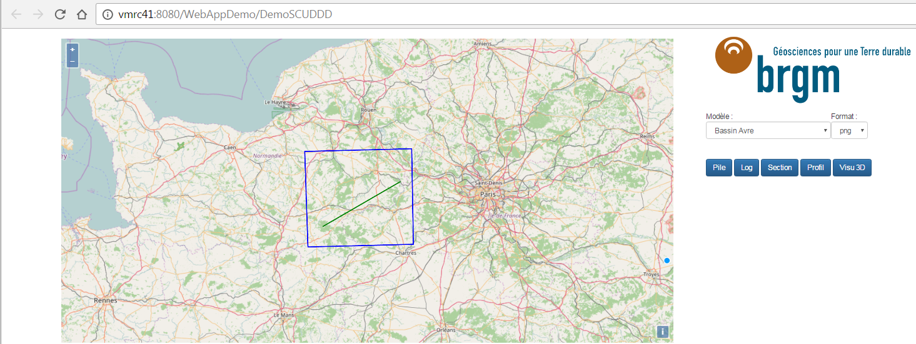
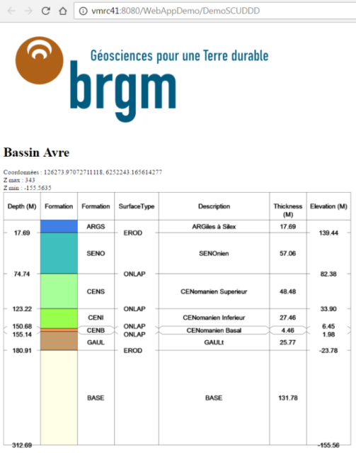
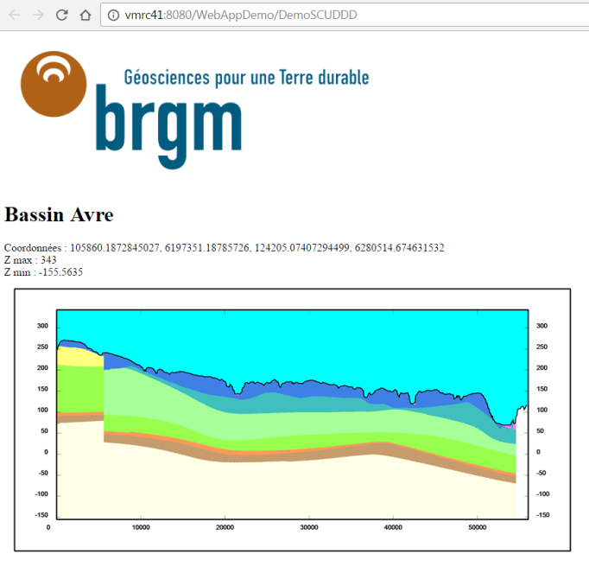
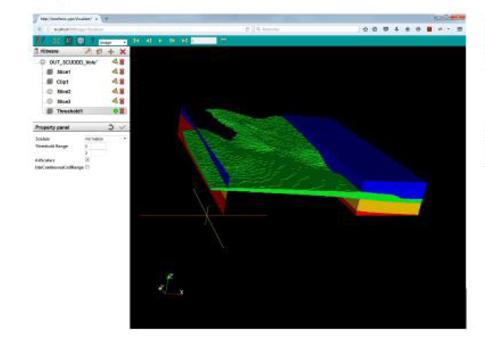
SCUDDD interface

Slide 6
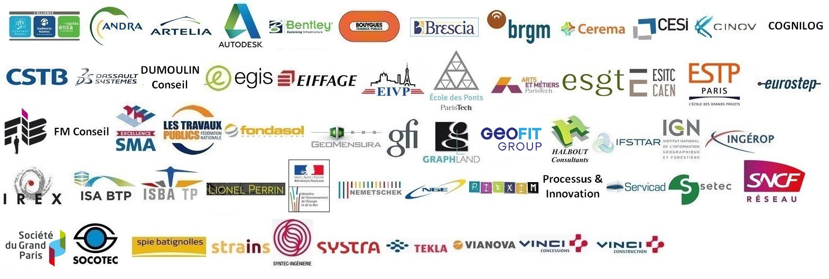
The MIN^{N}D project
http://www.minnd.fr/en/
Interoperable Information Model for Sustainable Infrastructures
A French consortium of 60 partners
1 goal: enhancing BIM capabilities for infrastructure modeling and management
In relationship with its environment

Slide 7
Underground Infrastructure use case (UC8)
14 partners
2 working groups
Developing / adjusting IFC standards to describe Underground Infrastructure and its equipment
Describe relationship between built part and environment and standardize geotechnical data exchanges (Lead by BRGM)
5 main actions
Cartography of data exchanges
Elicitation of semantics
Conceptual model definition
Definition of data access and representations
Standardization through BSI and OGC

Slide 8
What do we have in MIN^{N}D?
Targetting the « Holy Grail » BIM level 3
BIM level 2 ~ Exchange data in standardized format (IFC)
BIM level 3 ~ Service approach and data centralization
Revisiting some French normative documents (AFNOR, CETU) on which data shall be exchanged at which moment of the project + update & adjust with experience of the team
Feedback from first meetings:
Geotechnical data are mostly geoscience data
Geological models / geotechnical models are shaped and reshaped until uncertainty assessment is « acceptable »
We can (shall?) use our classical tools to provide data (O&M, WFS, …) + maybe have to address (again?) the uncertainty assessment topic

Slide 9
Opportunities about geomodelling standardization
Geology Architecture
Might be a very good linked data use case ?
Same features but with different relations depending on location
Standardizing geomodeling querying
By defining standard requests + parameters
By defining standardized outputs
By developing more APIs linked to geomodelling tools in order to be able to handle more native formats

Slide 10
Opportunities with geotechnical data standardization
Construction domain is a big geoscience data producer and consumer
MIN^{N}D UC8 offers a very applied use case to demonstrate usage of standardized geoscience data in production mode
Facilitate data transfer from construction domain to geoscience community to enhance our capacity of understanding subsurface
Facilitate data integration in modelling process while construction works are realised
Collaboration between BSI and OGC
Positioning OGC standards as solutions to help reaching BIM level 3
Perhaps not only for GeoScience data…(WFS to serve IFC?)

