Slide 1
3D geological model data sharing standards and CGS experience on urban geology
104th OGC Technical Committee – GeoScience DWG session
Southampton, United Kingdom
Hongggang QU, Minghua ZHANG, Rongmei LIU
13 September 2017

Slide 2
Outline
Geo3DML: an Open 3D Geological Model Data Exchange Format
Geo3DMD: a 3D Geological Model Metadata Architecture
CGS experience on urban geology

Slide 3
An Open 3D Application Frame work
3D Geological Modeling Tools
Soft A
Geo3DML
3D Geological Spatial Database
Geo3DML
Institutes & Enterprises
WVS
Soft B
Publication & Sharing Management System
Government Departments
WFS
Geo3DMD
W3DS
Geo3DMD
Soft C
3D model metadata Database
……
Other Consumers
……
Geological Survey Organizations
WVS: Web View Service
WFS: Web Feature Service
W3DS: Web 3D Service
Notes:
As we know. For the geological complexity, uncertainty, limitation of available useful data, diverse application fields, it is impossible to envisage a standard piece of software which will fulfill all of the geological modeling needs. Indeed. A wide range of techniques and software tools have been developed to meet various needs of modeling and information dissemination. And these 3D geological modeling software packages mostly have different data models. So it is needed to provide an open exchange format for interactively share 3D geological model data. And this is Geo3DML.

Slide 4
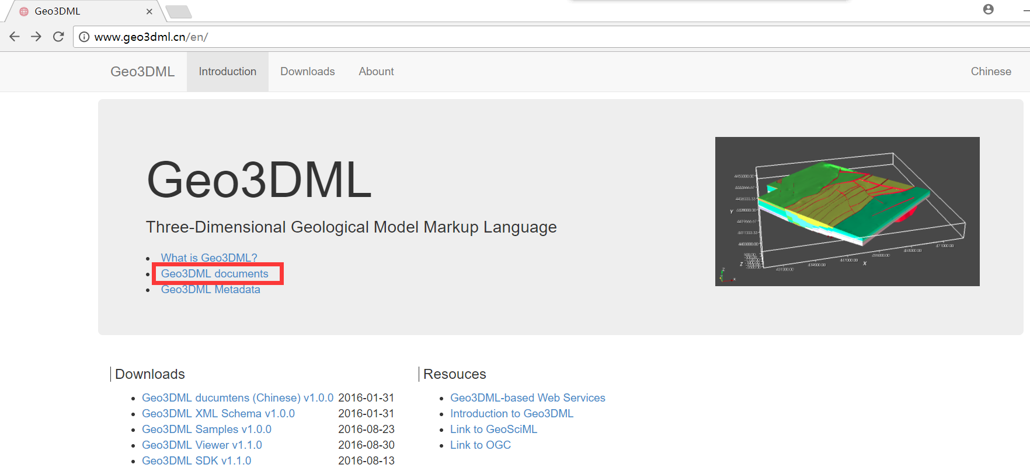
Geo3DML (3D Geological Model Markup Language)
An open 3D geological model data exchange format
  Started in 2011
  Issued as the China Geological Survey standard in Dec. 2015
  Geo3DML Viewer and SDK were released in the same time
  English version is available now. www.geo3dml.cn/en

Slide 5
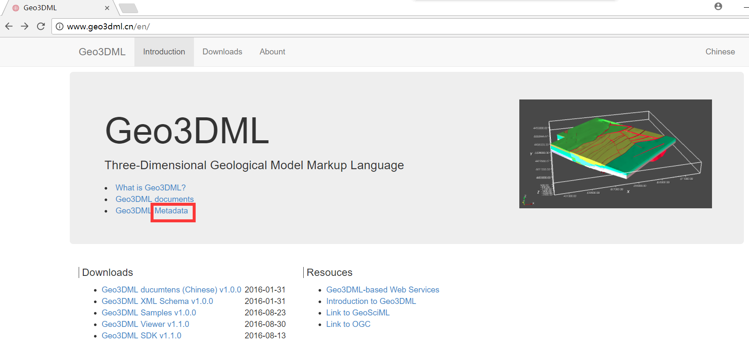
Geo3DMD: a 3D Geological Model Metadata Architecture
  Started in 2015
  Completed by the end of 2017
  Issued as the China Geological Survey standard in the first half of 2018 hopefully
  Supporting tools will be released in the same time
  English version is available now. www.geo3dml.cn/en

Slide 6
Geo3DMD
To provide a structure for describing 3D geological model.
To facilitate the sharing and management of 3D geological model data.
The framework and content of Geo3DMD is based primarily on "Geological Information Metadata Standards " (DD2006-05) and Geo3DML.
Some of international standards are referenced in this standard, such as ISO 19115:2003, ISO 19115:2014, GeoSciML, CityGML, etc.

Slide 7
Geo3DMD
3D geological model metadata is composed of 6 metadata packages:
  Metadata information
  Identification information
  Content information
  Model quality information
  Reference system information
  Distribution information

Slide 8
Geo3DMD
Package | Entity | Element | Mandatory
Metadata | 5 | 6 | 2
Identification | 4 | 20 | 14
Content | 2 | 4 | 2
Model quality | 4 | 22 | 7
Reference system | 3 | 6 | 5
Distribution | 2 | 8 | 4
TOTAL | 20 | 66 | 34

Slide 9
Geo3DMD
NOT easy to describe the model quality and 3D model uncertainty quantitatively (especially for the structure model).
The description of data source, modeling software and process is alternative solution.

Slide 10
3D in Urban Geology
2005-2010: Pilot works of 3D geological survey were carried out in more than six Cities, including Beijing, Shanghai, Tianjin, Guangzhou, Hangzhou and Nanjing. They have been popularized and applied in 28 other cities.
2011-2015: Integrated geological survey of urban agglomeration. The work was carried out in 10 major urban agglomerations, such as Jingjinji, the Yangtze River Delta, the Pearl River Delta and so on.
Notes:
Over the decade, urban geology has been becoming increasingly important in China.
Three-dimensional structural geological models were constructed, and a 3D urban geological information management and visualization platform (decision-making) and a public-oriented urban geological information service system were established.

Slide 11
3D in Urban Geology
2016-2025:
  National strategy: Co-ordinate the exploitation of underground and urban space, Strengthen urban geological survey.
  Program of Ministry of land and resources (2017-09):
  Plans for strengthening urban geological work
  By 2020, demonstration project of urban geological survey.
  By 2025, all the large and medium-sized cities (over 330) .
Notes:
In the past two years, urban geology has been highly valued.

Slide 12
3D in Urban Geology
Main types of models
  Bedrock geology models
  Superficial sediment models
  Engineering geology models
  Hydrogeology models
  Subsurficial pipelines, buildings, traffic facility models
Main datasets used in the modeling
  Boreholes
  Cross-sections

Slide 13
3D in Urban Geology
Characteristics of current Urban Geology:
  Multi-parameter geological survey, involving space, resources, environment and disasters
  Internet of things------an integrated geological environment monitoring network
  Big data
  3D and multiple dimensions, Transparent City
  Spatial precision: 0-200 m
  Urban geological information service and decision support system: open, shared and dynamic updating

Slide 14
3D in the Beijing UG
The constructed models
  Bedrock geology models (at the central Urban area)
  Cenozoic Erathem lithology models (at the plain area)
  Engineering geology models (at the plain area, at three new towns, at the Olympic sit, at the CBD sit )
Modeling Methods
  From boreholes, cross-sections, isopach maps, etc.
  Point-Line-Surface-Solid

Slide 15
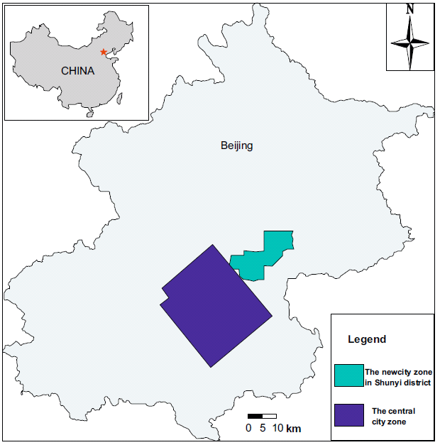
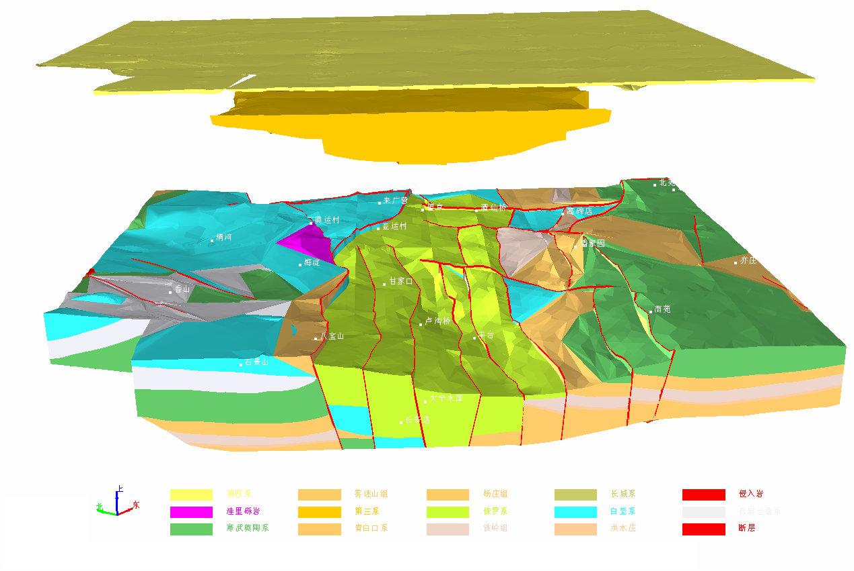
Bedrock geology models
  At the central Urban area
  Area: about 1000 km²
  Depth: about 2000m.
  Resolution: 1:100,000

Slide 16
Data collection
  Geothermal boreholes: Several hundreds~2500m. They are applied in controlling the framework.
  Groundwater boreholes: Tens ~hundreds meters. They are valuable for the detail information in the bedrock.
  Geophysical data: For the interpolation of fault position and occurrence, etc.

Slide 17
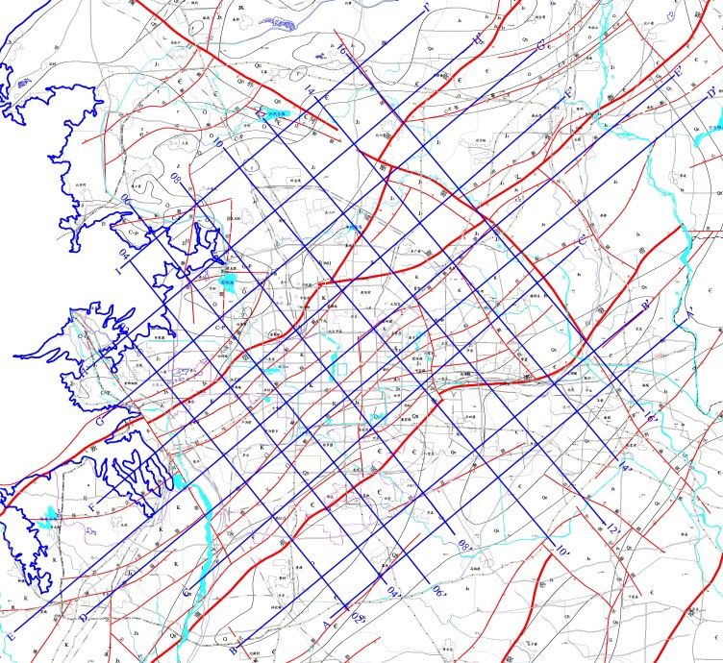
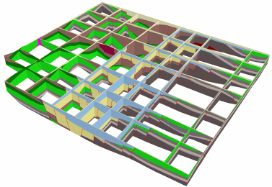
Creating cross-sections
  8 north-west cross-sections, perpendicular to the strike of the main structures.
  9 north-east cross-sections.
Layout map and fence diagram of cross-sections
Notes:
Fence diagram of the 18 cross sections

Slide 18
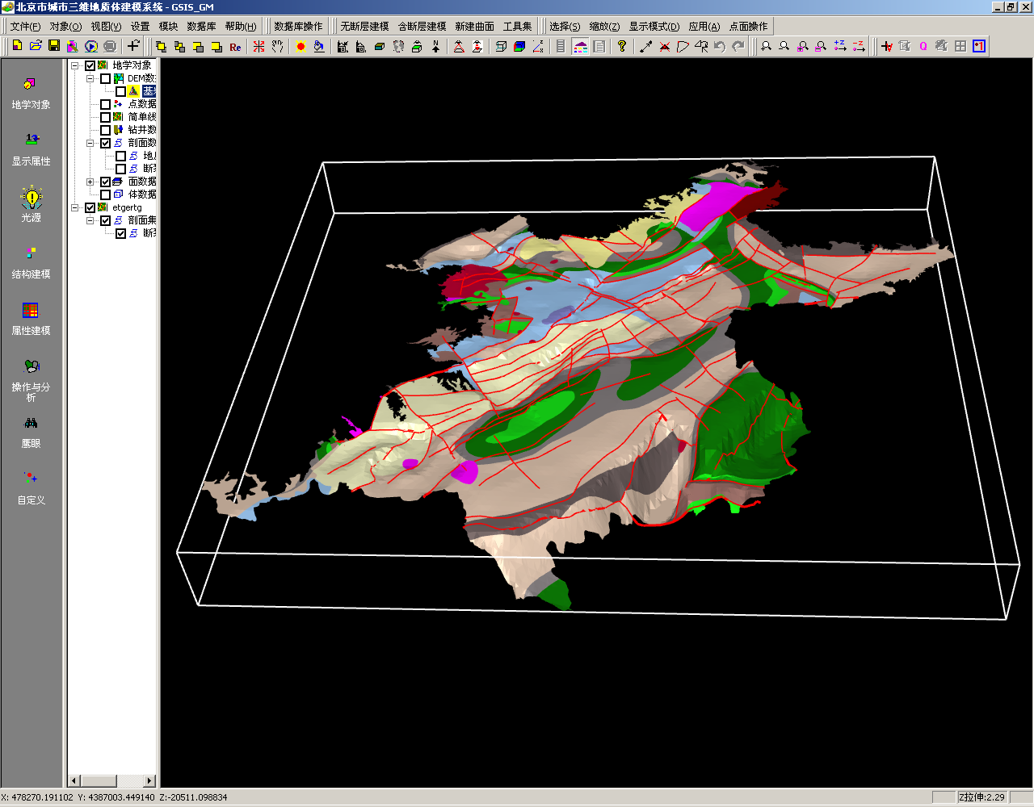
Superficial bedrock geology

Slide 19
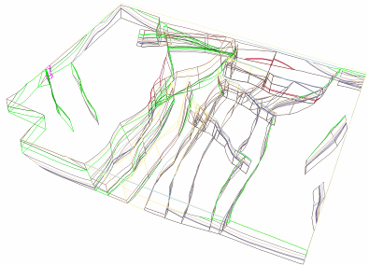
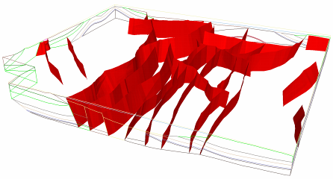
The fault models in wire frame and color mode.

Slide 20
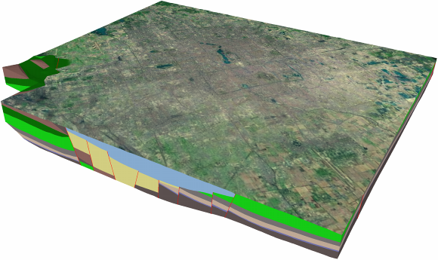
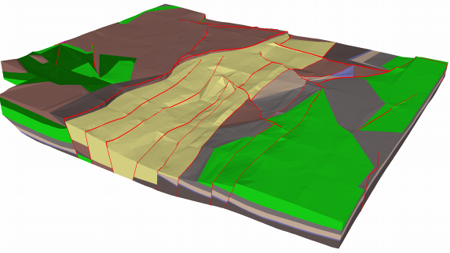
Bedrock geology models
with Remote Sensing image
Model without Cenozoic stratum

Slide 21
3D Geo-Model for Groundwater and Geothermal Reservoirs

Slide 22
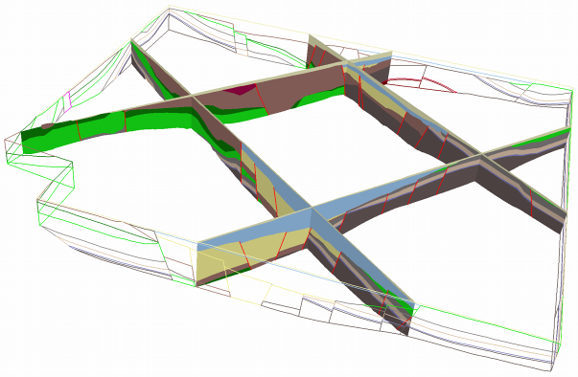
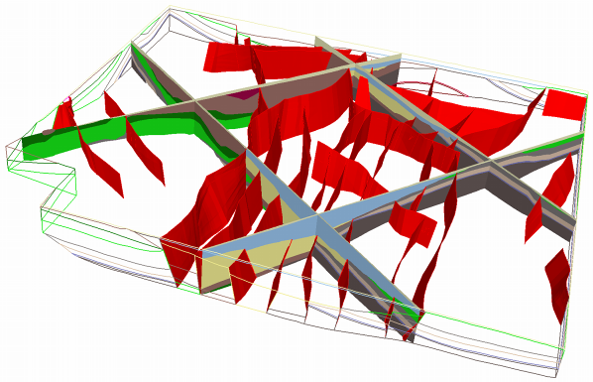
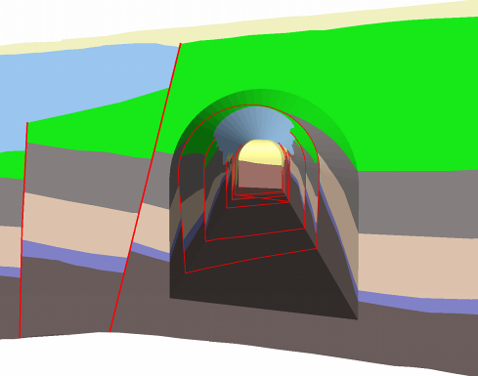
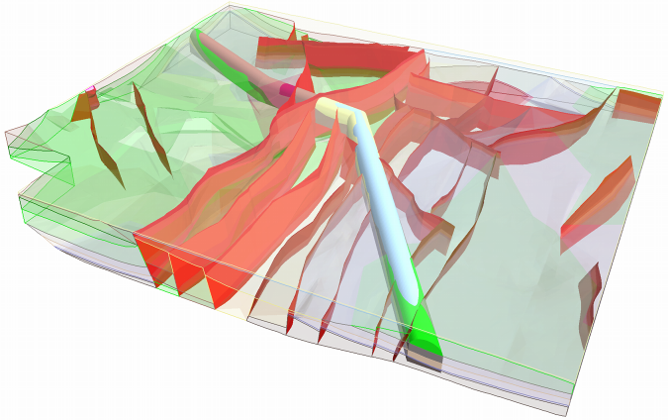
B
A
D
C
Visualization and analysis.(A)2×2 fence diagram. (B)Fence diagram with faults. (C)Virtual excavation on the model. (D) Virtual tunnel.

Slide 23
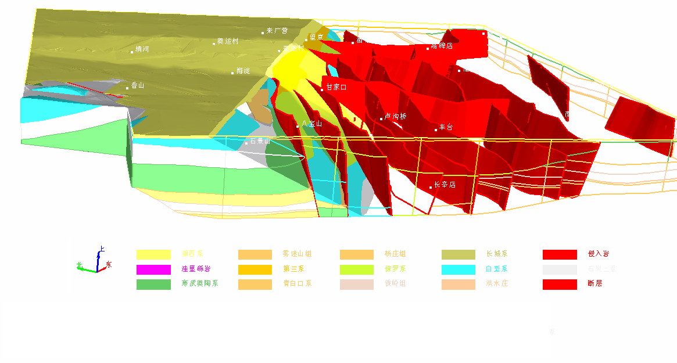
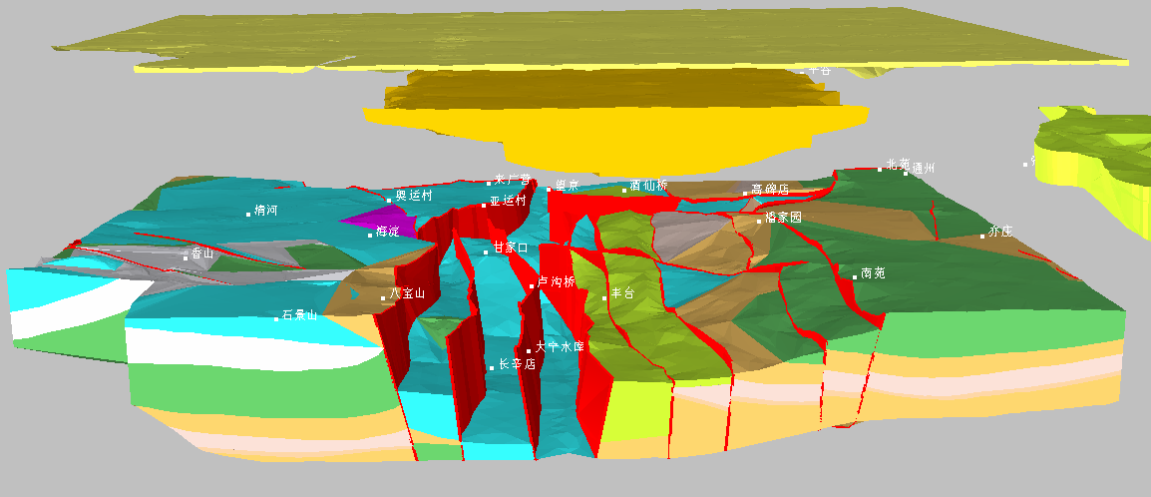
A
B
Visualization and analysis: (A) Model cutting. (B) Model extraction.

Slide 24
Cenozoic Erathem lithology models
Area: The plain area with about 6400 km².
Resolution: 1:100,000
Due to the difference of precision in source data , the Cenozoic model was divided into two parts to be constructed respectively. The first part, Quaternary, was constructed from intersecting cross-sections with topology, while the second part, Neogene and Paleogene system, was constructed from isopach maps.

Slide 25
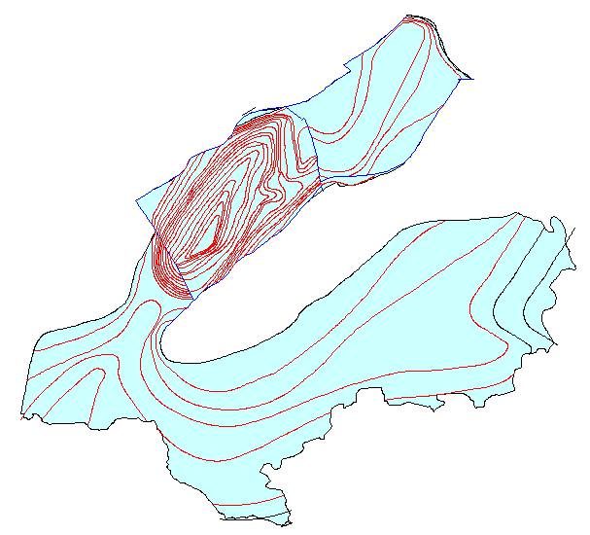
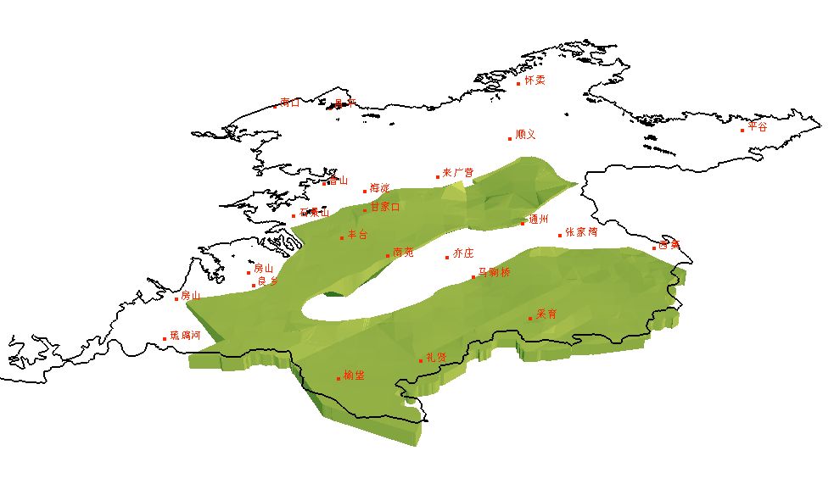
The distribution area and isopach map of Neogene system
3D models of Neogene system

Slide 26
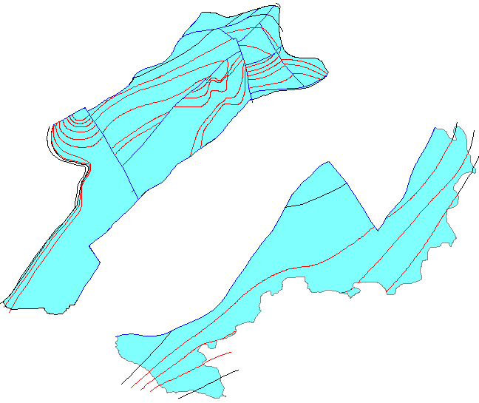
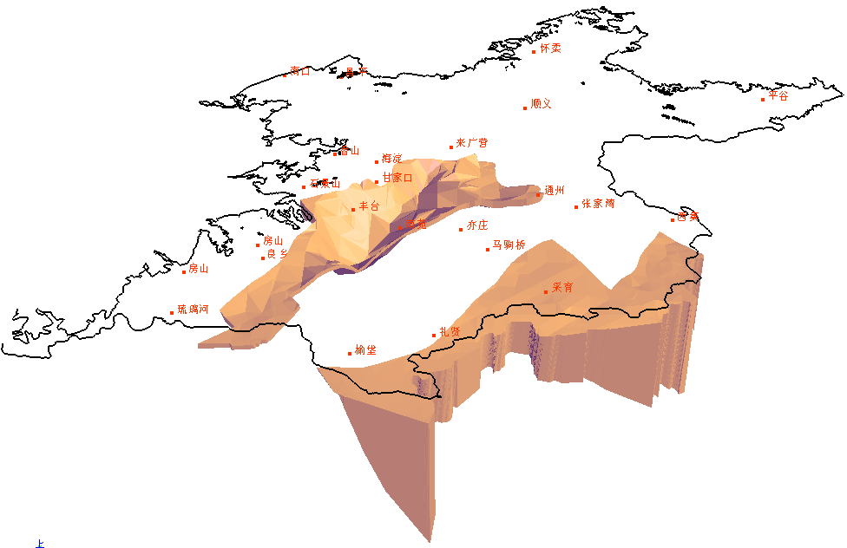
The distribution area and isopach map of Paleogene system
3D models of Paleogene system

Slide 27
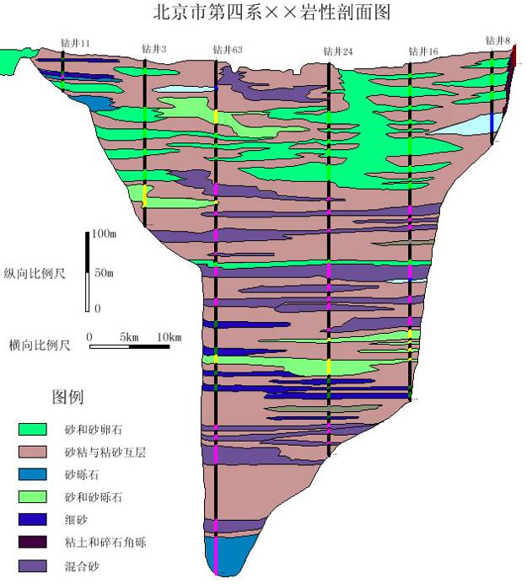
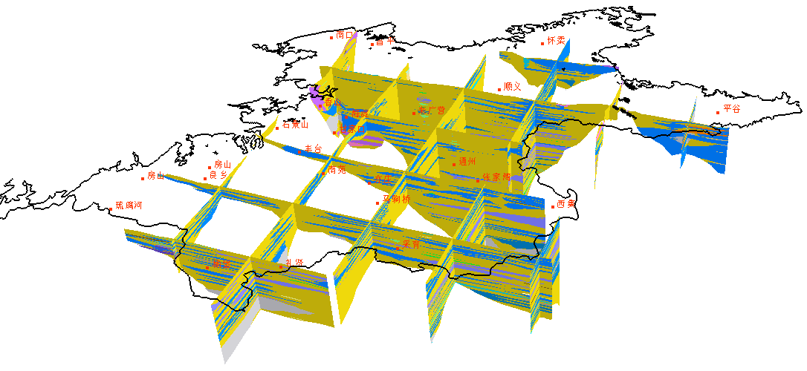
A lithologic cross-section
Layout map of 17 cross-sections of Quaternary System
Fence diagram of 17 cross-sections of Quaternary System

Slide 28
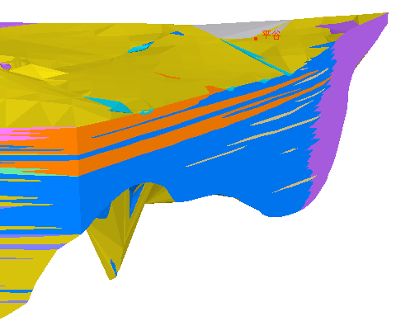
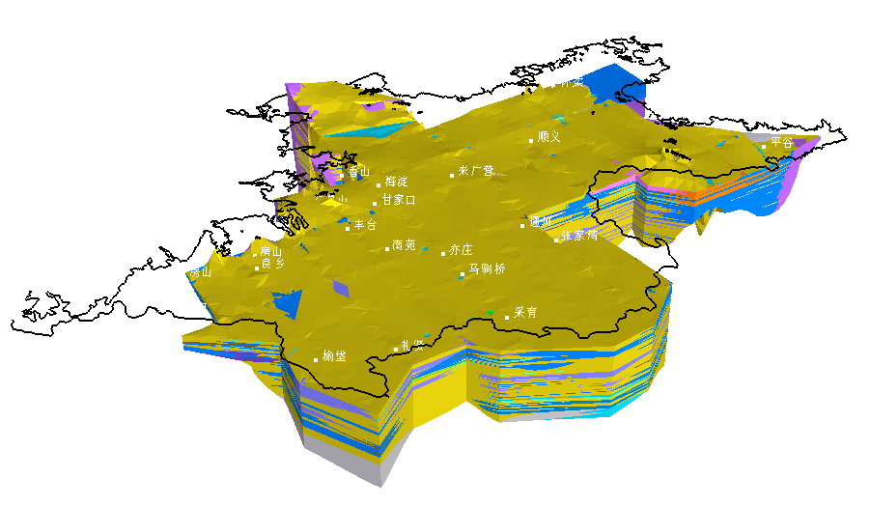
3D Quaternary System models
Notes:
Zoom in

Slide 29
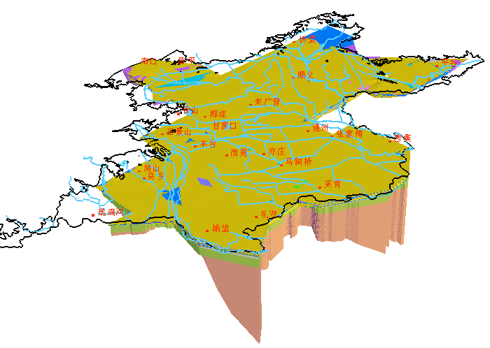
Integrated visualization of Quaternary, Neogene and Paleogene system.

Slide 30
Engineering geology models at the plain area
Area: 6400 km²
Depth: about 30~40m.
Resolution: 1:50,000~1:100,000
161 boreholes, 38 cross-sections

Slide 31
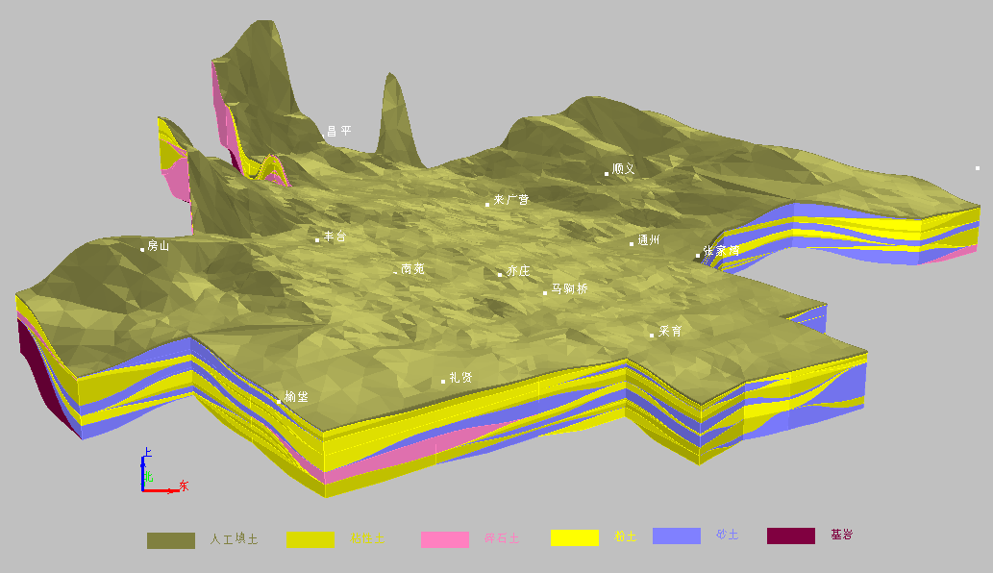
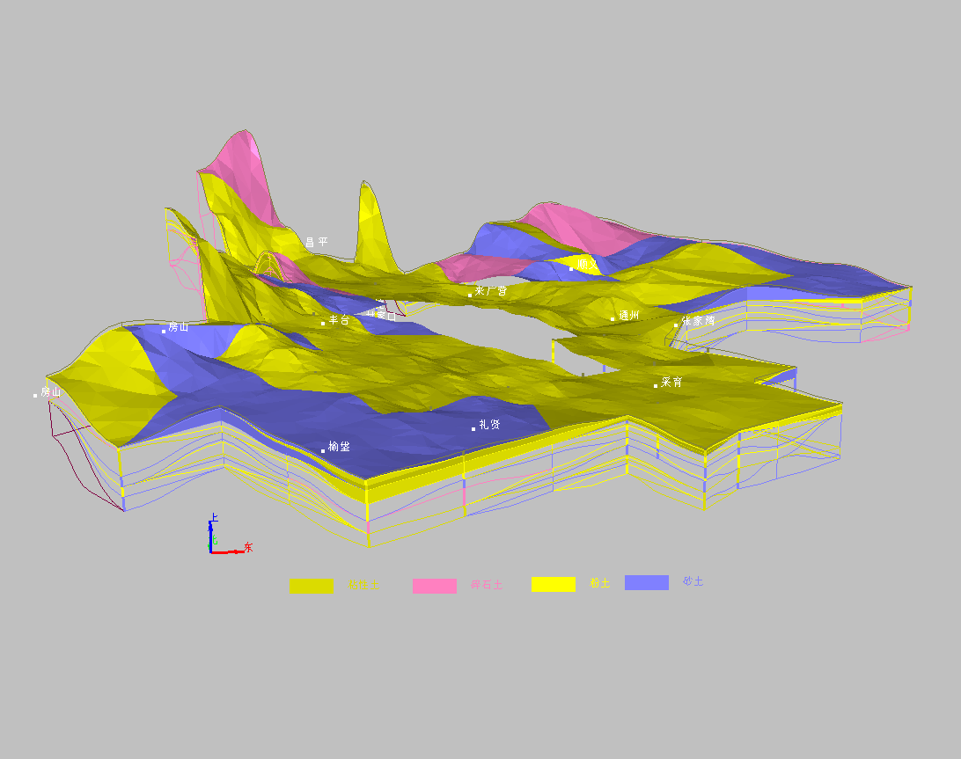
3D engineering geological models at the plain area
Several extracted interesting strata.

Slide 32
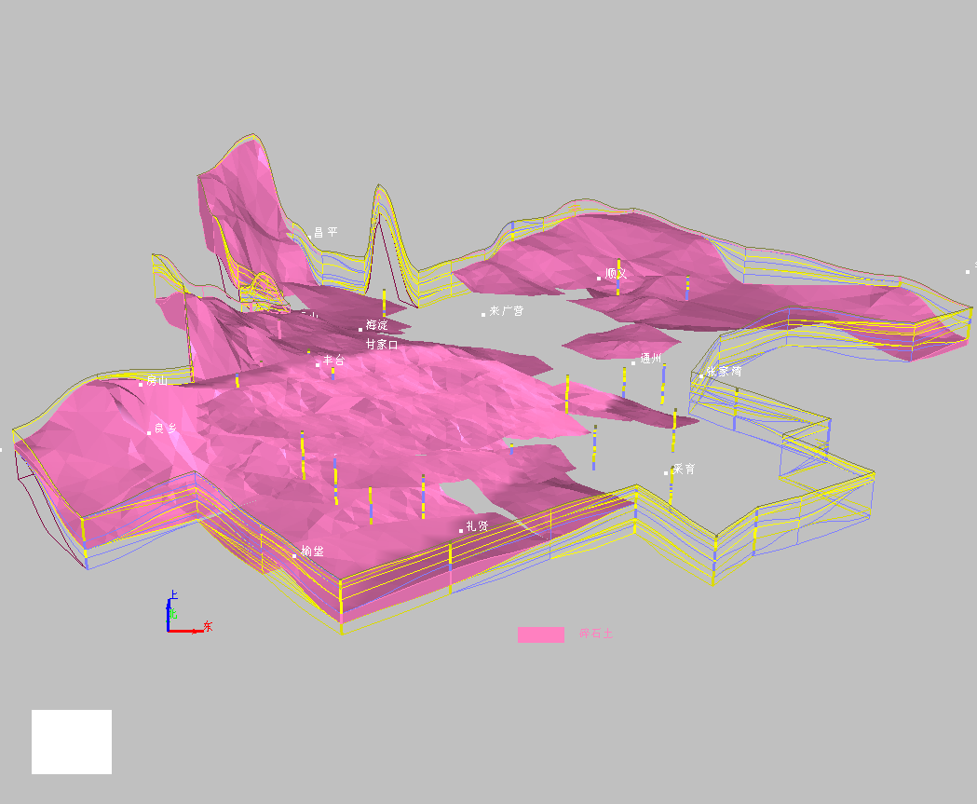
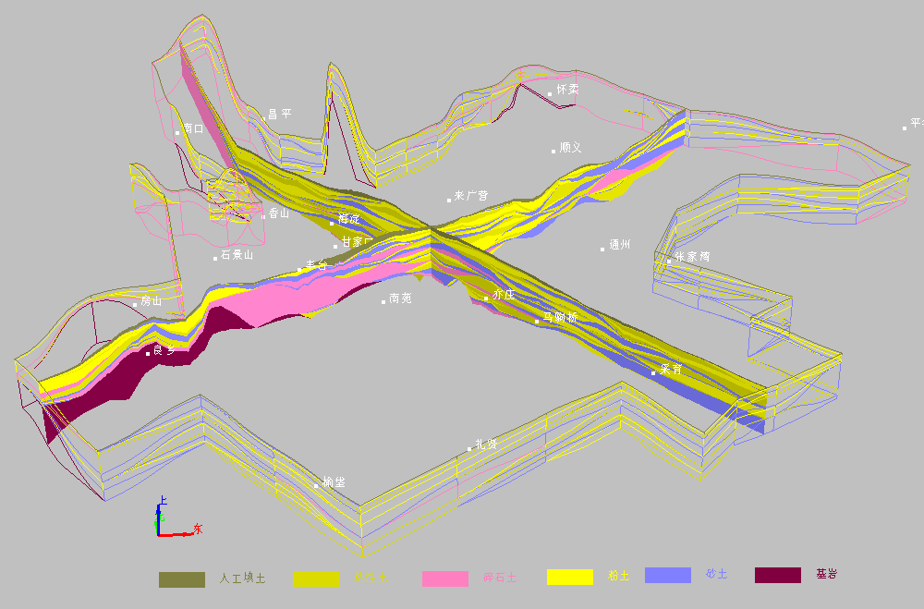
The distribution of soft soil stratum.
Two cross-sections cut along the interesting routes from the models.

Slide 33
Engineering geology models at Shunyi New Town
Area: 270 km²
Depth: 40~70m.
Resolution: 1:25,000
87 boreholes -> 45 cross-sections

Slide 34
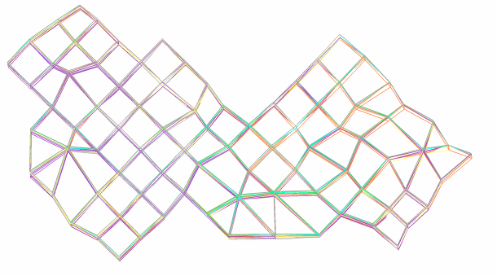
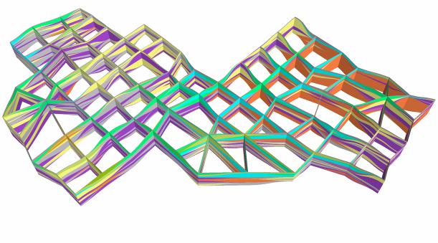
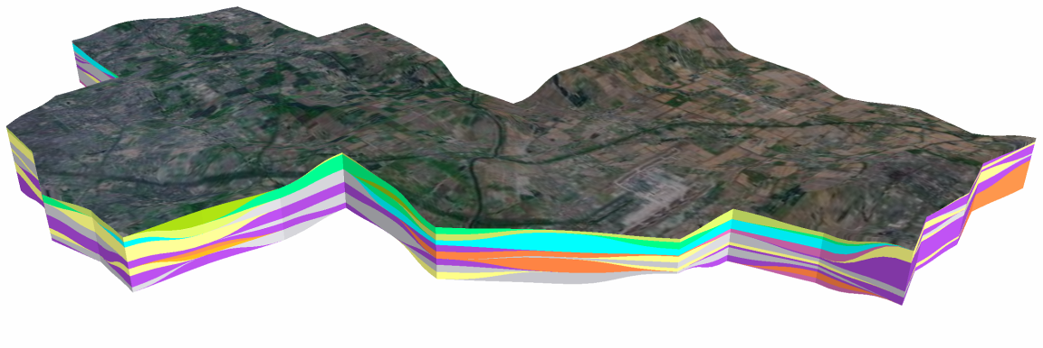
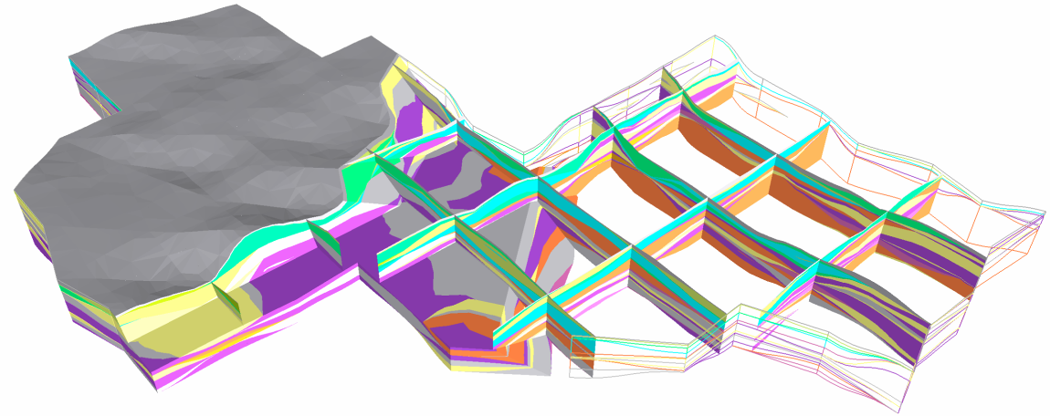
A
B
U
N
E
C
D
3D engineering geological model of Shunyi New Town. (A) Cross-sections (wire frame mode). (B) Cross-sections (color mode). (C) Whole model with Remote Sensing image. (D) Interior structure.
Notes:
Note: the vertical exaggerate coefficient stands for the scaling ratio of the vertical coordinate Z. Sometimes the horizontal extension of the model is much greater than its vertical extension, so the depth is exaggerated for better visualization.

Slide 35
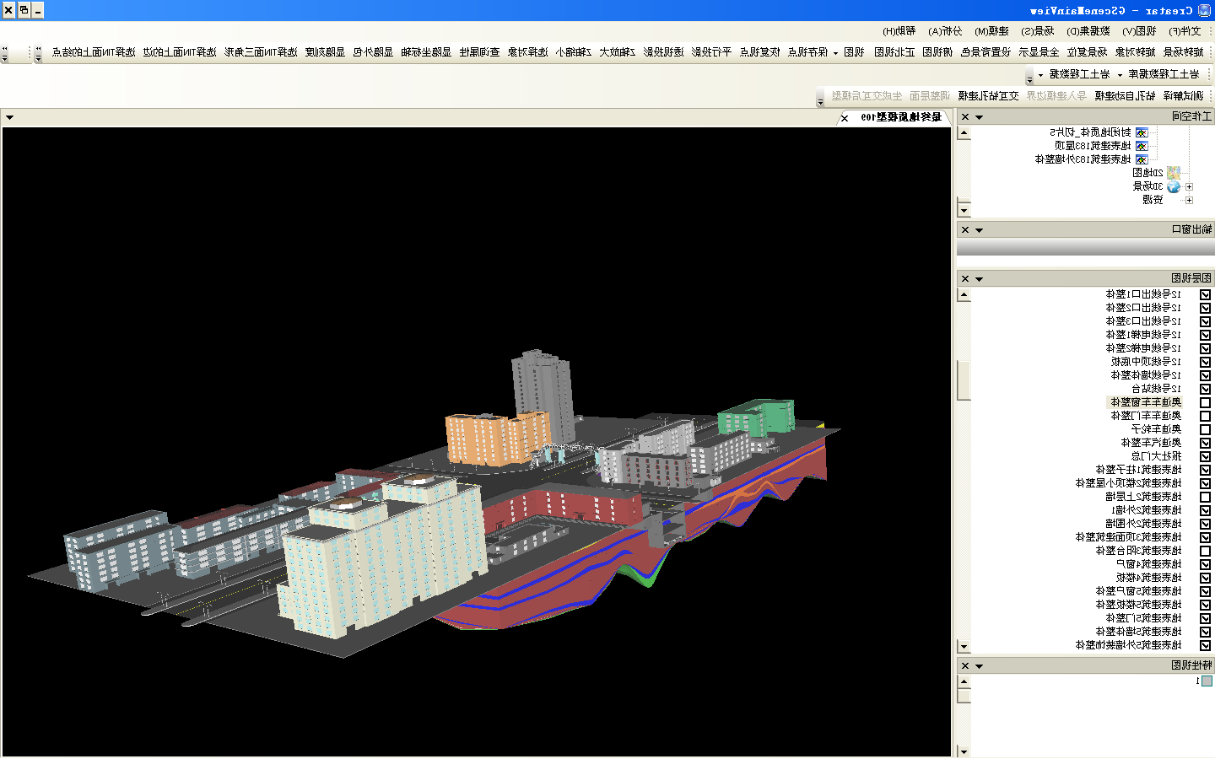
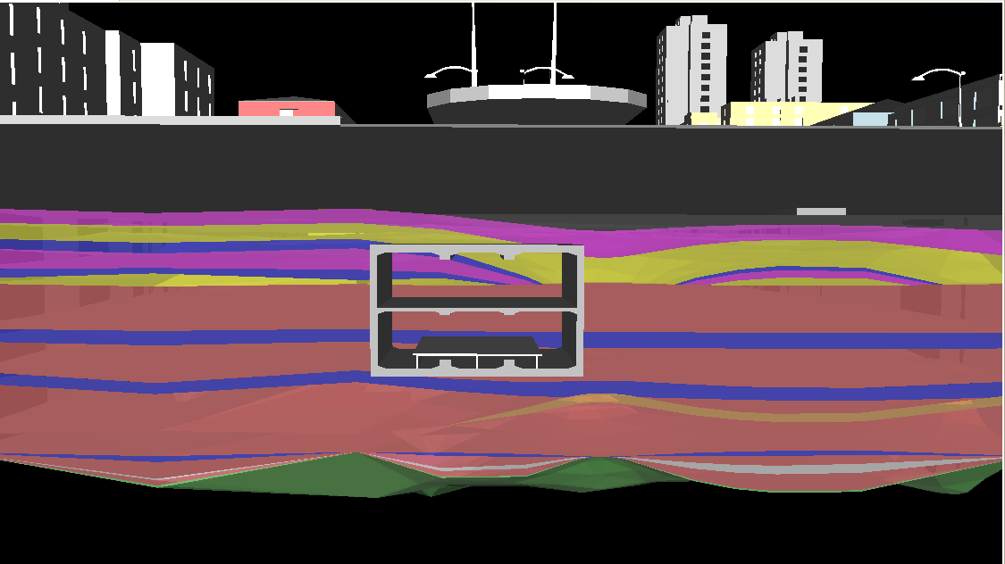
Integrated display of surficial and subsurficial models.
Integrated display of geological and subway station models.

Slide 36
3D in Urban Geology
Technological difficulty:
  Integration of underground and surface information including geological models, pipelines, buildings, etc.
  Massive data (high precision model) management and its publishing service.
  Efficient geomodel building and dynamic updating.

Slide 37
Thank you!
Honggang QU
qhonggang@mail.cgs.gov.cn

