Slide 1
An ISO 19115 based metadata profile for 3D geological models The approach of the German GSOs
104th OGC Technical Committee – GeoScience DWG session
Southampton, United Kingdom
Gerold Diepolder (LfU – Geological Survey)
14 September 2017

Slide 2
An ISO 19115 based metadata profile for 3D geological models
Definition
descriptive metadata: discovery and identification, → basis for a straightforward discovery and disclosure services,
structural metadata: internal setup & containers,
administrative metadata: information on access requirements and rules for dissemination & exploitation
Notes:
Definition: A metadata record is a file of information which captures the basic characteristics of a data or information resource

Slide 3
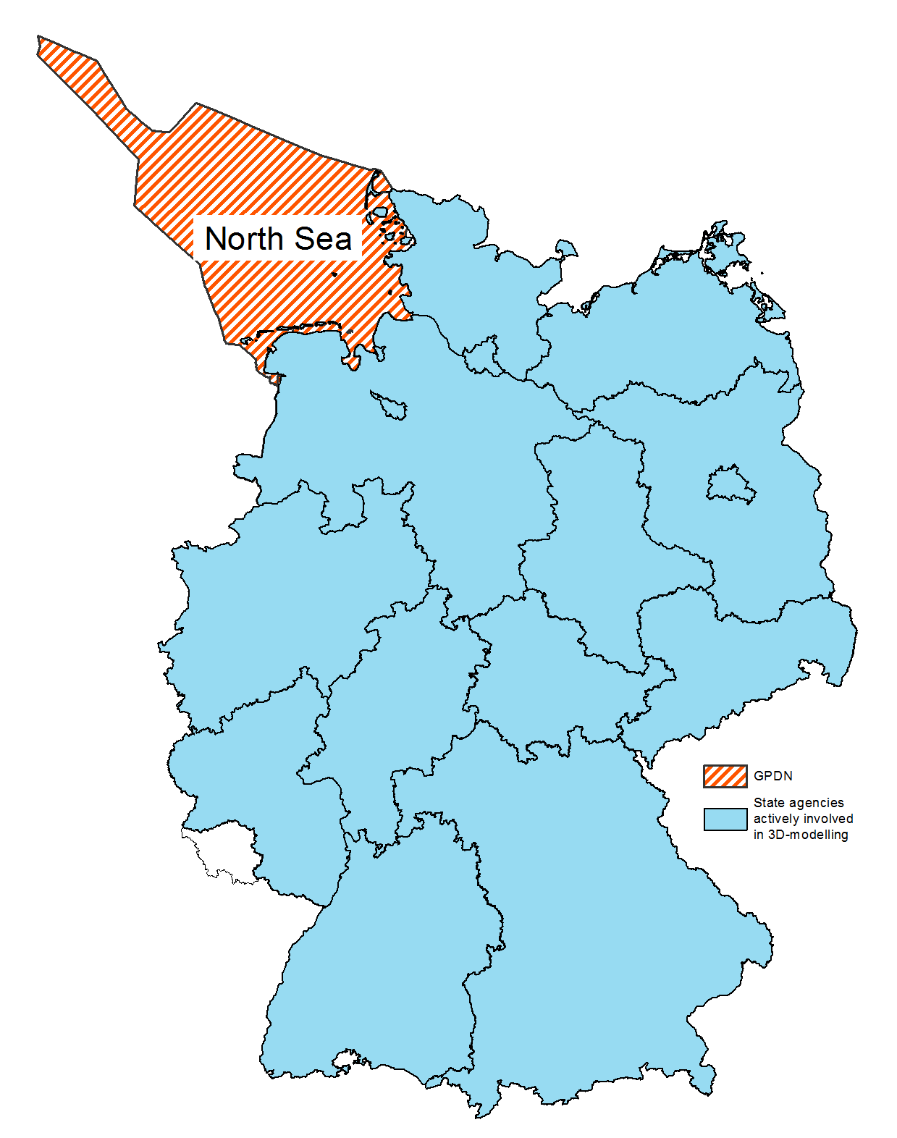
An ISO 19115 based metadata profile for 3D geological models
The federal situation (all GSOs have a regional mandate only)
15 State Geological Surveys
2 Federal Institutes
GPDN Consortium
GFZ + Universities
numerous 3D geomodels (local to regional)
made for different purposes and based on different source data
internal tools, only few disclosed, file based bilateral exchange
no common hub for discovery
mostly “private” model descriptions following internal stipulations
Notes:
Inducement

Slide 4
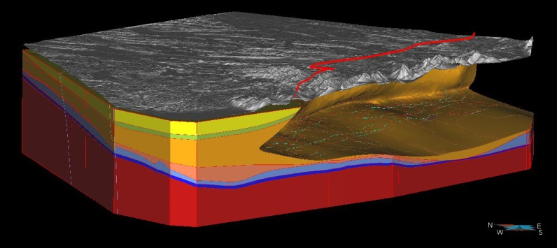
An ISO 19115 based metadata profile for 3D geological models
Demand for common metadata description, eventually allowing a hub for search & discovery by topic / area using established standard(s)
Select and see metadata
Drag a box and get info
Disclosed data:
tick and explore
Non-disclosed data:
Details of source of supply
Notes:
Objective

Slide 5
An ISO 19115 based metadata profile for 3D geological models
The pragmatic approach
Collocation & prioritization of what is deemed important to delineate a 3D geomodel properly (review of the “private” geomodel descriptions) → capturing the basic characteristics of the 3D resource
Mapping onto established standard(s) for objects that have an explicit or implicit geographic extent → ISO 19115 "Geographic Information – Metadata„
→ Fairly good match for the extent (2D) information and administrative metadata, but no 3D inherent issues are covered: vertical sequence of modelled units (volumes, surfaces, …)

Slide 6
An ISO 19115 based metadata profile for 3D geological models
Data set descriptions (metadata) conform to the ISO 19115 standard commonly are considered inadequate to describe the crucial characteristics inherent in a 3D geological model: the succession of lithostratigraphic units and the faults.
? Description of each modelled lithostratigraphic surface resp. unit separately – quasi as a stack of 2D maps
→ Disregards the coherent entity of 3D models and the topological interdependency of all model units therein → How to deal with faults?
? Using multiple stratum keywords to list the entire succession of lithostratigraphic units modelled
→ Empty words as long as not backed by a controlled vocabulary resp. a linked data thesaurus

Slide 7
An ISO 19115 based metadata profile for 3D geological models
Benefits of using stratum keywords linked to thesauri
→ No semantic harmonization required as lithostratigraphic vocabularies cover and relate regional terminologies !

Slide 8
An ISO 19115 based metadata profile for 3D geological models
Benefits of using stratum keywords linked to thesauri
Pooling of subunits can be illustrated easily using (responsive) PDF intermediates referring to true formations
Specifically 3D models
of the deep subsurface are based on seismic evidence. Seismic reflectors not always coincide with (litho)stratigraphic boundaries.
Lower to
Middle Jurassic

Slide 9
An ISO 19115 based metadata profile for 3D geological models
Two basic requirements
Lithostratigraphic vocabularies must be made fit for web services and the linked data requirements (RDF interface, etc.)
custodians of the pure science must be convinced to admit entries beyond the strict lithostratigraphic subdivision (group / subgroup / formation / member …) e.g. using the status “informal – 3D model unit”
Semantic harmonization through implementation of linked data controlled vocabularies is envisaged for GeoERA IP (WP4 led by GBA), core of a overall multilingual thesaurus ?? + European fault database (TNO) as “thesaurus” for principal faults ??

Slide 10
An ISO 19115 based metadata profile for 3D geological models
The concept “multiple keywords + linked data” is
applicable to many topics
Many linked data vocabularies are available:
Geoscience Vocabularies for Linked Data: http://resource.geosciml.org/
Research Vocabularies Australia https://vocabs.ands.org.au/
INSPIRE code list register: http://inspire.ec.europa.eu/codelist
& more
Notes:
Metadata Information Systems are responibility of the German states

Slide 11
An ISO 19115 based metadata profile for 3D geological models
Presently we are running practice tests.
Lessons learned soon.
Thank you for your attention

