Slide 1
Towards BIM with underground point clouds and geomodels
106th OGC Technical Committee, GeoScienceDWG session
Orléans, France
Thomas Dewez, Dept. Risks & Mitigation, BRGM
22 March 2018

Slide 2
Take home message
BIM requires knowledge of underground properties
BRGM is gathering momentum to meet the expectation
Use a generic API allowing to query geological model at any location and allowing to join point clouds and geomodels
Scalable approach to any BIM object, not just underground cavities

Slide 3
Context and opportunities
Geological urban models are a growing demand for urban development planning
Traditional borehole data are not ubiquitous
Cavities offer a unexploited glimpse of the geology
Orleans has >700 underground cavities on its territory
Many are former building stone quarries
Some are karstic caves
Cavity collapse is a high local hazard
Outside of surface observations and boreholes, geomodelling tools do not know what to do with 3D cavities

Slide 4
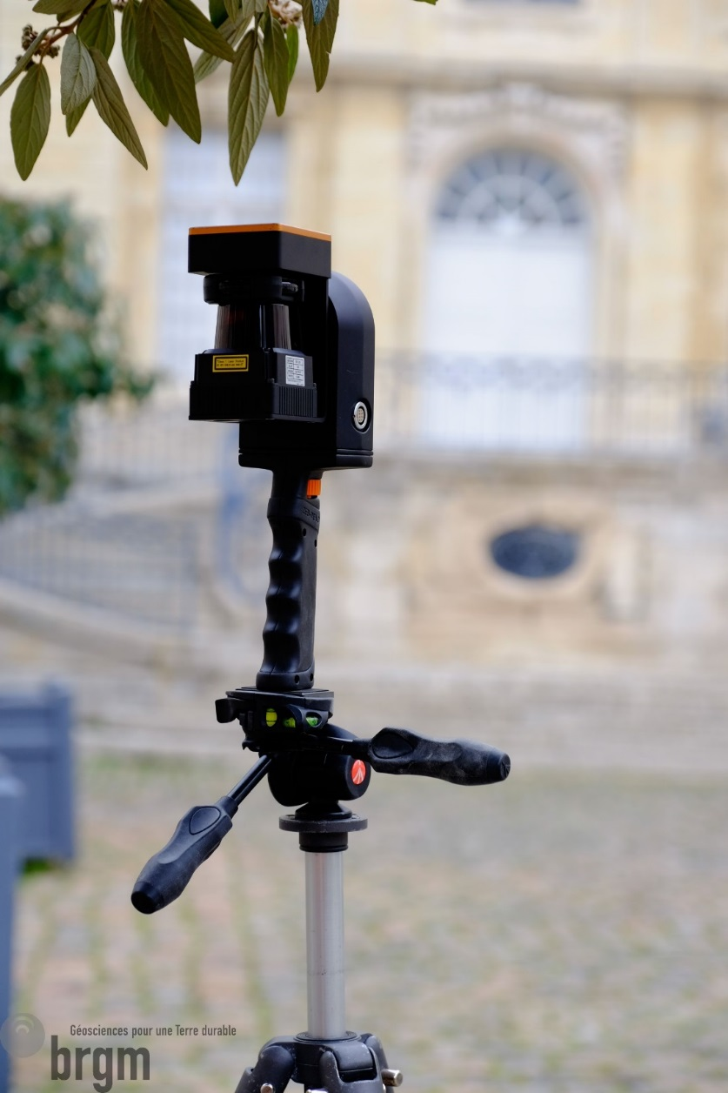
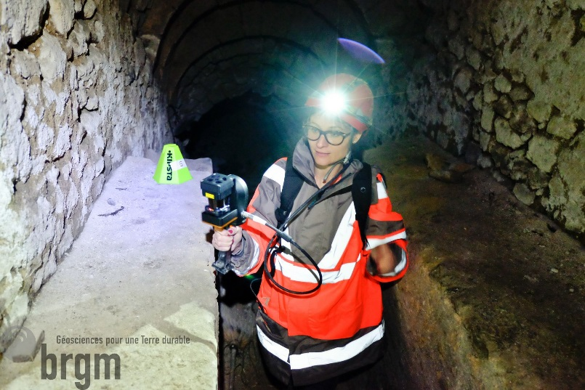
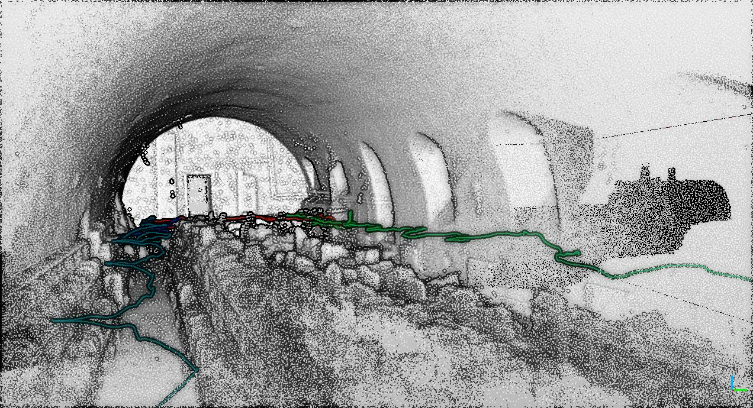
Underground mapping technology
Handheld laser scanner : What can a Zeb do for us?
GeoSLAM Zeb-Revo

Slide 5
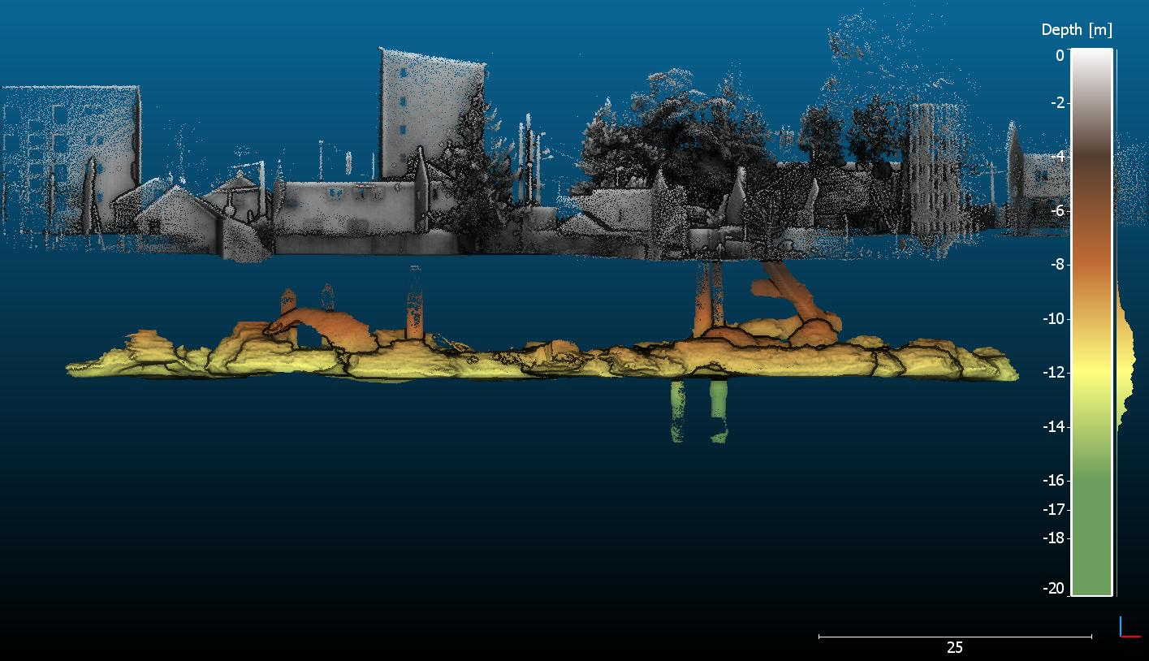
La Bordé quarry Orleans case study
Movie
Roof collapse
Ventilation shafts
Access staircase
Quarry between -9 and -14m below the ground

Slide 6
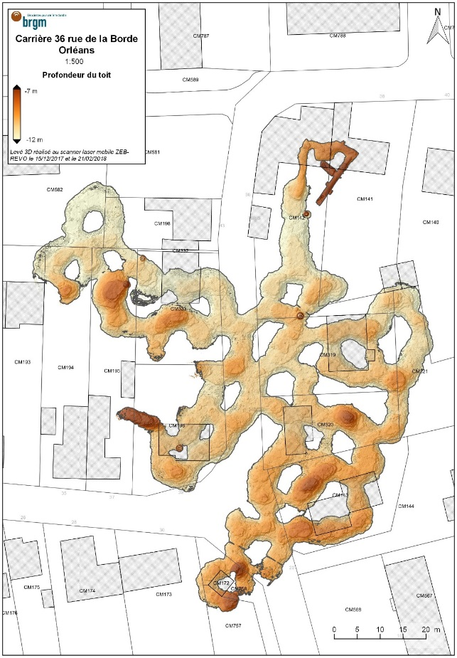
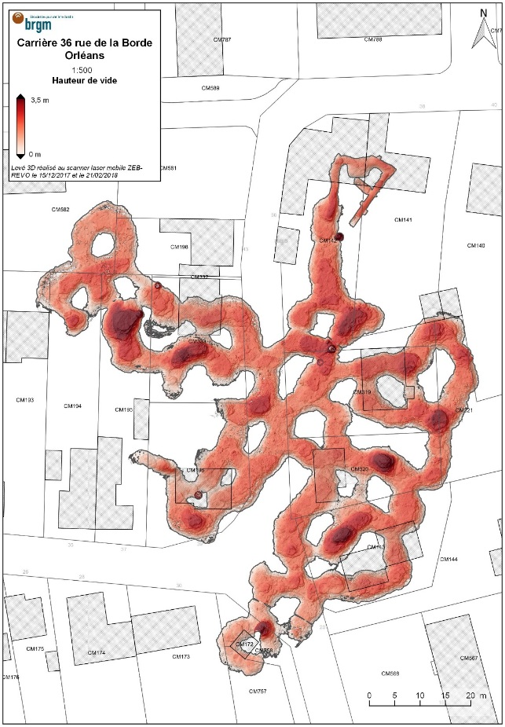
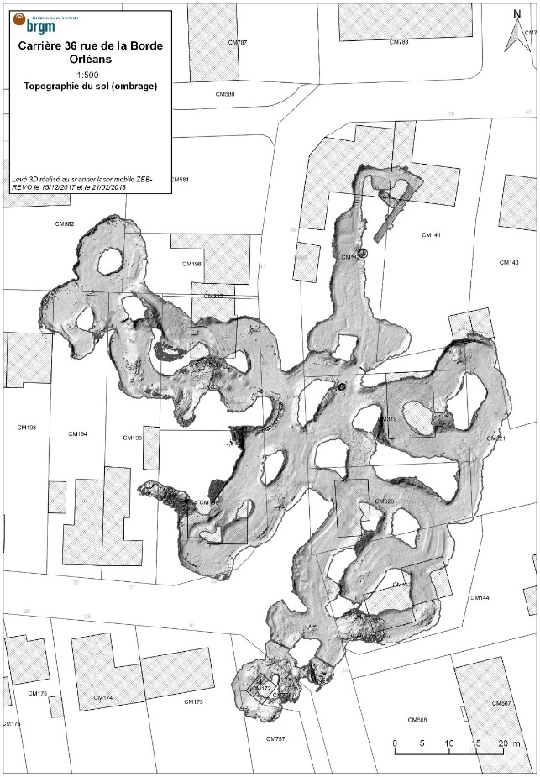
Survey characteristics
Product types:
Location maps of the cavity with respect to cadastre and surface assets
Thickness of overburden, floor to ceiling height (collapse susceptibility parameters)
Existing disorder (vault collapse, rubble piles)
Fragility features (bedding, fractures, …)
Overburden thickness
Gallery height
Floor topography

Slide 7
From point cloud to ground properties
To infer rock properties behind gallery walls > Geomodelling
Geomodelling tools expect sparse and discrete information
Based on geologist’s field note book, boreholes, geophysics
Typically less than 10’000 observation points with weak precision
Geological models do not expect voids
Creating interactions between ~100Mpts in 3D and geomodels is a challenge

Slide 8
Interactions between model and point clouds
Geomodels natively are represented & discretized by meshed grid (tetrahedra)
Point clouds needs meshing (not trivial – requires normals)
Meshing is solved at point cloud processing end
2 levels of interaction between 3D galleries and geomodel
Label gallery wall triangles with geological formation they lie in. Visualisation to confirm modelling hypothesis
Constrain geomodel with structural data extracted from the gallery point cloud geometry

Slide 9
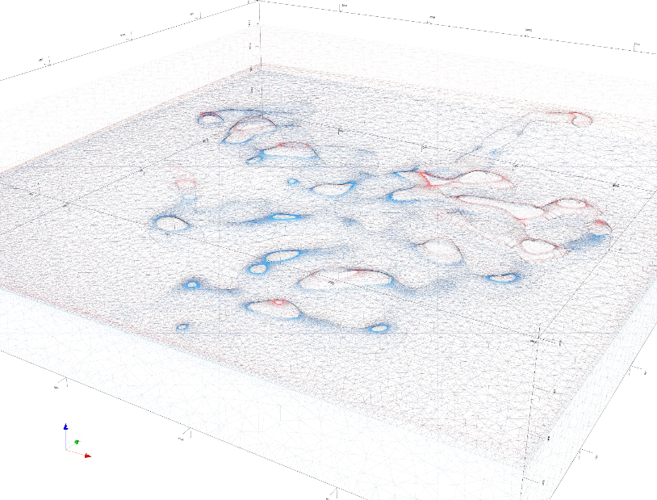
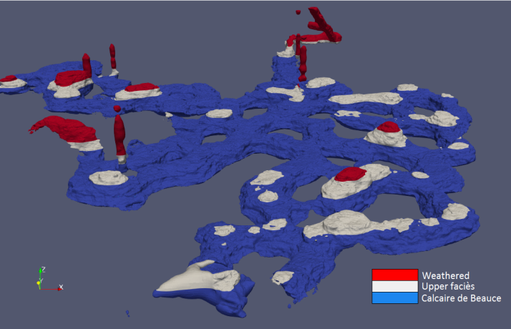
Level 1: Query model with gallery points
3D geomodel is created from scratch over the domain
3 horizontal layers at realistic depths
At point cloud end
Decimate point cloud
Mesh it for visu & carving holes into model
At geomodelling end
Generic SCUDDD API queries 2 predicates :
→In which layer is this point?
→ Does an interface split this triangle?
The SCUDDD generic query API is fully applicable to BIM points and faces

Slide 10
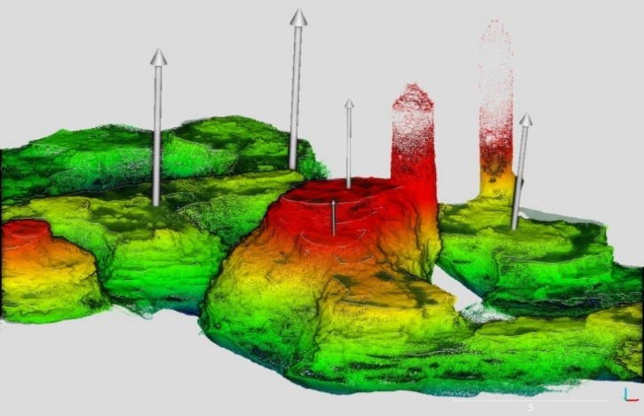
Level 2: Refine geomodel with cavity geometry
At point cloud end
Structural mapping tools (FACETS or COMPASS) are used to generate structural data objects as wkt (center XYZ, size, dip, strike)
At geomodelling end
Structural data is imposed as geopotential constraints
Structural data
Real la Bordé quarry structural data
Geomodel on a complexe geology

Slide 11
Implications for BIM
Geomodels can be turned into geotechnical models by adding rock properties on cells
Generic geomodel querry API concept readily applicable to foundation faces and vertices
Limit pressure p_{l}* (metric for foundations)
Weathered: 0.5 – 1 Mpa
Upper facies: 1.5 – 2.5 Mpa
Calcaire de Beauce: 4 Mpa

Slide 12
Aknowledgements
This work is a BRGM team effort bringing together experts in mapping, geotechnics, geomodelling, and local authorities
Geomodelling team
Cécile Allanic, Gabriel Courrioux, Simon Lopez
3D mapping team
Silvain Yart, Florian Masson, Thomas Dewez
Geotechnics
Gildas Noury
SCUDDD API
Christelle Loiselet, Christian Bellier, Simon Lopez, Gabriel Courioux
Local authorities (Orléans metropole)
Imed Ksibi

