Slide 1
GeoScience DWG Welcome
106th OGC Technical Committee - GeoScienceDWG session
Orléans, France
Mickaël BEAUFILS
22 March 2018

Slide 2
Agenda
8h30 – 10h15:
GeoScience DWG Welcome
IE news (~ the rest)
Borehole IE
3D-4D Model Discovery IE
10h45 – 12h30:
Presentation session
Exploring GeoScience DWG horizons

Slide 3
GeoScience DWG position
Main targets:
Harmonize geoscience data expression and facilitate usage
Stay connected and even propose enhancements to technologies / solutions
Connect people interested in the geoscience topic
Ensure proper connections with other groups / communities inside and outside OGC
Volcanology
Agriculture oriented WG
Technology oriented WG
Mineral
resources
Seismology
Soil
GeoScience DWG
Geology
Climate
oriented WG
City & infrastructure oriented WG
Mining
Oil & gas
Geophysics
Hydrology oriented WG
HydroGeology
Underground
constructions

Slide 4
Breaking news: we are not alone!
21/3 : Joint session with RDA ESES
https://www.rd-alliance.org/ig-earth-space-and-environmental-sciences-rda-11th-plenary-meeting
GeoScience DWG
Earth, Space, and Environmental Sciences
Interest Group
More groups here

Slide 5
Presentation session trailer
Exploring GeoScienceDWG horizons
Volcanology
BIM and Geomodelling (Mickaël Beaufils - BRGM)
LIDAR and Geomodelling (Thomas Dewez - BRGM)
Seismology (Aurelien Dupont - EMSC)
Volcanology (Jean-Marie Saurel – IPGP)
Mining (Andrew Scott - GMSG)
Soil (Josh Liebermann - Tumbling Walls LLC)
AstroGeoScience (Mark Hunter - USGS)
Mineral
resources
Seismology
Soil
WP8
Geology
Oil & gas
WP11
Mining
Geophysics
HydroGeology
Underground
constructions

Slide 6
Interoperability Experiments reminder
Borehole Interoperability Experiment targeting a common Borehole conceptual model
Borehole is a core concept in geoscience
Several existing standards
Cross-countries initiatives on the run to push standard usage (EPOS, …)
3D-4D model discovery Interoperability Experiment targeting definition of metadata for 3D-4D models
3D-4D model standardization is not so advanced
“No consensus of 3D-4D model definition”
Have to make 3D-4D models at least findable
Cross-countries initiatives on the run to push standard usage (EPOS, OneGeology, …)

Slide 7
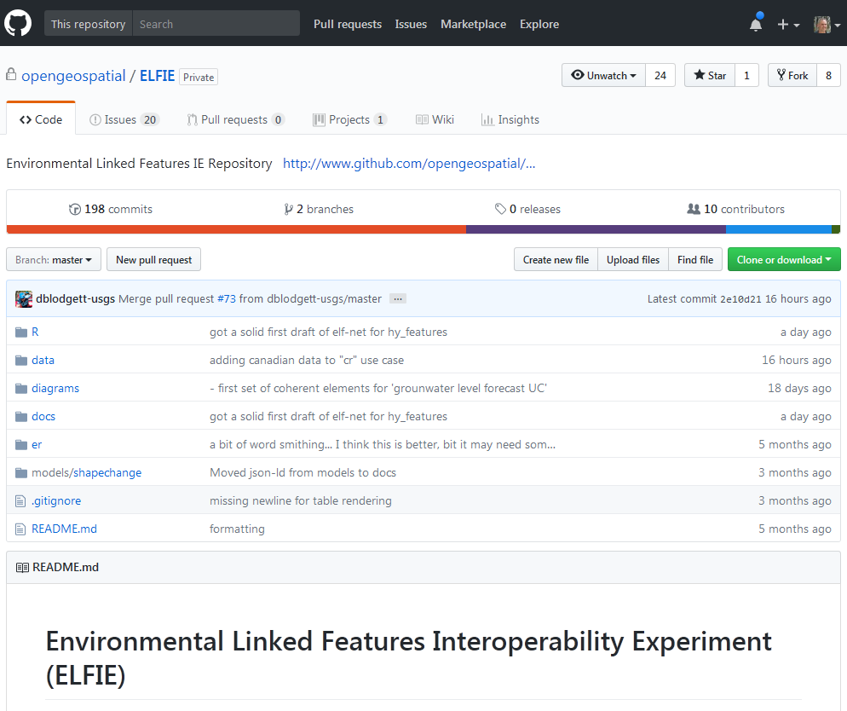
Another IE driven by the GeoScience community
Environmental Linked Features IE (ELFIE)
‘Demonstrate the use of existing and pending OGC standards for the encoding of environmental observation data in an integrated dataset of features linked according to ReSTful and Linked Data principles.’
From: https://github.com/opengeospatial/ELFIE
Initiators:
U.S. Geological Survey (US)
Land Information New Zealand (NZ)
BRGM (FR)
Participants
Tumbling Walls and Dewberry (US)
Meta-linkage (AU)
INSPIRE (EU)
Natural Resources Canada (CA)
Manaaki Whenua and Horizons Regional Council (NZ)

Slide 8
Interoperability Experiments Status
E
Environmental Linked Features IE
Charter
OAB
Review
B
Borehole IE
M
M
3D-4D Model Discovery IE
Startup
Preparation
Execution
Wrap-up &
Reporting
Letters of
Participation
Intent
B
Kickoff
E
Initiator
Agreement(s)
Draft IE
Reports
IE
Reports
Participant
Agreement(s)
NB: 1 IE ~ 1 year

Slide 9
Interoperability Experiment todo list
M
E
Environmental Linked Features IE
Write charter
Submit charter to OAB
Have OAB validation
Startup preparation phase (> 30 days)
2 OGC Press Releases ($)
Announcing IE content, kickoff date
30-day Participant Notification period starts
Interested organizations submit Letter of Participation Intent to OGC
By Kickoff date, all participating org’s must submit a signed Participant Agreement
Kickoff requirements:
30-day Participant Notification period finished
Initiator and participant agreements signed
Do the job!
Write report(s)
B
Borehole IE
M
3D-4D Model Discovery IE
B
E

Slide 10
Interoperability Experiment todo list
M
E
Environmental Linked Features IE
Write charter
Submit charter to OAB
Have OAB validation
Startup preparation phase (> 30 days)
2 OGC Press Releases ($)
Announcing IE content, kickoff date
30-day Participant Notification period starts
Interested organizations submit Letter of Participation Intent to OGC
By Kickoff date, all participating org’s must submit a signed Participant Agreement
Kickoff requirements:
30-day Participant Notification period finished
Initiator and participant agreements signed
Do the job!
Write report(s)
B
Borehole IE
M
3D-4D Model Discovery IE
B
E
NB: 1 IE ~ 1 year

Slide 11
Interoperability Experiments
Borehole Interoperability Experiment
Charter link: https://docs.google.com/document/d/1H4A5tGM4rKyHunLqeJXPZrqHX4Ya-H-5zhtFrKLQ1mQ/edit
3D-4D model discovery Interoperability Experiment
Charter link: https://docs.google.com/document/d/1jX5opnv2twVPR8KSO9Ox2u8TIBskv1UCp2OxuQhNWJ0/edit

Slide 12
Presentation session
Exploring GeoScienceDWG horizons
Volcanology
BIM and Geomodelling (Mickaël Beaufils - BRGM)
LIDAR and Geomodelling (Thomas Dewez - BRGM)
Seismology (Aurelien Dupont - EMSC)
Volcanology (Jean-Marie Saurel – IPGP)
Mining (Andrew Scott - GMSG)
Soil (Josh Liebermann - Tumbling Walls LLC)
AstroGeoScience (Mark Hunter - USGS)
Mineral
resources
Seismology
Soil
WP8
Geology
Oil & gas
WP11
Mining
Geophysics
HydroGeology
Underground
constructions

