Slide 1
Borehole update: simpleFeature exchange, conceptual UML model
104th OGC Technical Committee – GeoScience DWG session
Southampton, United Kingdom
Sylvain Grellet - BRGM
GeoSciML DWG - 12 September 2017

Slide 2
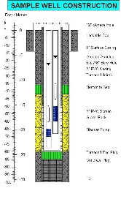
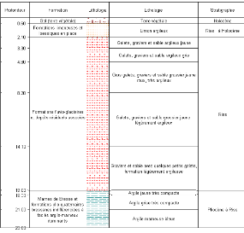
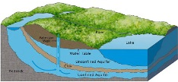
Borehole in EPOS – Model View
Env. Monitoring Facility
environmentalMonitoringFacility
hasObservation
Construction
details
Observations
construction
Borehole
attachedTo
relatedMonitoringFeature
featureOfInterest
relatedObservation
featureOfInterest
Observations / logs
Geology / HydroGeology
xx

Slide 3
Borehole in EPOS – Resource View
Env. Monitoring Facility
URI
URI
Construction
details
Observations
URI
Borehole
URI
URI
URI
URI
URI
Observations / logs
Geology / HydroGeology
URI

Slide 4
Using BoreholeView as an EU Index and shortcut to national data flows
detailedDescription -> (URI)
BoreholeIView
groundWaterLevel, groundWaterChemistry, … -> (URI)
gsmlp:identifier-> (URI)
Env. Monitoring Facility
URI
URI
Construction
details
Observations
URI
Borehole
URI
URI
URI
URI
gsmlp:geophysicalLogs
gsmlp:geologicalDescription -> (URI)
URI
Observations / logs
Geology / HydroGeology
URI

Slide 5
EPOS Borehole View
EPOS Borehole conceptual model

Slide 6
EPOS BoreholeView
GeoSciML BoreholeView with Stronger typing (ex : gml:ReferenceType for vocabularies,…)
Adding extra attributes (esp. to support reference to the complex flows)
Ex instance

Slide 7
EPOS BoreholeView

Slide 8
EPOS BoreholeView – use
BoreholeView
gsmlp:identifier-> (URI)
Borehole
gml:identifier SHALL contain a unique identifier for this BoreholeView representation
gsmlp:identifier SHOULD resolve to an internationnaly agreed complexFeature representation of a Borehole (e.g : Inspire Geology, GeoSciML,…)
…

Slide 9
EPOS BoreholeView – use
BoreholeView
groundWaterLevel -> (URI)
Env. Monitoring Facility
URI
Observations
Borehole
…
URI
URI
…
…
…
URI
Geology / HydroGeology
Tested Implementation
Environmental Monitoring Facility provided according to INSPIRE EF theme
groundWaterLevel provided either using OGC:WaterML2.0 and/or INSPIRE:PointTimeSeries
HydroGeology feature provided according to GWML2 and/or INSPIRE:Geology:HydroGeology
…

Slide 10
EPOS BoreholeView – use
BoreholeIView
Borehole
…
gsmlp:geologicalDescription
-> (URI)
URI
URI
Observations / logs
Tested Implementation
geologicalDescription (log) provided using GWML2:GW_GeologyLogCoverage
…

Slide 11
EPOS BoreholeView – feeding the index
Each institution maintains its Borehole BoreholeView (SF-0) service and underlying complexFeature flows
Only SF-0 flows are harvested at EU level
The index is up-to-date thanks to a pub/sub approach
BoreholeIView
Geoportals
(EPOS, INSPIRE, ...)
Pub/Sub
…

Slide 12
EPOS BoreholeView – Conclusions
Exposing summary Information (SF-0) is easier/faster than complex Feature
Allows to add more data providers
Harvesting simpleFeature is more reasonable than complex Feature
WFS on complexFeature is not meant/suited to synchronize millions of instances !
Harvesting a ‘Borehole vCard’ just for discovery makes more sense
The Borehole index in turns points to National data flows
With respect to INSPIRE semantics
SF-0 just here to support discovery

Slide 13
EPOS BoreholeView – Conclusions
Data provider
So far: BRGM, GEUS, ISPRA, UU-SE
Coming: BGS, GSI, GFZ, CGS, GeoZS
Add more EU geological surveys and research partners
IT
EU Borehole Index entries now around 3 Million (this will grow)
Need for faster WFS : Studying connexion of GeoServer app-schema with Sol’R index
Having the index indexed by search engines
Exposing its content in (Geo)JSON-LD
Where is the reference ontology we could point to

Slide 14
EPOS Borehole View
EPOS Borehole conceptual model

Slide 15
EPOS Borehole conceptual model
To define what should be retrieved from national complexFeature flows
agree on the semantic
Bridging the gap between standards
=> Map to pre-existing standards (GeoSciML 4.1, GWML2, BoreholeML, INSPIRE:GE)

Slide 16
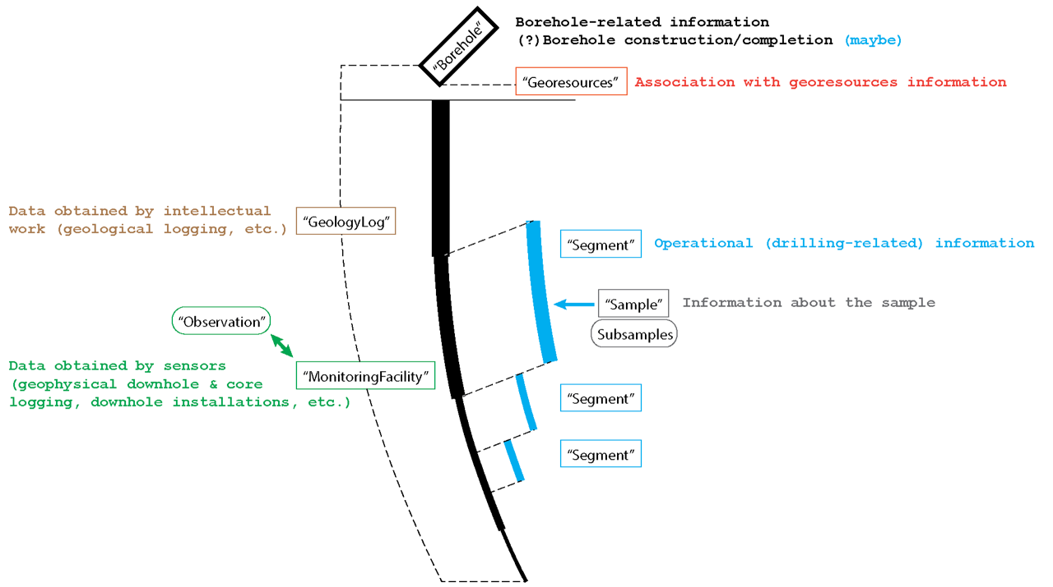
EPOS Borehole conceptual model

Slide 17
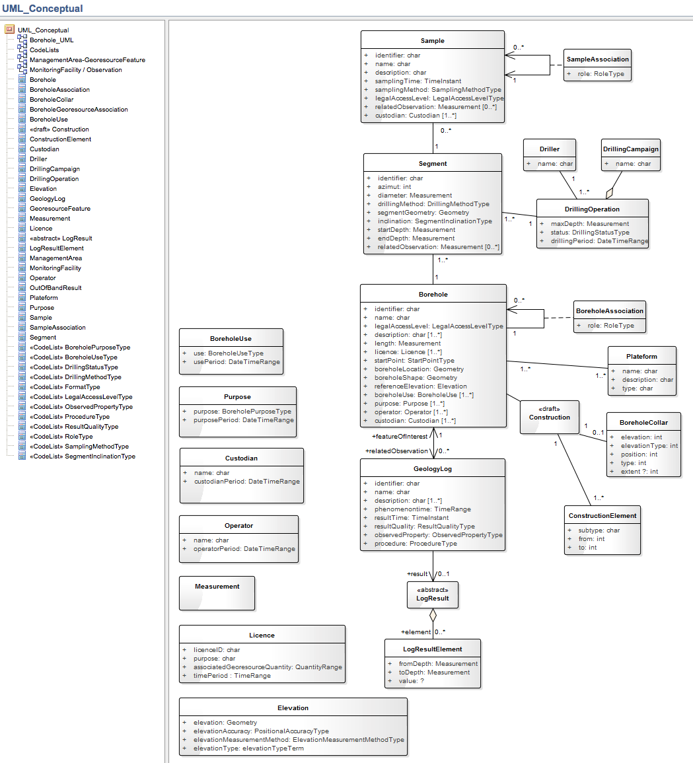
EPOS Borehole conceptual model

Slide 18
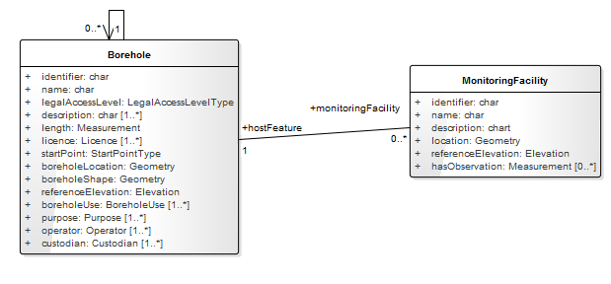
EPOS Borehole conceptual model

Slide 19
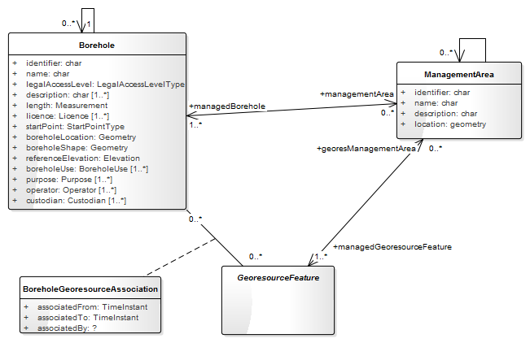
EPOS Borehole conceptual model

Slide 20
EPOS Borehole conceptual model – next steps
Finish first version of conceptual UML model
90% done. Only GWML2 mapping missing
Share it with OGC SWGs (GeoSciML, GWML) for feedback
Decide on logical model for implementation, then services and code lists
Logical models
Within OGC : GeoSciML4.1 / GWML2 overlap on this.
Maybe some clarification is needed
Implement

Slide 21
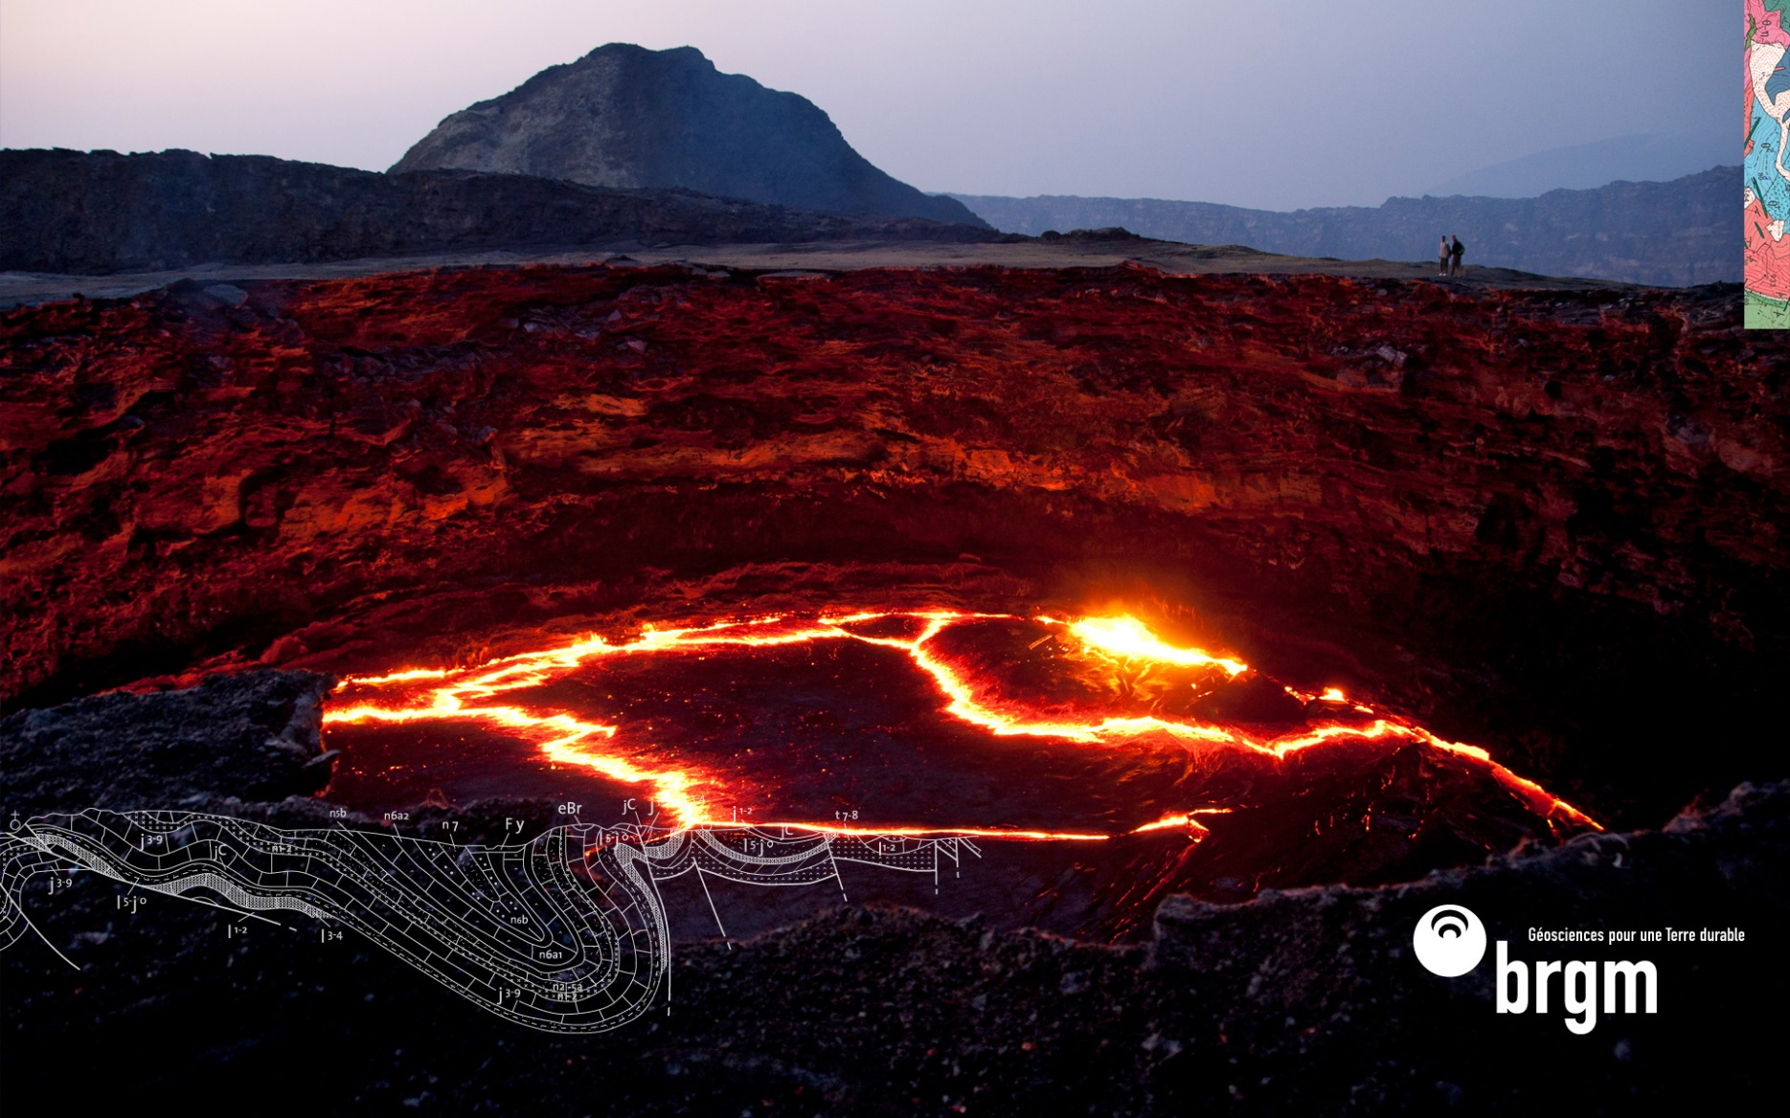
Thanks
s.grellet@brgm.fr

