Slide 1
GWML 2.0
Eric Boisvert and GWML SWG team

Slide 2
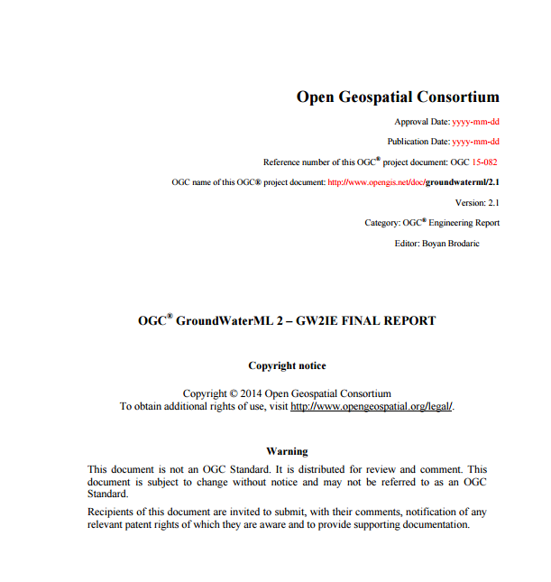
GWIE report

Slide 3
Proposed Groundwater SWG
The Hydrology DWG recommends that the OGC Technical Committee approve the formation of a “GroundWater Standards Working Group“ to submit a “GroundWaterML2” via the RFC process
A RFC Submission Team will be formed, a charter of the SWG will be developed and discussed at the HydroDWG workshop, Orléans 20-24 Sep. The SWG charter will be finalised and sent to TC for approval by an electronic vote in October 2015.
Pending final edits and review by OGC staff
Motion: Bruce Simons, CSIRO
Second: Alistair Ritchie, Landcare Research
The vote was passed with unanimous consent
Objective of the SWG is to progress the groundwater conceptual model and GWML2 XML encoding to the state of an adopted OGC standard

Slide 4
GWIE 2
Model built as a interop experiment
Use cases
Commercial
This use-case involves identifying the location and properties of water wells, to inform drillers and the public about local environmental conditions
Policy
This use case involves the delivery of groundwater quantity information required for water management reporting purposes.
Environmental
This use case involves serving the appropriate groundwater information to allow environmental managers, water managers and legislators to assess the risks to GDEs.
Scientific
This use case involves the delivery of information required to help determine the flow of groundwater within a particular terrain, likely for input into a computational flow modeling software.
Technologic
This use case involves using the schema as a canonical structure into which heterogeneous ground-water data formats are transformed.

Slide 5
GWML 2.0
Five packages
Nucleus (hydrogeological units, groundwater properties, Fluid body)
Constituent (biological, material, chemical)– FOI of OM_Observation
Flow (flow model from one interface to another one)
Well
Well construction (construction elements of a well, includes Borehole)

Slide 6
Hydrogeologic units
Notes:
You may think, it’s just one class, but this class brings a lot of baggage. Those vocab were created as replacement of subtyping. We subtype

Slide 7
GeoSciML relation
<gsml:relatedFeature>
<gsml:GeologicFeatureRelation gml:id="host1">
<gsml:relationship xlink:href="&gwvoc;/def/relationshipRoles/aquiferGeologicalHosting" xlink:title="Host"/>
<gsml:sourceRole xlink:href="&gwvoc;/def/relationshipRoles/aquifer" xlink:title="aquifer"/>
<gsml:targetRole xlink:href="&gwvoc;/def/relationshipRoles/hostGeologicUnit" xlink:title="aquiferHost"/>
<gsml:relatedFeature xlink:href="http://weblex.nrcan.gc.ca/ws/lexrest.svc/lithobyid/GSCC00053013643.xml" xlink:title="Shefford sandstone"/>
</gsml:GeologicFeatureRelation>
</gsml:relatedFeature>
<gsml:relatedFeature>
<gsml:GeologicFeatureRelation gml:id="host2">
<gsml:relationship xlink:href="&gwvoc;/def/relationshipRoles/aquiferGeologicalHosting" xlink:title="Host"/>
<gsml:sourceRole xlink:href="&gwvoc;/def/relationshipRoles/aquifer" xlink:title="aquifer"/>
<gsml:targetRole xlink:href="&gwvoc;/def/relationshipRoles/hostGeologicUnit" xlink:title="aquiferHost"/>
<gsml:relatedFeature xlink:href="http://weblex.nrcan.gc.ca/ws/lexrest.svc/lithobyid/GSCC00053011797.xml" xlink:title="Philipsburg Group"/>
</gsml:GeologicFeatureRelation>
</gsml:relatedFeature>

Slide 8
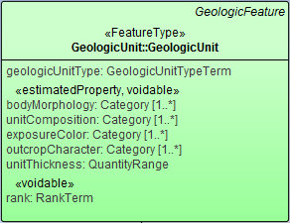
Question
http://resource.geosciml.org/vocabulary/cgi/201211/geologicunittype.html
No hydrogeologicunit

Slide 9
Wells
Notes:
GW has its own Borehole

Slide 10
Geologic Log
<gww:element>
<gww:LogValue>
<gww:fromDepth>
<swe:Quantity>
<swe:uom xlink:href="&meter;" xlink:title="m"/>
<swe:value>9.14</swe:value>
</swe:Quantity>
</gww:fromDepth>
<gww:toDepth>
<swe:Quantity>
<swe:uom xlink:href="&meter;" xlink:title="m"/>
<swe:value>11.58</swe:value>
</swe:Quantity>
</gww:toDepth>
<gww:value>
<swe:DataRecord definition="http://www.opengis.net/def/gwml/2.0/datarecord/earthMaterial" id="le.4">
<swe:field name="lithology">
<swe:Category definition="http://www.opengis.net/def/gwml/2.0/observedProperty/earthMaterial">
<swe:codeSpace xlink:href="http://resource.geosciml.org/classifierscheme/cgi/201211/simplelithology" xlink:title="Simple lithology"/>
<swe:value>Gravel</swe:value>
</swe:Category>
</swe:field>
</swe:DataRecord>
</gww:value>
</gww:LogValue>
</gww:element>
Notes:
Based on coverage

Slide 11
SWE Common Log
From
To
Column definition
From
To
From
To

Slide 13
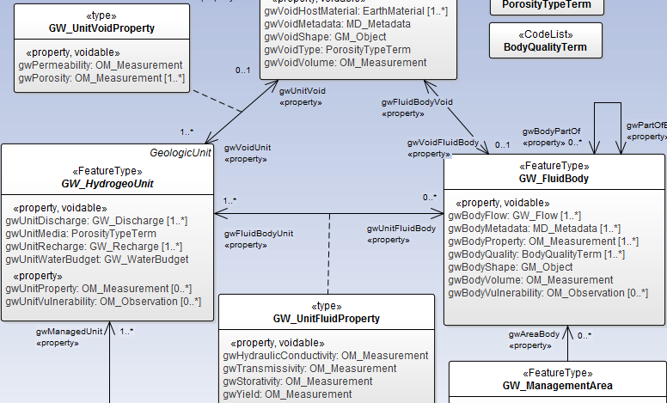
Notes:
Hydraulic conductiviy

Slide 14
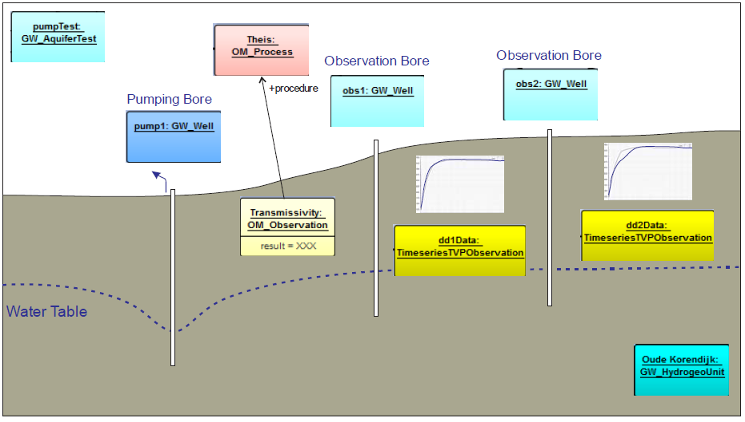
Profile of O&M

Slide 15
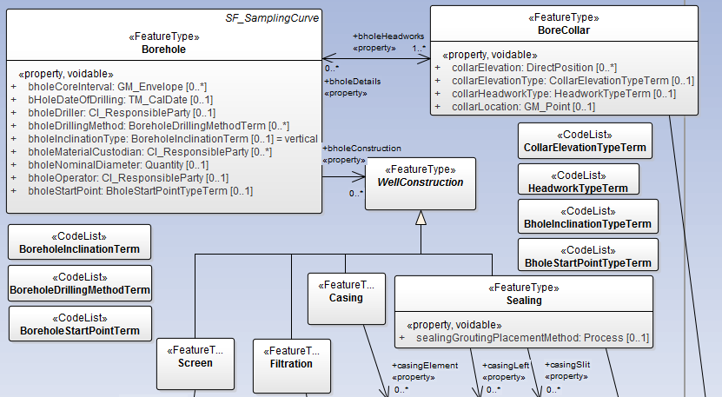
GWML Borehole

Slide 16
Existing implementations
FedUni
BoM
GIN (partial)
USGS (partial)
BRGM
GNS (partial ?)

