Slide 1
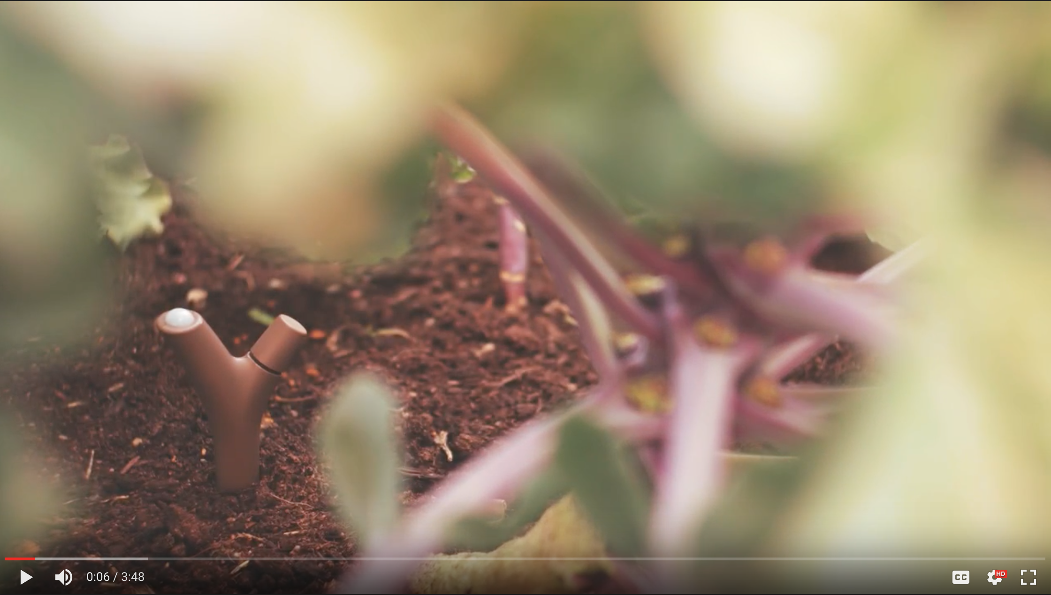
Server Side
SOS (by Cheating)
Andy Cobley
University of Dundee
This project has received funding from the European Union’s Horizon 2020 research and innovation programme under grant agreement No 690199

Slide 2
Live Example, GROW and HackAir
http://35.211.124.163/Circles/SOS.html
Please feel free to play with it yourself.
Right click to show data
University of Dundee

Slide 3
Interactive example, GROW and HackAir
PowerBI on line
Not public.
University of Dundee

Slide 4
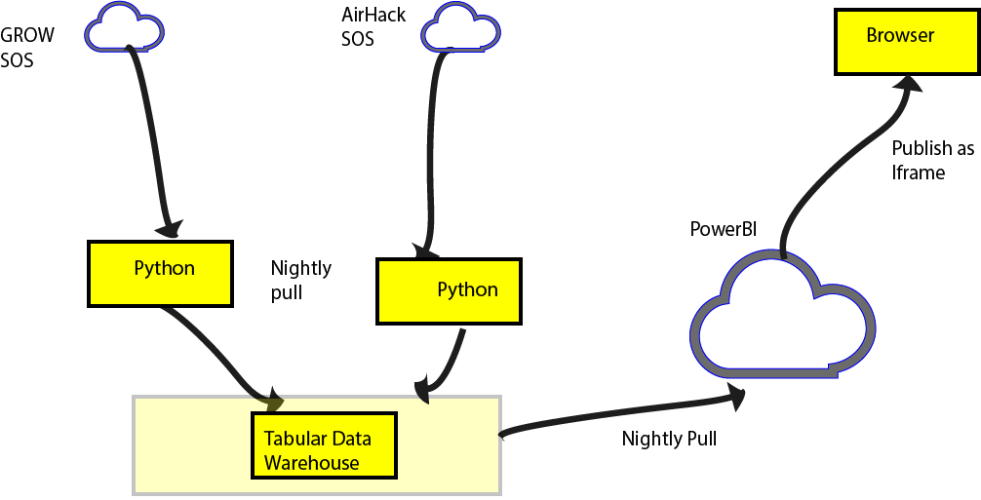
Data Flow
1%
21%
growobservatory.org
University of Dundee

Slide 5
Interfaces
AirHack Python processes GetFeature of Interest and XML response
GROW processes Getcapabilities and JSON
growobservatory.org
Name of organisation

Slide 6
Conculsion
GROW SOS needs some work !
growobservatory.org
Name of organisation

Slide 7
Thank You

